Slide 1
Micro Teaching

Slide 2
Micro teaching
Micro means small, microteaching simply means teaching in a small scale.
Microteaching was developed by Dwight W. Allen, a professor of education at Stanford University, in 1963. Allen was interested in finding a way to help student teachers develop effective teaching skills in a safe and supportive environment. He believed that microteaching could provide student teachers with the opportunity to practice their skills without the pressure of a real classroom setting.

Slide 3
Definition
In the words of Clift and others "Micro-teaching is a teacher training procedure which reduces the teaching situation to simpler and more controlled encounter achieved by limiting the practice teaching to a specific skill and reducing teaching time and class size,“
According to D.W. Allen. "Micro-teaching is a scaled down teaching encounter in class size and class period".

Slide 4
Definition
According to Mc Aleese and Urwin, "Micro-teaching is most often applied to the use of closed circuit television (CCT) to give immediate feedback of a teacher trainee performance in a simplified environment.“
According to B.K. Pasee, "Micro teaching is a training technique which requires student teachers to reach a single concept using specified teaching skills to a small numbers of pupils in a short duration of time."

Slide 5
Objectives
1. To enable the teacher trainee to learn and assimilate new teaching skills under controlled situations.
2. To enable trainee to gain confidence.
3. To utilize the academic potential of trainee.
4. To gain maximum advantage with little time, money and material.

Slide 6
Characteristics
It is real teaching that focus developing teaching skill.
It includes5-10 student.
Duration of 5-10 minute.
Small topic with few objectives.
Limited number of teaching skill.
It is highly individualized instruction.
It provides immediate feed back.
It provides opportunity to modifying the behavior by repeating the performance.

Slide 7
5 r’s of Micro teaching
Recording.
Reviewing.
Responding.
Refining.
Re doing.

Slide 8
Purpose
To help individual teacher to develop or modifying specific teaching skill under control teaching practice through immediate feedback.
To bring instructional improvement by developing effective teaching skill among teacher.

Slide 9
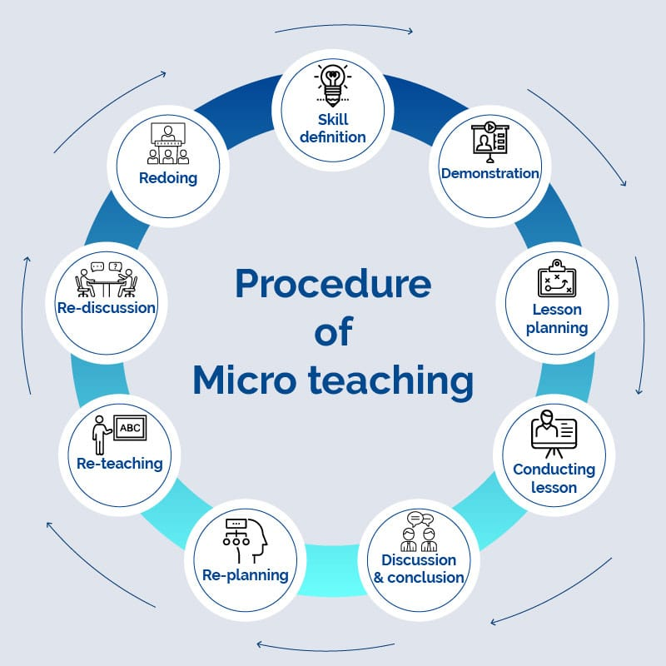
Procedure of micro teaching

Slide 10
Phases of micro teaching
Knowledge Acquisition
Skill acquisition
Transferring Phase

Slide 11
Knowledge Acquisition
This is the first phase of micro teaching. It includes the collection of data. In this phase, the trainee teacher gathers knowledge about the required skills by reading different literature as well as going through certain demonstrating videos. Further, this phase includes the understanding of required skill in a rational manner, as a classroom component.

Slide 12
Skill Acquisition
This is the working phase of the micro-teaching program. Under this phase, the trainee teacher is asked to prepare lessons and practice skills based on the model presented at the start. Here, the two important factors of micro teaching are the feedback and the setting. Setting includes the length of the lesson, the duration of the class, the skill to be obtained, the supervisor and the students.

Slide 13
Transferring Lesson
This is the last and major phase of micro-teaching. Here the trainee comes out in a real situation, which is not controlled. Here the teachers, as well as the students, get the platform to learn and grow. This takes place in a real classroom, unlike the previous stages of micro teaching.

Slide 14
Micro Teaching Cycle
Plan
Teach
6 min
Feedback
6 min
Re- Plan
12 min
Re- feedback
6 min
Re- Teach
6 min

Slide 15
Advantages
1. It is carried out in real classroom situation so teacher get confidence in such situation in future.
2. It helps competency in identified teaching skill.
3.Play back of the recording of the actual teaching help supervisor and peers not to depend on the recall but based their judgment on the review of the teaching act thus assessment become more objective.

Slide 16
Advantages
4. The immediate feed back also help to carryout the re-planning and re teaching to bring necessary improvement in time.
5. It become economical, it takes comparatively short time and reduce the complexities of the normal class room teaching practice.

Slide 17
Limitations
The provision of video camera itself is an expensive learning resource.
The discussion and feed back, repetition of microteaching till the behavior of teacher comes to an acceptable level are very time consuming activities.
It can not be used in all teaching methods.

Slide 18
Thank You

