Slide 1
Gestalt (Insightful Learning) ; Methods of Learning and Laws of Learning
B.Ed. 1st Sem. Unit- III
Paper code 204

Slide 2
What is Gestalt Psychology?
Gestalt psychology is a school of thought that looks at the human mind and behavior as a whole. It suggests that structures, perceived as a whole, have specific properties that are different from the sum of their individual parts.

Slide 3
The theory of learning by insight is the contribution of Gestalt Psychologists. Gestalt is a term derived from the German word 'gestalten', has no English equivalent. The nearest English translation of Gestalt is ‘configuration’ or an ‘organized whole’ or the ‘totality of a situation’.

Slide 4
Gestalt Psychologists
Founded by Max Wertheimer.
Wolfgang Köhler, and Kurt Koffka in early 20th-century Germany, it helped shape modern ideas about perception, problem-solving, and how we make sense of the world.

Slide 5
Max Wertheimer
The inaugural article of Gestalt Psychology was Max Wertheimer’s Experimental Studies of the Perception of Movement, published in 1912.
Wertheimer, then at the Institute of Psychology in Frankfurt am Main, described a visual illusion called apparent motion in this article.
Apparent motion is the perception of movement that results from viewing a rapid sequence of static images, as happens in the movies or in flip books.
Wertheimer realized that the perception of the whole (the group of figures in a sequence) was radically different from the perception of its components (each static image).

Slide 6
Wolfgang Köhler
Wolfgang Köhler was particularly interested in physics and natural sciences.
He introduced the concept of psychophysical isomorphism – arguing that how a stimulus is received is influenced by the brain’s general state while perceiving it (Shelvock, 2016).
He believed that organic processes tend to evolve to a state of equilibrium – like soap bubbles, that start in various shapes but always change into perfect spheres because that is their minimum energy state.
In the same way, the human brain would “converge” towards a minimum energy state through a process of simplifying perception – a mechanism that he called Pragnanz (Rock & Palmer, 1990).

Slide 7
Kurt Koffka
Koffka contributed to expanding Gestalt applications beyond visual perception.
In his major article, Principles of Gestalt psychology (1935) he detailed the application of the Gestalt Laws to topics such as motor action, learning and memory, personality and society.
He also played a key role in taking the Gestalt Theory to the United States, to where he emigrated after the rise of Nazism in Germany.

Slide 8
Gestalt principles
Gestalt’s principles, or Laws of Perception, were formalized by Wertheimer in a treaty published in 1923, and further elaborated by Köhler, Koffka, and Metzger.
The principles are grounded on the human natural tendency of finding order in disorder – a process that happens in the brain, not in the sensory organs such as the eye.
According to Wertheimer, the mind “makes sense” of stimulus captured by the eyes following a predictable set of principles.
The brain applies these principles to enable individuals to perceive uniform forms rather than simply collections of unconnected images.
Although these principles operate in a predictable way, they are actually mental shortcuts to interpreting information.

Slide 10
How the Gestalt Approach Formed?
Two of the main philosophical influences of Gestalt are Kantian epistemology and Husserl’s phenomenological method.
Both Kant and Husserl's sought to understand human consciousness and perceptions of the world, arguing that those mental processes are not entirely mediated by rational thought (Jorge, 2010).
Similarly, the Gestalt researchers Wertheimer, Koffka and Kohler observed that the human brain tends to automatically organize and interpret visual data through grouping.

Slide 11
They theorized that, because of those “mental shortcuts”, the perception of the whole is different from the sum of individual elements.
This school of thought defended that mental processes should be broken down into their basic components, to focus on them individually.
It argues that the whole is grasped even before the brain perceives the individual parts – like when, looking at a photograph, we see the image of a face rather than a nose, two eyes, and the shape of a chin.

Slide 12

Insight Learning Theory:

Slide 13
Insight learning theory is all about those “lightbulb moments” we experience when we suddenly understand something. Instead of slowly figuring things out through trial and error, insight theory says we can suddenly see the solution to a problem in our minds.
This theory is super important because it helps us understand how our brains work when we learn and solve problems. It can help teachers find better ways to teach and improve our problem-solving skills and creativity. It’s not just useful in school—insight theory also greatly impacts science, technology, and business.

Slide 14
KOHLER’S EXPERIMENTS
In one experiment, Kohler put the chimpanzee, “Sulthan” inside a cage and a banana was hung from the roof of a cage. A box was placed inside the cage. The chimpanzee tried to reach the banana by jumping but could not succeed. Suddenly he got an idea and used the box as a jumping platform by placing it just below the hanging banana.
In another experiment Kohler made this problem complicated that two or three boxes were required to reach the banana.

Slide 15
3. In a more complicated experiment, a banana was kept far outside the cage and two sticks – one larger than the otherwhere kept inside the box. When failed to reach the banana by one stick, with a sudden bright idea the chimpanzee tried to reach the banana by joining the two sticks
These experiments demonstrated the role of intelligence and cognitive abilities in higher learning and problem-solving situations.

Slide 16
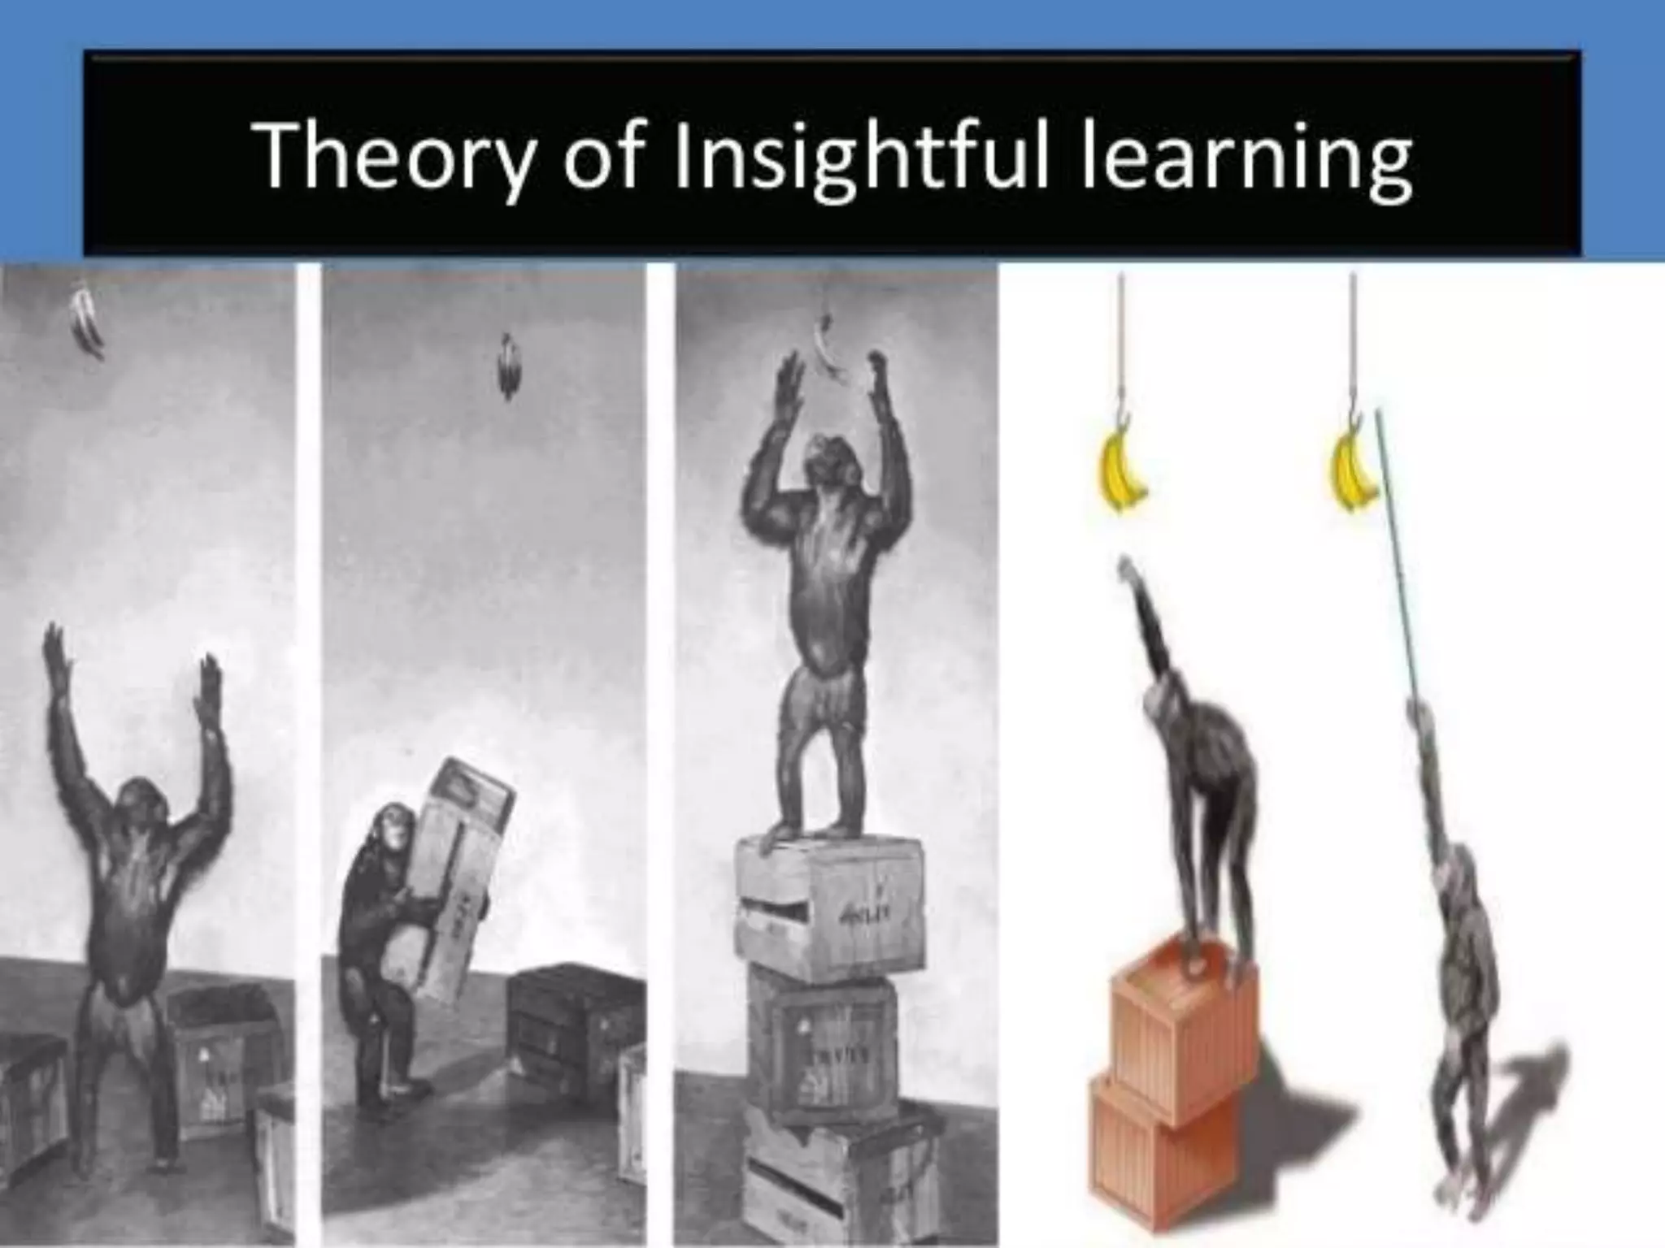

Slide 17
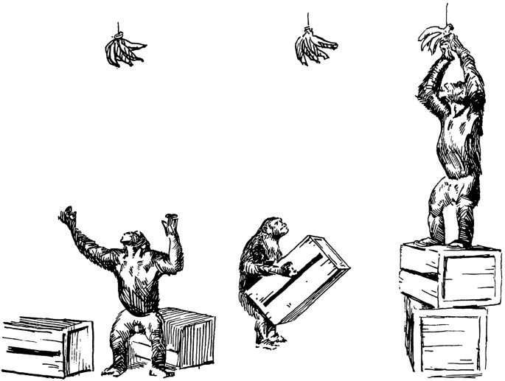

Slide 18
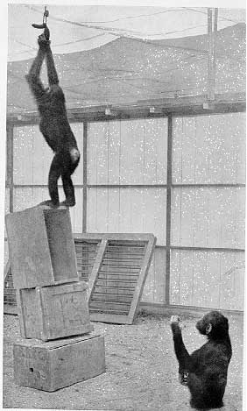

Slide 19
STEPS IN INSIGHT LEARNING:
1. Identifying the problem: The learner recognizes the presence of an intervening obstacle on his way to the goal.
2. Understanding the Problem: The learner observes the problematic situation, analyse it and perceive the relation between the goal and the obstacles.
3. Incubation of Ideas: After analyzing the total situation he reaches in conclusions by means of hesitation, pause, concentrated attention etc.
4. Trail of Mode of Response: The learner makes initial efforts in the form of a simple trial and error mechanism.

Slide 20
5. Sustained Attention: The learner maintains frequently recurrent attention to the goal and motivation.
6. Insight Development: In a certain moment there is a sudden perception of the relationship in the total situation and the organism directly performs the required acts.
7. Steady Repetition of Adaptive Behaviour: After getting an insightful solution, the individual tries to implement it in another situation.
8. Comprehension of Ability: The learner reaches the ability to understand the relevant parts of the situation and overlooking the irrelevant ones.

Slide 21
GESTALT LAWS OF LEARNING:
There are four important laws regarding insight learning. They are as follows:
1. The Law of Similarity:
The law of similarity states that “when there are different sets of objects on view then they are perceived as groups rather than individual objects”. This law leads us to link together parts of the visual field that are similar in color, lightness, texture, shape, or any other quality.

Slide 22


Slide 23
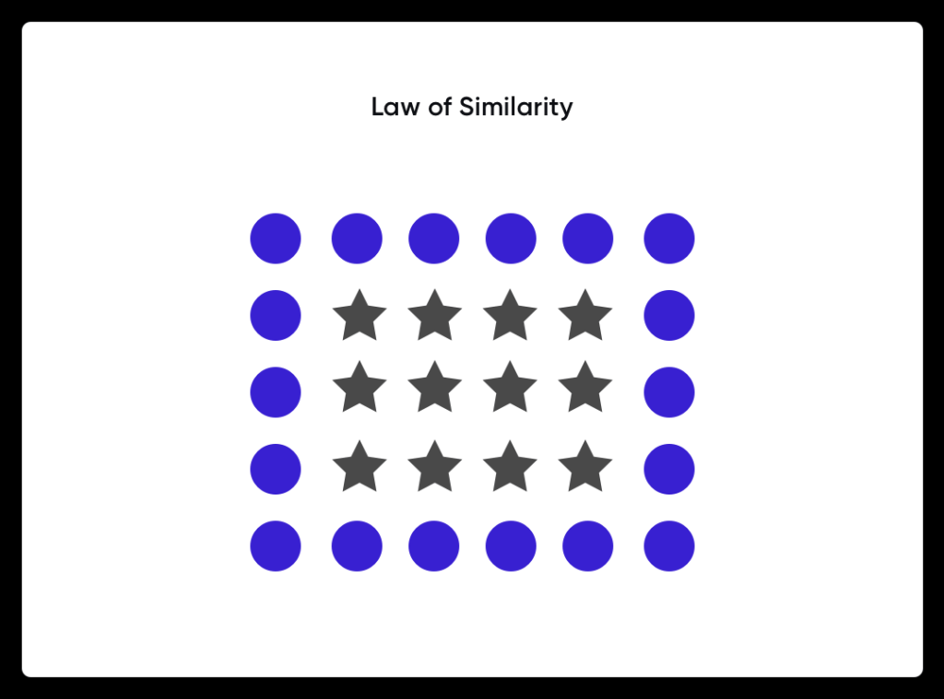

Slide 24
2. The Law of Proximity: The law of proximity states that “objects which are close together are likely to be seen as a group”. For example, look at the following line.
III II IIII I
You are likely to perceive this as four separate groups, comprising three, two, four and one members respectively, rather than to view it as a line of ten I s. This doesn't only apply to visual perception, think for example of music, perceived as a melody rather than a procession of single notes.

Slide 25
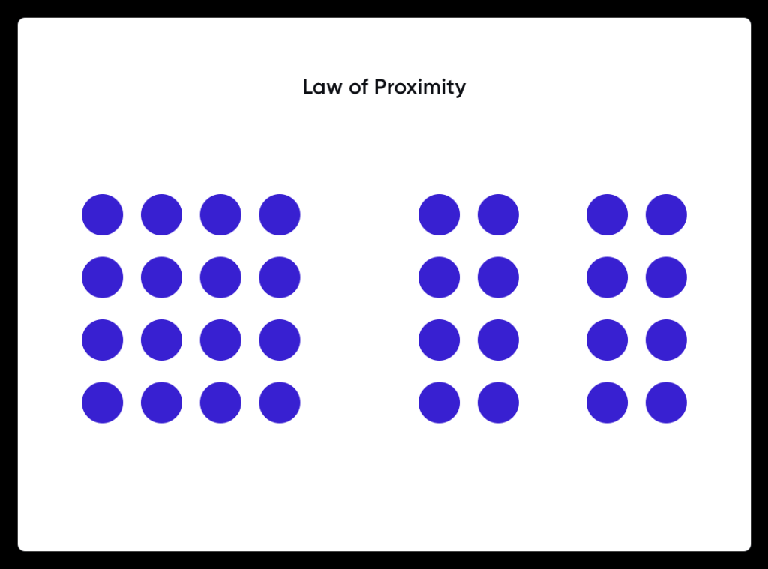

Slide 26


Slide 27


Slide 28

3. Law of Closure: According to the law of closure, we prefer complete forms to incomplete forms. When the outline of an object is left unfinished, as long as the gap is less than half the total circumference then the object is identified and perceived as whole rather than as a different shape. Thus, in the drawing below, we mentally close the gaps and to perceive whole objects from incomplete and imperfect forms.
3. Law of Closure: According to the law of closure, we prefer complete forms to incomplete forms. When the outline of an object is left unfinished, as long as the gap is less than half the total circumference then the object is identified and perceived as whole rather than as a different shape. Thus, in the drawing below, we mentally close the gaps and to perceive whole objects from incomplete and imperfect forms.

Slide 29


Slide 30
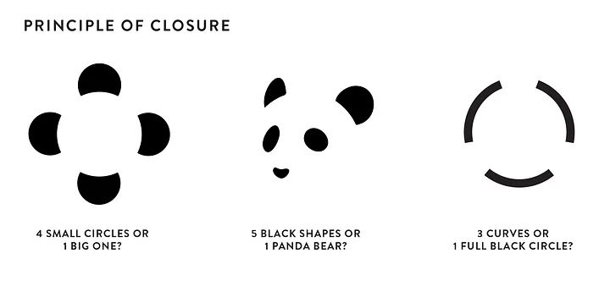

Slide 31
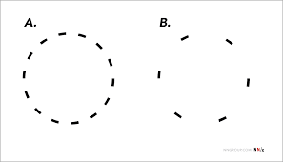

Slide 32
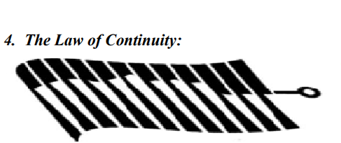
4. The Law of Continuity: to us”. That is, we tend to perceive the components of a perceptual filed as smoothly flowing rather than discontinuous forms.

Slide 34
EDUCATIONAL IMPLICATIONS OF GESTALT THEORY
1.From Whole to Parts: The teacher should present the subject matter as a whole to facilitate insight learning.
2. Integrated Approach: While planning curriculum, gestalt principles should be given due consideration. A particular subject should not be treated as the mere collection of isolation facts. It should be closely integrated into a whole.
3. Importance of Motivation: the teacher should arouse the child’s curiosity, interest and motivation. He should gain full attention of the whole class before teaching.
4. Emphasis on Understanding: abilities than a stimulus - response association. So, the learner must be given opportunities for using his mental abilities.

Slide 35
5. Problem Solving Approach: problems by his insight, meaningful learning, learning by understanding, reasoning, etc. must be encouraged in the school.
6. Checking of Previous Experiences: the learner, the teacher must check the previous experiences of the child and relate them with the new learning situation.
7. Goal Orientation: As learning is a purposeful and goal-oriented task, the l well acquainted with these objectives. purposes of every task.

Slide 36
Transfer of Learning
Learning of one skill is used in another skill is the transfer of learning. Eg. Learning hockey and the skills used in cricket. Transfer of learning is one of the major goals of modern education. Education is worthwhile if it can be transferred

Slide 37
Definition of Transfer of learning
According to Crow and Crow: “The carry over of habits of thinking, feelings or working of knowledge or skills from one learning areas to another is usually referred to as Transfer of learning” According to Judd : “ Transfer is a form of generalization”

Slide 38
Types of Transfer of learning or Training
Positive Transfer
Negative Transfer
Zero Transfer

Slide 39
Positive Transfer:
Transfer is said to be positive when something previously learnt benefits performance or learning in a new situation. Eg. Knowledge of typing is helpful in learning computer typing

Slide 40
Negative Transfer:
In case the previous learning hinders or block or interfere with performance or learning in a new situation. We call it negative transfer. E.g. Having learned to pronounce ‘but’ correctly, what happens later on when a similar type of spelling ‘put’ when this thing cropped up affects the children in a negative manner. Or Pronunciation of mother tongue becomes obstacles while pronouncing of English language

Slide 41
Zero Transfer
When learning of one activity neither facilitates nor interferes with the learning of new work it is said to be zero transfer. Eg. There may be zero transfer between English Language and mathematics.

Slide 42
Vertical Transfer: When one lesson facilitates in understanding for another lesson in a subject is called vertical transfer eg. Habits and values of the family influence the child to adopt them in his daily life
Horizontal Transfer: When knowledge of one subject helps in understanding the other subject. Eg. Knowledge of the history of the Vedic period helps in understanding the literature of that period, it is called horizontal transfer.
Bilateral Transfer: When the training given to one part of the body is transferred to another part is called bilateral transfer. Eg. Writing with the right hand may be transferred to the left one
Unilateral Transfer: When the learning stored in one area is required by another area with the latter not sending its responses back, it is unilateral transfer.

Slide 43
Motivation – Definition, Process, Types, Features and Importance
Motivation comes from the Latin word “movere” which means, “to move”.
Need: A need is a condition of lack or deficit of something required by the organism/person.
Motives: Motive is defined as an inner state that energises, activates (or moves) and directs (or chanalises) the behaviour towards certain goals.

Slide 44
Definitions of Motivation
The word Motivation derives from the Latin word “Movere”. The Latin word “Movere” means “To move”, “To drive” or “To drive forward” etc. Motivation can be defined as stimulating, inspiring and inducing the employees to perform to their best capacity. Motivation is a psychological term which means it cannot be forced on employees. It comes automatically from inside the employees as it is the willingness to do the work.

Slide 45
Joe Kelly defined Motivation as “Motivation is a process where by needs instigate behavior directed towards the goals that can satisfy those needs.”
According to W. G. Scot, “Motivation means a process of stimulating people to action to accomplish the desired goals.”
According to Michael J. Jucius, “Motivation is the act of stimulating someone or oneself to get a desired course of action, to push the right button to get a desired results.”

Slide 46
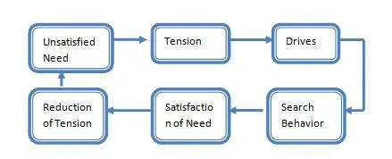
Process of Motivation

Slide 47
Unsatisfied need. Motivation process begins when there is an unsatisfied need in a human being.
Tension. The presence of unsatisfied need gives him tension.
Drive. This tension creates an urge of drive in the human being an he starts looking for various alternatives to satisfy the drive.
Search Behavior. After searching for alternatives, the human being starts behaving according to chosen option.
Satisfied need. After behaving in a particular manner for a long time then he evaluates that whether the need is satisfied or not.
Reduction of tension. After fulfilling the need the human being gets satisfied and his tension gets reduced.

Slide 48
For example, if an employee develops a need to earn more, this need will make him restless and he will start thinking how to satisfy his need. To satisfy his need he may think of working hard in organization and get promotion so he will start working hard. After sometime he will get incentives or increments or promotion which will satisfy his need.

Slide 49
Types of Motivation
The two types of motivation are:
Intrinsic motivation
Extrinsic motivation

Slide 50
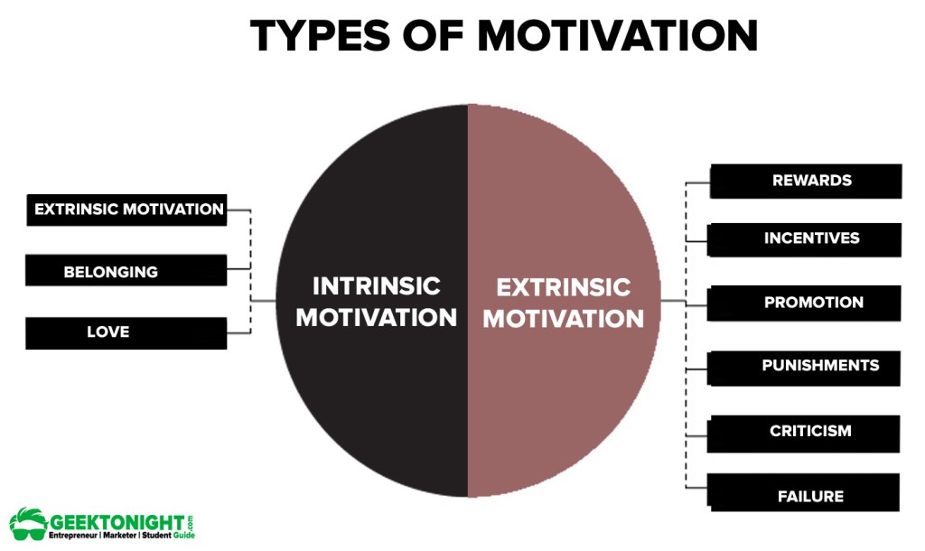

Slide 51
Intrinsic motivation
Intrinsic motivation can arise from self-generated factors that influence people’s behaviour. It is not created by external incentives.
It can take the form of motivation by the work itself when individuals feel that their work is important, interesting and challenging and provides them with a reasonable degree of autonomy (freedom to act), opportunities to achieve and advance, and scope to use and develop their skills and abilities.

Slide 52
Extrinsic motivation
Extrinsic motivation occurs when things are done to or for people to motivate them.
These include rewards, such as incentives, increased pay, praise, or promotion; and punishments, such as disciplinary action, withholding pay, or criticism. Extrinsic motivators can have an immediate and powerful effect, but will not necessarily last long.

Slide 53
Types of Motivation
Achievement Motivation: It is the drive to pursue and attain goals. An individual with achievement motivation wishes to achieve objectives and advance up on the ladder of success. Here, accomplishment is important for its own shake and not for the rewards that accompany it. It is similar to ‘Kaizen’ approach of Japanese Management.
Affiliation Motivation: It is a drive to relate to people on a social basis. Persons with affiliation motivation perform work better when they are complimented for their favorable attitudes and co-operation.
Competence Motivation: It is the drive to be good at something, allowing the individual to perform high quality work. Competence motivated people seek job mastery, take pride in developing and using their problem-solving skills and strive to be creative when confronted with obstacles. They learn from their experience.

Slide 54
Power Motivation: It is the drive to influence people and change situations. Power motivated people wish to create an impact on their organization and are willing to take risks to do so.
Attitude Motivation: Attitude motivation is how people think and feel. It is their self confidence, their belief in themselves, their attitude to life. It is how they feel about the future and how they react to the past.
Incentive Motivation: It is where a person or a team reaps a reward from an activity. It is “You do this and you get that”, attitude. It is the types of awards and prizes that drive people to work a little harder.
Fear Motivation: Fear motivation coercion’s a person to act against will. It is instantaneous and gets the job done quickly. It is helpful in the short run.

Slide 55
Features of Motivation
Motivation is a psychological phenomenon. Motivation is an internal feeling which means it cannot be forced on employees. The internal feelings such as need, desire, aspirations etc. influence human behavior to behave in a particular manner. For example, desire to have a new house, respect and recognition etc.
Motivation produces goal directed behavior. Motivation induces people to behave in such a manner so that they can achieve their goal. Motivated person need no supervision or direction. He will always work in desired manner. For example of a person has a motive to get promotion so he will work efficiently to get promotion.
Motivators can be positive as well as negative. To motivate employees managers use various motivators. Some motivators are positive and some are negative few examples of positive motivators are promotion, increment, bonus, respect, recognition etc. if employee does not improve his performance with positive motivators then manager uses negative motivators such as warning, issue o memo, demotion, stopping increments etc. sometimes fear of negative motivators also induces person to behave in a desired manner.

Slide 56
Motivation is a complex process. Motivation is a complex and difficult task. In order to motivate people a manager must understand various types of human need. Human needs are mental feelings which can be measured accurately. If manager measures them accurately then also every person uses different approaches to satisfy his need. Some get satisfied with monetary incentives, some with non-monetary, some with positive and some with negative motivators. So it is not possible to make generalization in motivation.
Motivation is a dynamic and continuous process. Human beings are ever-changing. Human needs are unlimited and go on changing continuously. Satisfaction of one need gives rise to another so managers have to continuously perform the function of motivation.

Slide 57
Importance of Motivation
Motivation helps to change from negative attitude to positive attitude. Without motivation the employees try to perform minimum activities in the organization. But the motivation fills in the desire to perform to their maximum level. All the resources of the organization are of no use unless and until the employees use these resources. The motivated employees make best use of the resources.
Motivation improves performance level of employees. The motivation improves the efficiency level of employees which means the employees start performing the job to the best of their ability with minimum wastage of time and resources because motivated employees always go for best utilization of resources. The motivation bridges the gap between the ability to work and willingness always improves efficiency.
Help in achieving the organizational goals. The motivated employees always try to achieve the organizational goal and contribute their best efforts for the realization of organizational goal as they know with the achievement of organizational goal only they can achieve their personal goal. All the employees contribute their efforts in one direction of accomplishment of goal.

Slide 58
Motivation creates supportive work environment. In motivation the relations between superior and subordinates are always improved. When the employees get their need satisfied or get the recognition and respect in the organization then they always offer a supportive hand to superiors. There is more co-operation and co-ordination in the organization and all the employees work with the team spirit.
Motivation helps the managers to introduce changes. The motivated employees show less resistance in accepting the changes according to changes in the business environment because they know if the changes are not implements in the organization, not only the organization will lose by this but the employees also will find it difficult to get their needs fulfilled. Motivated employees are always supportive and co-operative in accepting changes in the organization.
Reduction in Employee Turnover. The motivation creates confidence in the employees to get their need satisfied in the organization itself. They always select the alternative to remain in the organization and increase their earning rather than leaving the organization and increasing their earnings. With motivation employee turnovers are less because the satisfied employees never leave the job.

Slide 59
Thank You and good luck for examination.
God bless you all

