Slide 1
Learning- Meaning, Definition, Nature. Factors affecting Learning
B.Ed. 1st Sem. Unit- III
Paper code 204

Slide 2
LEARNING
It can be implied that it is a change in behaviour. It takes place due to experience, growth or maturation. Change must be relatively permanent. Learning is termed to be guided and stimulated. It is acquisition of habits, attitudes and knowledge.

Slide 3
DEFINITION
HENRY P.SMITH:“ Learning is the acquisition of new behavior or the strengthening or weakening of old behavior as a result of experience”.
WOODWORTH : “Any activity can be called Learning so far as it develops the individual (in any aspects, good or bad) & makes his behavior & experiences different from what otherwise would have been”.

Slide 4
FEATURES OF LEARNING:
1.Learning is a change in behavior for better or worse.
2. It is a change that takes place through practice & experience.
3. The change in behavior must be relatively permanent i.e it must last for a long time, learning lasting for days, months, years.

Slide 5
Principles of learning
It is an active process. It is believed that learners learn effectively when they are actively involved in the learning process.
Learners try to link previous knowledge with the new experiences and information. Thus, this previous information helps learners to learn better.
Learning is often symbolic ( learning language, numbers, words, images etc.)
It is affected by contextual factors.
It is equally affected by emotional state, social interactions, relationship etc.
Motivation (extrinsic and intrinsic) affect the learning behavior.
It is noted that instructional constant support results in high achievement among children.
Learners need constant feedback on the learning.

Slide 6
NATURE OF LEARNING
1.Learning is Universal: Every creature that lives learns. Man learns most. The human nervous system is very complex, so are human reactions and so are human acquisition.
2. Learning is through Experience: Learning always involves some kind of experience, direct or indirect.
3. Learning is from all Sides: Today learning is from all sides. Children learn from parents, teachers, environment, nature, media etc.

Slide 7
4.Learning is Continuous: It denotes the lifelong nature of learning. Everyday new situations are faced and the individual has to bring essential changes in his style of behavior. Learning is birth to death.
5. It results in Change in Behavior: It is a change of behavior influenced by previous behavior.
6. Learning is an Adjustment: learning helps the individual to adjust new situation adequately to new situation. In later life the individuals acquire new forms of behavior.

Slide 8
TYPES OF LEARNING
•MOTOR LEARNING
• VERBAL LEARNING
• CONCEPT LEARNING
• DISCRIMINATION LEARNING
• LEARNING OF PRINCIPLE
• PROBLEM SOLVING
• ATTITUDE LEARNING

Slide 9
Theories of Learning
We can divide the learning theories into three parts:
Behavioristic Theory : It focuses on understanding learning through objectively measurable and observable behavior. Focus on mind’s independent activities are not there.
Cognitive Theory : It tries to define learning getting affected by different mental processes. This gets influenced by internal and external factors.
Social Learning Theory - It includes the view that individual learn by observing others, remembering their actions and replicating their actions.

Slide 10
THORNDIKE CONNECTIONISM/ TRIAL AND ERROR THEORY/ BEHAVIORAL THEORY
It was developed by Edward Lee Thorndike. His theory has greatly influenced B.F. Skinner’s theory of operant conditioning. He was a pioneer in using animals for psychological testing and studying learning and the basis of behaviorism.
Connectionism in his theory refers to bonds between Stimulus and Responses.

Slide 11
Thorndike’s Puzzle Box
Thorndike worked with animals particularly Cat. He believed that learning occurred through trial and error. He made a puzzle box to test the laws of learning. The animal placed in the box made many wrong chances and finally lead to getting desirable results.

Slide 12
Task in the puzzle box
A hungry cat was put in the cage who wanted to escape to get to the food but did not know the way out. It moved relentlessly and finally stepped on the foot switch and thus the door opened. When it escaped it was put in the cage again and in successive trials the cat learn that pressing the lever would lead to favorable consequences. Thus, the cat learn the desired behavior.

Slide 13
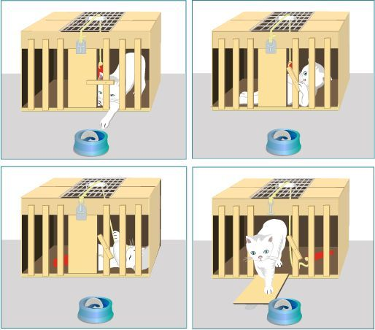

Slide 14
Stages in the experiment
1. Drive - The cat was hungry and hence it tried harder to reach the food.
2. Goal- To find the food.
3. Random movements
4. Cat recognized the correct movement after manipulating.

Slide 15
Thorndike’s Laws
Thorndike presented the laws of learning on the basis of his belief in stimulus response connection. He first wrote it in the book Animal Learning (1898).
The primary laws are:
3. Law of Effect
1. Law of Readiness
2.Law of Exercise

Slide 16
Law of Readiness
This law states that learning occurs best when a learner is ready to act. If the learner is not mentally or physically prepared, forcing learning can cause frustration.
Example: A student eager to solve math problems will learn faster than one who is uninterested or unprepared.

Slide 17
Law of Exercise (or Use and Disuse)
Repetition strengthens the connection between stimulus and response, while lack of practice weakens it.
Example: Regular practice of grammar exercises improves language skills, while neglect reduces fluency.
This law emphasizes the role of practice and reinforcement in learning.

Slide 18
Law of Effect
The most important of all, this law states that responses followed by satisfaction are more likely to be repeated, while those followed by discomfort are less likely to occur again.
Example: If a student receives praise for answering correctly, they are more likely to participate again.

Slide 19
Subordinate Laws
There are five subordinate laws:
1. Law of Multiple Responses – A learner tries different responses until the correct one is found.
3. Law of Partial Activity – Only relevant parts of a situation affect learning.
4. Law of Response by Analogy – Learners apply past knowledge to new but similar situations.
5. Law of Associative Shifting – A response can be shifted from one stimulus to another with practice.
2. Law of Set or Attitude – The learner’s mindset influences learning.

Slide 20
Educational Implications of Thorndike’s Theory
Emphasis on Practice: Learning becomes permanent through repetition. Teachers should provide drill work and practice exercises to reinforce correct responses.
2. Use of Motivation: According to the Law of Readiness, learning is effective when students are motivated. Teachers must ensure learners are mentally and emotionally ready.
3. Reinforcement and Rewards: The Law of Effect highlights the importance of positive reinforcement (praise, marks, grades, recognition) to encourage desirable behavior.

Slide 21
4. Gradual Learning: Thorndike’s theory suggests that learning is incremental, not sudden. Teachers should introduce concepts step by step.
5. Importance of Feedback: Feedback helps learners know whether their responses are correct, strengthening the right connections.
6. Application in Classroom Teaching: Using trial and error methods for problem-solving.
Reinforcing correct answers immediately.
Providing learning-friendly environments that encourage curiosity.

Slide 22
PAVLOV’S CLASSICAL CONDITIONING
Ivan Pavlov started from the idea that there are some things that one need not learn Example, Dogs salivate when they see food. Thus, food is the stimulus and salivation is the response.

Slide 23
Experiment:
Food (Unconditioned Stimulus) = Salivation (Unconditioned response)
Bell (neutral Stimulus) = No Salivation (No response)
Food (Unconditioned Stimulus) + Bell (Neutral Stimulus) = Salivation (Unconditioned Response)
Bell (Conditioned Stimulus) = Food (Conditioned Response)

Slide 24
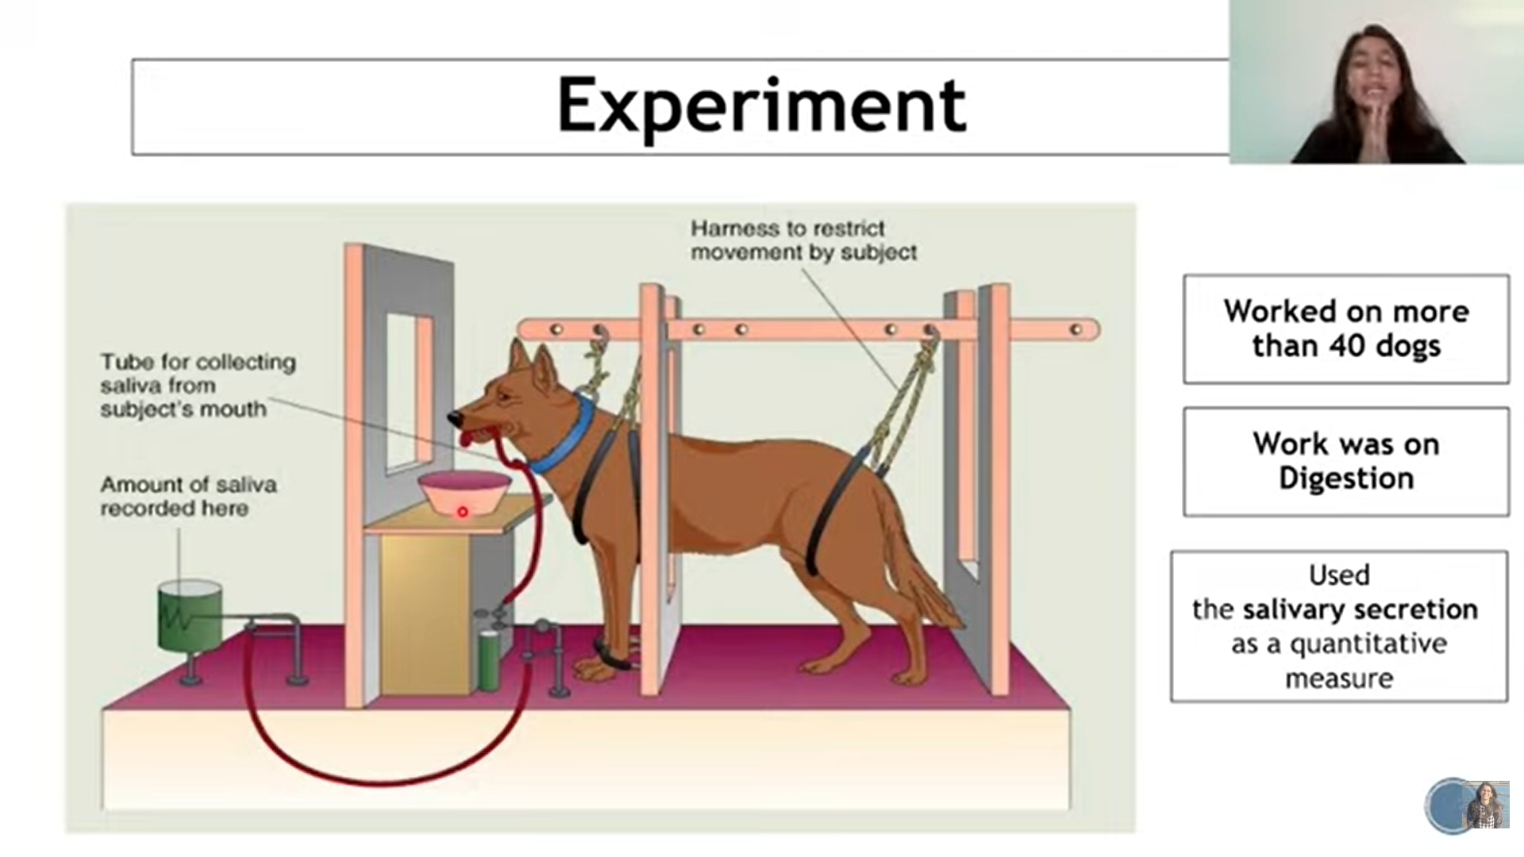

Slide 25
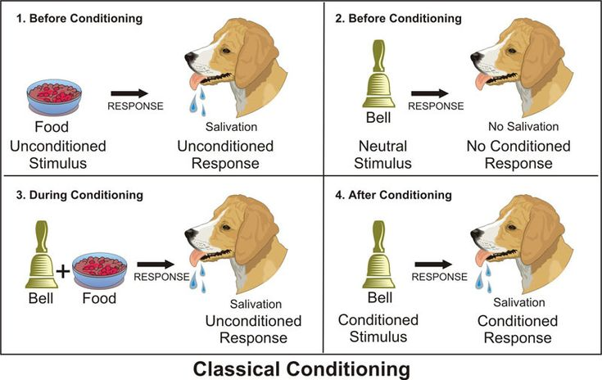

Slide 26
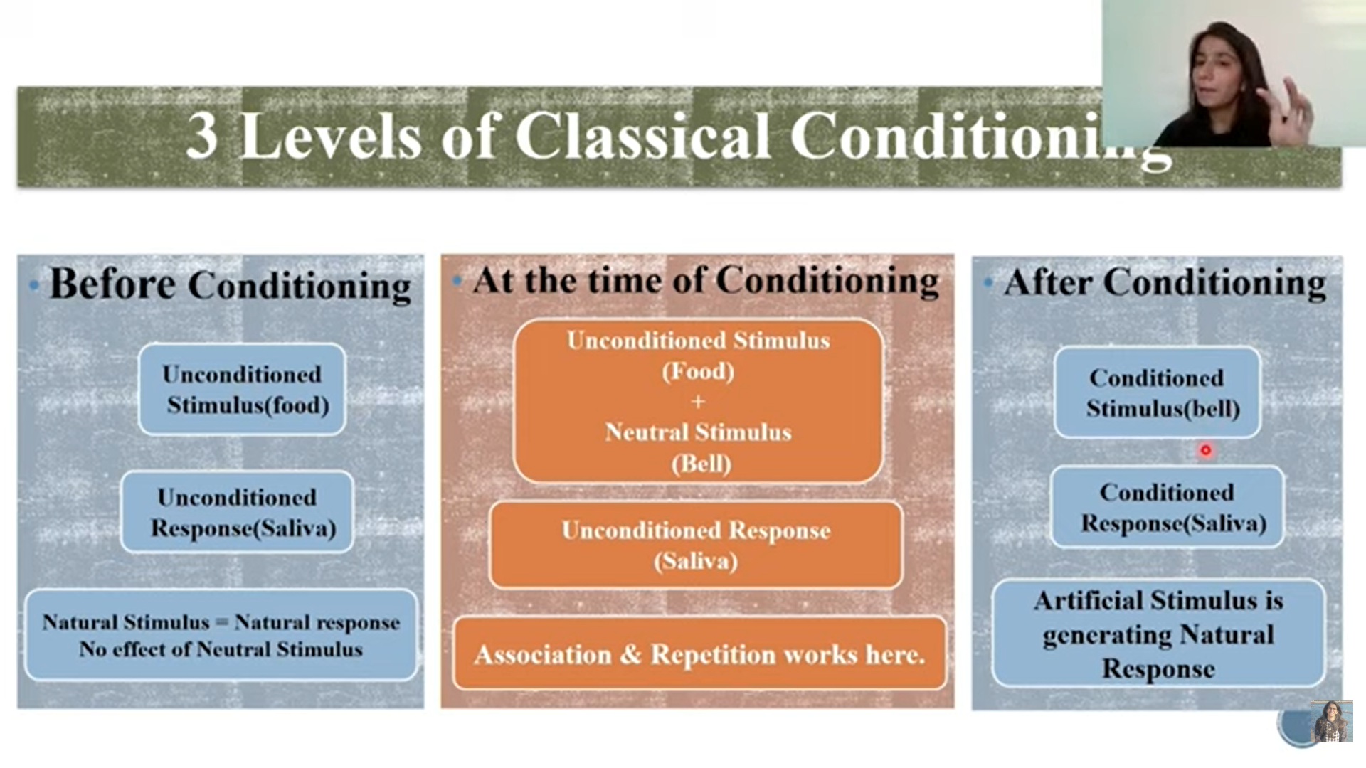

Slide 27
Elements of Classical Conditioning
Unconditioned Stimulus - Naturally occurring stimulus that leads to involuntary response.
Unconditioned Response - Response to the unconditioned stimulus.
Conditioned Stimulus - Pavlov noted that any stimulus can become associated with unconditioned stimulus.
Conditioned Response - This is a learned response to previous neutral stimulus.

Slide 28
Types of Conditioning
Forward conditioning: Occurs when the neutral stimulus (NS) appears just before and during the presentation of the unconditioned stimulus (UCS).
Delayed conditioning: Involves a delay between the presentation of the NS and the arrival of the UCS.
Trace conditioning: Relies on the animal's memory - it is when the presentation of the NS ceases before the arrival of the UCS.
Backward conditioning: Involves the presentation of the NS after the UCS and usually results in no learning at all!

Slide 29
Educational Implications of Pavlov's theory of classical conditioning
Developing Positive Attitudes: Associate subjects, teachers, or the classroom with pleasant experiences (praise, enjoyable activities) to foster enthusiasm for learning.
Habit Formation: Teach cleanliness, punctuality, and respect by pairing these actions with positive reinforcement.
Reducing Anxiety & Phobias: Pair stressful situations (tests) with relaxation techniques (calming music) to create calm associations, or use reconditioning to break fears.

Slide 30
Classroom Management: Use cues (like a bell) to condition students to focus and transition smoothly into learning mode.
Language & Skill Acquisition: Teach language (associating words with pictures) or basic skills (linking letters with concrete objects) through direct association.
Creating Positive Environments: Establish routines and positive associations to build a supportive emotional climate in the classroom.

Slide 31
SKINNER’S OPERANT CONDITIONING
B. F. Skinner gave the theory of Operant Conditioning. It is the learning by which voluntary learning is strengthened or weakened by consequences. It is based on Thorndike’s law of effect. There was a limitation with Classical conditioning as how new behaviors are acquired as it only focused on how the existing behaviors get paired up by new stimuli. It can be understood as A-B- C or Antecedent - Behavior - Consequence. Antecedent - (Behaviors which precedes an action) Consequence - (Behavior that follow an action) Thus behavior can be altered by changes in the antecedents or consequences or both.

Slide 32
Skinner’s Experiment
He invented Skinner box which can be worked with the animal in the box. For rats, cats and monkeys the box contained lever and for pigeons it contained a panel which can be pecked.
First, he placed a hungry rat inside the Skinner box. The rat gradually began to explore the box. Eventually, the rat discovered a lever, upon pressing food was released inside the box. This phenomenon continued and the hungry rat learnt that if hungry the lever is to be pressed. Skinner also conducted an experiment that explained negative reinforcement. Skinner placed a rat in a chamber and subjected the chamber to an unpleasant electric current. The rat having experienced the discomfort started to desperately move around the box and accidentally knocked the lever. Pressing of the lever stopped the current. After a few times, rat learnt the desired behavior.

Slide 33
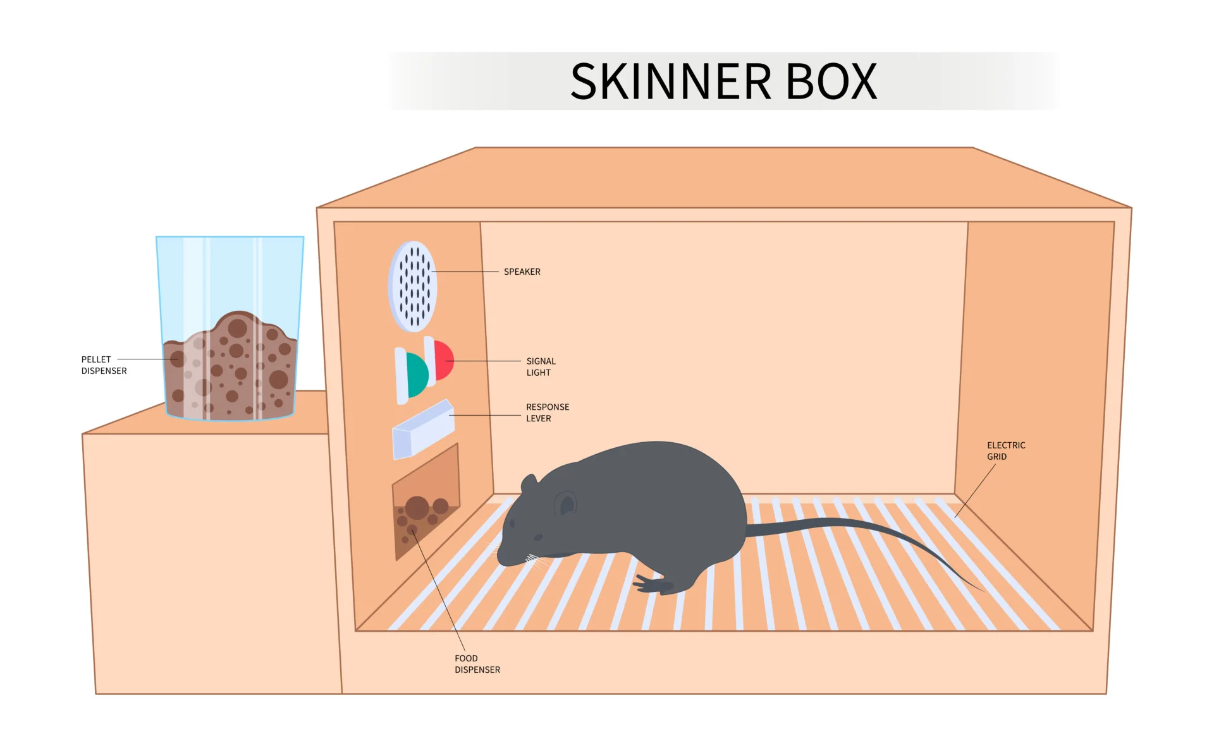

Slide 34
Concepts under Operant conditioning:
 | Reinforcement | Punishment
Positive | Something is added to increase the likelihood of the behavior. Example rewards, praises or food pellet to the animal | Something is added to decrease the likelihood of the behavior. Example scolding a student to stop him from texting in the class. Thus, a reprimand is added to decrease the behavior.
Negative | Something is removed to increase the likelihood of the behavior. Example, removing of aversive stimulus or current from the box. | Something is removed to decrease the likelihood of the behavior. Example, taking away a toy, privileges from children.

Slide 35
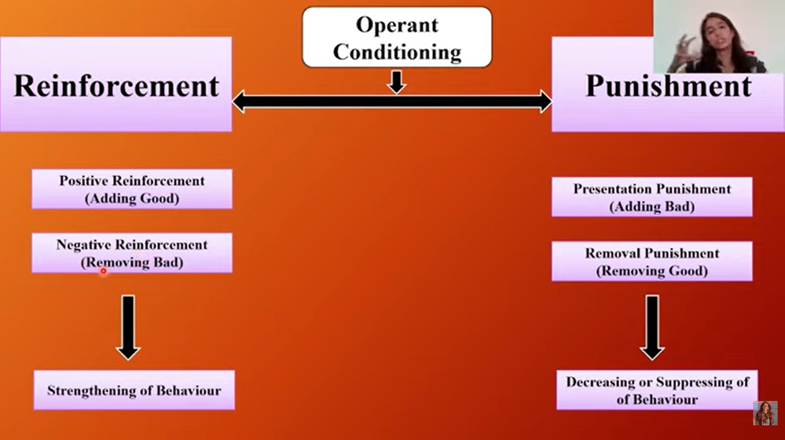

Slide 36
SCHEDULES OF REINFORCEMENT
Schedule | Meaning
Continuous | Reinforcement after every response
Fixed interval | Reinforcement after set period of time.
Variable interval | Reinforcement after varying lengths of time.
Fixed ratio | Reinforcement after a set number of responses
Variable ratio | Reinforcement after varying number of responses.

Slide 37
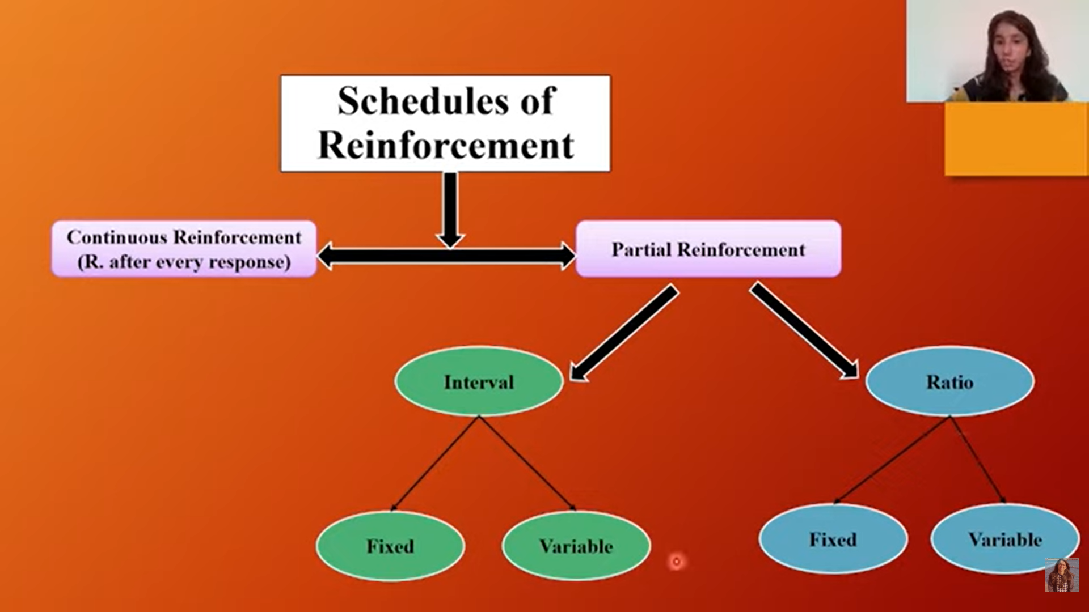

Slide 38
Educational implication of Operant conditioning
Conditioning study behaviour: Teaching is the arrangement of contingencies of reinforcement, which expedite learning. For effective teaching teacher should arranged effective contingencies of reinforcement.
Example: For Self learning of a student teacher should reinforce student behaviour through variety of incentives such as prize, medal, smile, praise, affectionate patting on the back or by giving higher marks.

Slide 40
Gestalt (Insightful Learning)

