Slide 1
Unit: 5
Models Lesson Planning
Herbartian Approach
RCEM Approach
5E Model
Notes:
Models Lesson Planning

Slide 2
Herbartian Approach:
Herbartian Approach is based on the idea that students learn new things better when they connect them with what they already know.
According to this approach, the teacher provides all the information because the student is seen as a clean slate in the beginning.
When new knowledge is linked with the student’s previous knowledge or experiences, learning becomes easier and stays in the memory for a longer time.

Slide 3
Herbartian Lesson Plan Model
Date………..
Class……….
Period……..
Subject……..
Lesson No………
Topic...........

Slide 4
Herbartian Lesson Plan Model
Objectives of the lesson (a) General Objectives (b) Specific Objectives
Teaching Aids
Previous knowledge
Introduction
Statement of the aim
Presentation
Explanation
Black-board summary
Recapitulation
Home-work

Slide 5
RCEM Lesson Plan Model:
RCEM Lesson Plan Model was developed by the Regional College of Education, Mysore.
It is a systematic approach to lesson planning based on clearly defined behavioral objectives.
Learning objectives are linked with specific learning experiences for better clarity.
The model uses a modified form of Bloom’s Taxonomy, focusing on mental abilities such as knowledge, understanding, application, and creativity.

Slide 6
RCEM Lesson Plan Model:
RCEM Model follows a Three-Step Approach
Input Process Output
Input: Content analysis, motivation, sequencing, and stating objectives.
Process: Teacher-student interaction, relationship, mechanism, questioning, activities, and communication.
Output: Evaluation of learning outcomes and assessment.
Overall, it makes classroom teaching more engaging and effective

Slide 7
RCEM Lesson Plan Model
Date:
Subject:
School:
Unit:
Class:
Topic/Lesson:
Duration:

Slide 8
RCEM Lesson Plan Model
Concepts:
Teaching Aids :
Previous Knowledge:
Introduction:
Statement of the Aim/Topic :
Presentation:
Black Board Summary:
Home Assignment:
References:

Slide 9
5E Lesson Plan Model
The 5E lesson plan framework includes five distinct phases, each playing a crucial role in creating an engaging and effective learning experience.

Slide 10
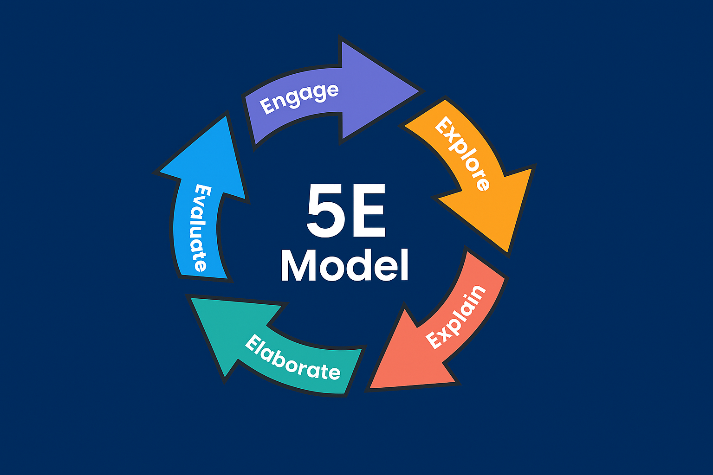

Slide 11
Phase | Teacher Behavior | Student Behavior
Engage | - Motivates and creates interest - Taps into students' existing knowledge - Raises questions and encourages responses - Acts as a facilitator | - Listens attentively - Asks questions - Shows interest - Engages in activities and forms hypotheses
Explore | - Observes and listens to student interactions - Asks inquiry-based questions - Provides time for reflection - Encourages cooperative learning | - Participates in activities - Listens and shares ideas - Records observations - Discusses alternatives

Slide 12
Phase | Teacher Behavior | Student Behavior
Explain | - Provides definitions and explanations - Listens and builds on student discussions - Asks for clarification - Uses prior knowledge to enhance learning | - Explains in own words - Applies new concepts - Uses formal terms and definitions - Engages positively
Elaborate | - Encourages application in various contexts - Uses new terms and definitions - Explains and questions effectively | - Applies concepts to new scenarios - Extends understanding - Uses formal language and terms

Slide 13
Phase | Teacher Behavior | Student Behavior
Evaluate | - Observes and assesses student behaviours - Encourages self-assessment - Asks open-ended questions - Provides reasonable conclusions | - Demonstrates understanding - Evaluates own progress - Responds to open-ended questions

