Slide 1








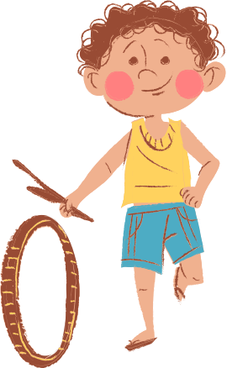



Naturalism

Slide 2










Meaning of Naturalism
  It is a materialistic philosophy which has been playing an important role in the field of education.
  Naturalism is also known as materialism on the basis of the premise that the universe is matter.
  It believes that reality and nature are identical and that beyond nature, there is no reality. "Material world is the real world". It means that nature is everything.

Slide 3
Meaning of Naturalism
  Nothing is before, behind and beyond 'Nature‘.
  The ultimate reality is of Nature.
  Naturalism is a distinct philosophy, which does not believe in sentimentalism, spiritualism and supernaturalism.
  It is a philosophy which considers nature as everything and denies the existence of any spirit. It accepts nature to be the ultimate and complete reality and those who accept this view are regarded as naturalists.

Slide 4
Meaning of Naturalism
  This philosophy does not believe in the existence of God.
  The term 'Nature' in naturalism stands for the totality of objects and events in space and time.
  Human life is a part of the scheme of nature.
  Naturalism applies natural laws to the entire gamut of human experiences, material, rational or-spiritual.
  It gives importance to the matter' and the physical world.

Slide 5
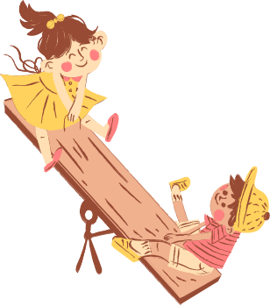



Definitions
George Hayward Joyee, "Naturalism is a system whose salient characteristic is the exclusion of whatever (s spiritual) or indeed. whatever is transcendental of experience from our philosophy of nature and man".
Hocking, "Naturalism is metaphysics which considers nature as the whole of reality. It excludes what is supernatural or of other world".

Slide 6
Forms Of Naturalism
Scientific Naturalism
Mechanical Naturalism
Historical Naturalism
Atomic Naturalism
Physical Naturalism
Biological Naturalism

Slide 7
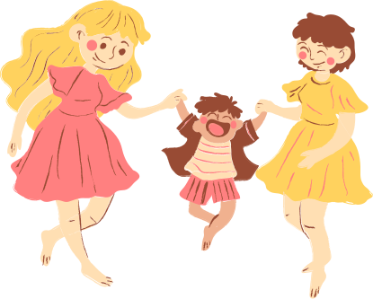
Atomistic Naturalism
Epicurus and Democritus are the chief exponents of this philosophy. According to this philosophy, when we go on dividing or discussing a thing, a situation arises when further division or not possible. This ultimate individual unit is known as atom.
The universe is compotied of such atoms. which are different from each other in colour, form, shape and quality.
Democritus states further that heavy atoms fall more quickly than the lighter one and begin to unite with each other on the way.
Thus, according to them, the creation of the universe is a natural process in which there is no role of any metaphysical power.

Slide 8
Scientific Naturalism
This type of philosophy of naturalism emerged in the period during which scientific experiments were going on at a fast speed.
Scientific experiments prove that heavy and light atoms fall with the same velocity.
Materials divided atoms into electron, proton and neutron.
The ultimate unit of substance for them is not atom but energy of electric or electronic power.
According to this form of naturalism, Nature has been created by this energy.
As far as explanations are concerned, scientific naturalism totally against the philosophy of atomistic naturalism.

Slide 9
Physical Naturalism
This is the sub-form of scientific naturalism.
Physical naturalism attaches greater importance to the external materials phenomena than the conscious human beings.
In other words, this philosophy is related to external nature and it discusses the world in terms of matter. It has no faith in morality, freedom of will and the inner nature of human mind.
According to this philosophy, nature and matter are the same things and there is no difference between nature and consciousness.
It accepts the laws of physical science as supreme.
This philosophy has not got importance in the field of education.

Slide 10
Biological Naturalism
This is an other subdivision form of scientific naturalism on the evolution theory of (Darwin).
Man is the supreme product of this evolution. The advocates of this philosophy believe that heredity has a powerful influence on the nature and temperament of an individual human being, naturalism emphasizes the development of man's natural impulses, natural propensities and inborn tendencies.
Darwin puts forward three principles to explain this philosophy:
First is adaptation to the environment, that is, each species has to gain adjustment in order to live.
Second is struggle for existence, that is, one has to struggle to live.
The third principle is survival of the fittest, that is, only the fittest survive, others decay and die out. This form of naturalism has a great influence on the process of education.

Slide 11
Mechanical Naturalism
Herbert Spencer is the main exponent of mechanical philosophy.
According to him, the world is like a huge machine which gets its form through matter and motion.
Man is considered as a tiny part of this huge machine and is himself a small machine. This philosophy therefore, aims at training man as a good machine, and keeping it in good working conditions.
The machine goes on moving without any mental or spiritual power.
"The mechanical naturalistic philosophy has given rise to the development of modern psychology which emphasises the importance of conditioned responses and the effective principle of learning by doing.

Slide 12
Historical Naturalism
This philosophy considers that wealth is real and it is essential for human survival.
According to this philosophy, human history is the history of man's struggle on this earth.
The main cause which motivates all struggles is the accumulation of wealth.
This is because wealth is real and its accumulation is a natural phenomenon.
This philosophy has led to the rise of the communist philosophy in the twentieth century.

Slide 13
Principles of Naturalism
Belief in nature: Nature is great and powerful and delimits all the capacities o an individual human being. There is no reality beyond nature. Everything is nature and nature is everything. Naturalism regards nature as the ultimate reality.
Man-a supreme product: Naturalists consider man as the supreme creation of nature. He maybe termed as the supreme and superior animal.
Belief in science: Naturalism stresses the study of science subjects only. It believes that scientific knowledge is real and final. According to the naturalists the knowledge which is obtained from experience and experimentation is real.

Slide 14
Principles of Naturalism
Belief in material: The real world is the material world and the material world is the real world. It is so because the matter can be experienced by our senses. But the soul, spirit or God cannot be experienced by our senses. Therefore, they are not real. Naturalists believe only in what is real.
Man-a machine: The universe or world is a huge machine. Man is also a part of this huge machine and a complete machine in himself.
No faith in soul: Naturalists do not have any faith in soul or spirit/According to them, God, soul, mind, heaven, hell, freedom of will, moral values, prayer and wonders are illusions. Human life is interpreted in terms of matter only.

Slide 15
Principles of Naturalism
Unchangeable laws of nature: Laws of nature which govern the whole universe are unchangeable. They explain all the events and occurrences of the world.
Nature is good: Naturalists believe that nature is good and society is full of evils. They think that everything that comes to us from nature is good but it degenerates in the hands of man.
Equality: According to the naturalists, in the natural order of things all human beings are equal.
Nature of values: All values are created in terms of specific needs and purposes. They are the outcome of the conditions of human life.

Slide 16
Principles of Naturalism
Man creates society: Naturalists advocate the development of the society. They regard man as a social animal. He must live in the society. He creates society to fulfill his requirements. He adjusts and changes the environment according to his needs.
Senses gateway of knowledge: Naturalists believe that all knowledge comes through the senses, that is, eye, ear, nose, tongue and skin. Knowledge acquired through these senses is more lasting than that acquired through books.
Heredity and environment: Naturalists regard that both heredity and environment have a vital role in influencing the personality of a man. A good psychological environment is essential for a man to adjust himself in the society.

Slide 17
Naturalism In Education
Naturalism in education means putting the child at the centre of all educational processes.
Natural laws will be the teacher to teach the child according to his own nature.
The credit of introducing naturalism into education goes to Comenius and Francis Bacon but Rousseau and Herbert Spencer have brought this movement to the zenith.

Slide 18
Naturalism In Education
Rousseau and Herbert Spencer put the child at the central position of educational process and declared that nature should be regarded as the best teacher and that natural facts are the agencies and means of education of the child according to nature.
Ross, Education is merely the fostering of natural development, and true education takes place when the nature, power and inclinations of the child are allowed to develop freely with a minimum of guidance".

Slide 19
Naturalism In Education
Monroe says, "Education is the process of development into an enjoyable rational, harmoniously balanced, useful and hence natural life".
The application of naturalistic philosophy in the field of education has enabled it to be child-centred as well as scientific.

Slide 20
Characteristics of Naturalistic Education
Back to nature Back to Nature" and "Follow Nature" are the watch words of naturalism for effective education. According to the naturalists, the best teacher for a child is Nature.
Hence, education should be provided in the natural environment in order to develop the child according to his nature.
Rousseau declares, "All things are good as they come from the hands of the author of nature, every where they degenerate in the hands of man".

Slide 21
Merits of Naturalism
Development of Child Psychology.
Emphasis on experienced centered curriculum.
Important contributions in the field of methods of teaching.
Opposition to repression in the field of discipline.

Slide 22
Demerits of Naturalism
Ignores importance of the books.
Over emphasis on physical education.
Ultimate freedom to the child.
No importance to teachers.

Slide 23
Thank You.

