Slide 1
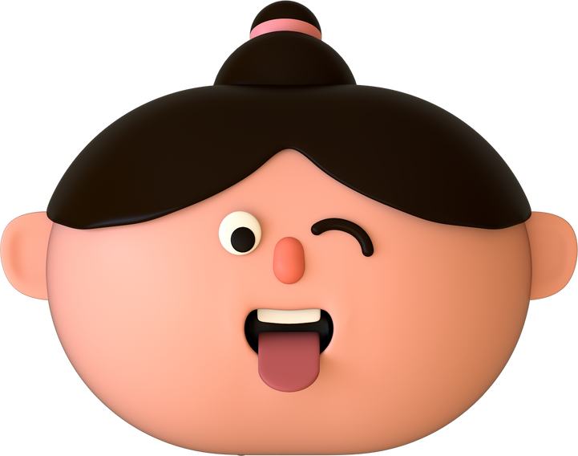
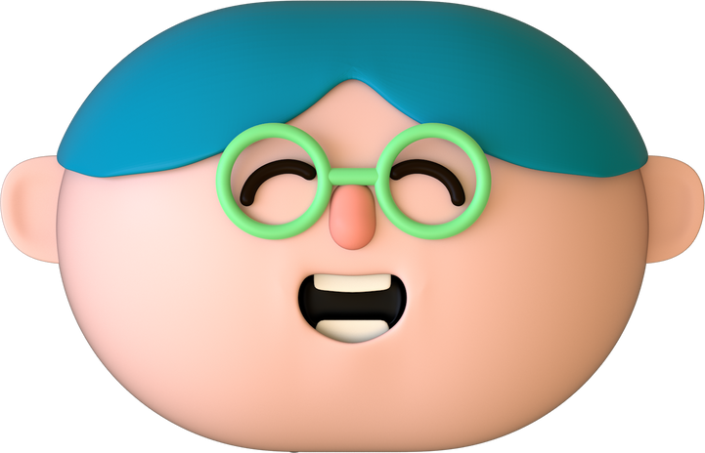
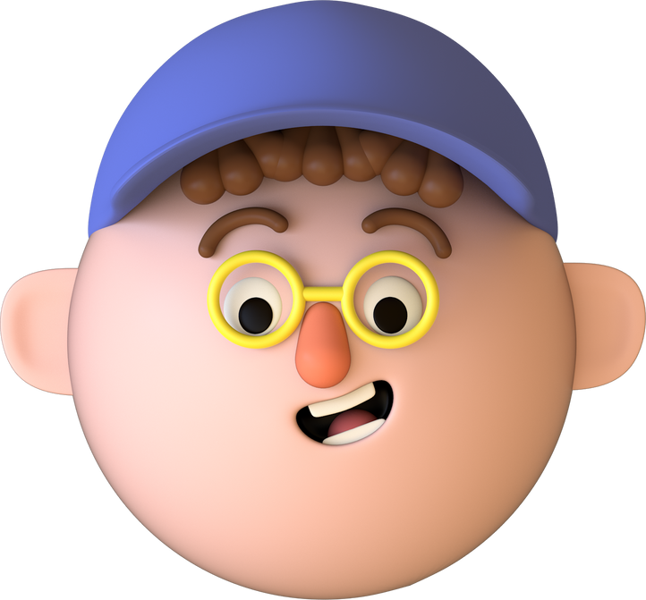
Agencies of education – Peer groups

Slide 2
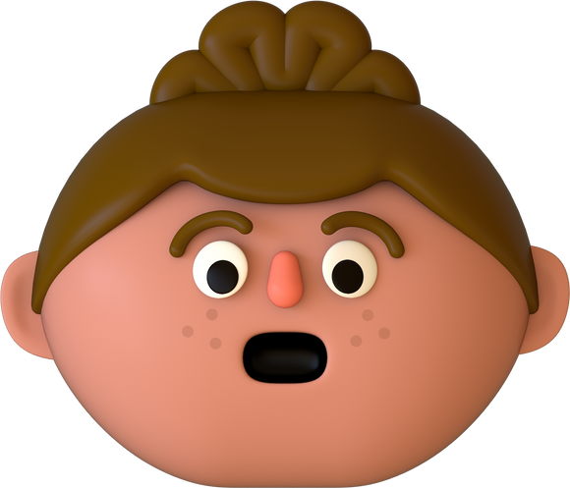


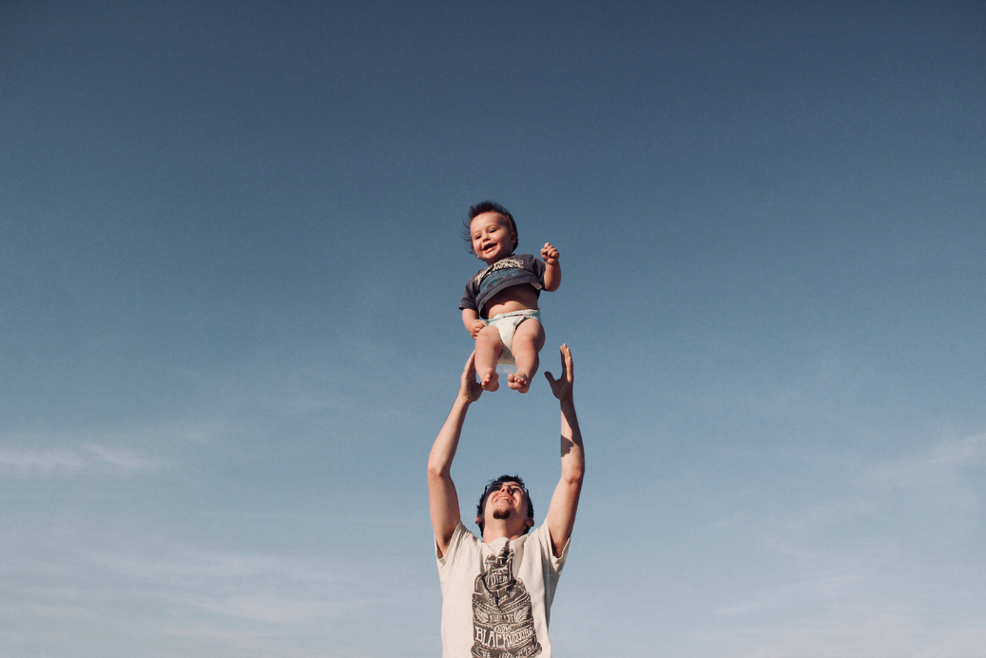
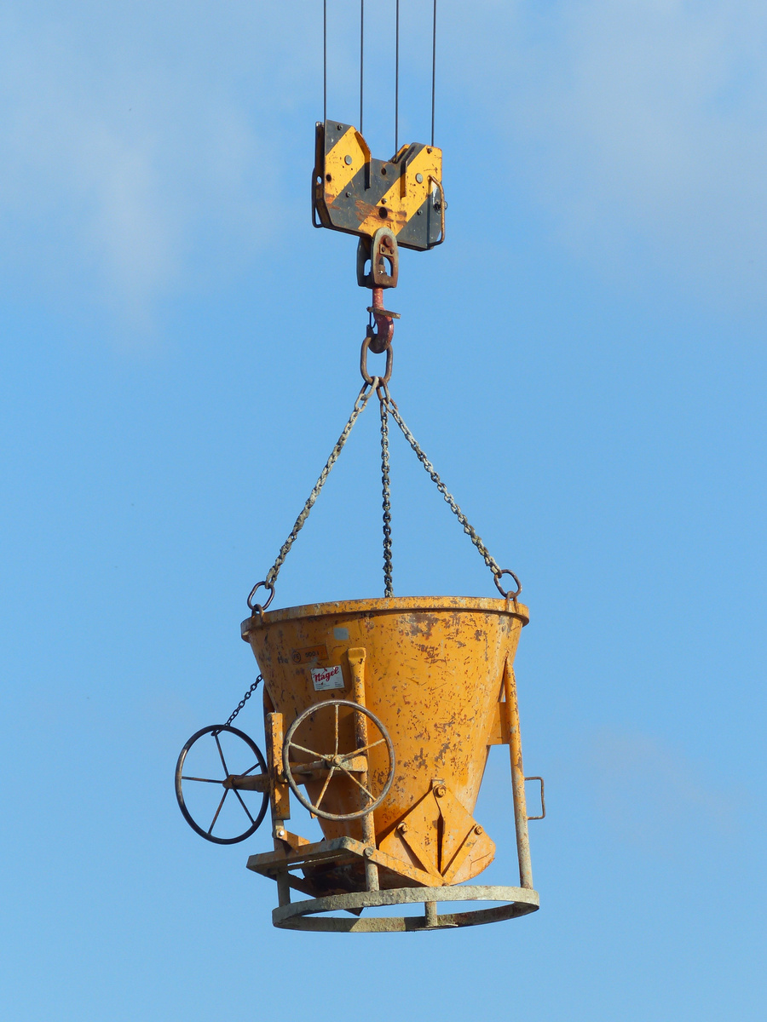

Introduction
A peer group is a group of individuals having more or less same age and status. It is a group of friends that a certain person will try to impress to get their bond, social status, and interest.

Slide 3
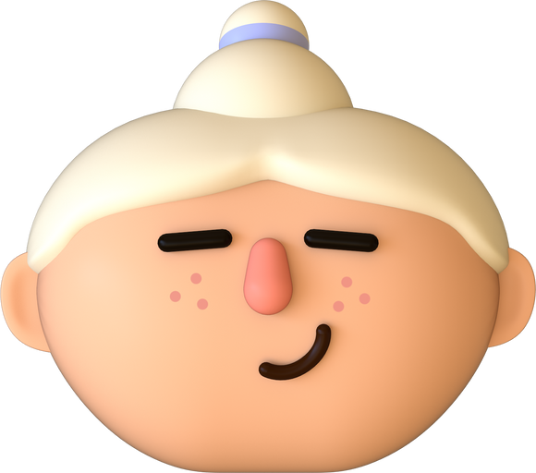

1.
It socializes the individual.
Educational role of peer group
2.
It helps to develop balanced personality.
3.
It facilitate mental development.
4.
It favours physical development
5.
It inculcate social values.

Slide 4
6.
It develops leadership qualities.
Educational role of peer group
7.
It helps to develop balanced personality.
8.
It foster talents and creative abilities.
9.
It acculturates.
10.
Children learn to go beyond 'egocentric interests.’

Slide 5
11.
Provide opportunities to children to mix-up with children of different socio-economic strata of society.
Educational role of peer group
12.
It foster talents and creative abilities.
13.
Working in play groups, children learn to respect other's rights and privileges..

Slide 6


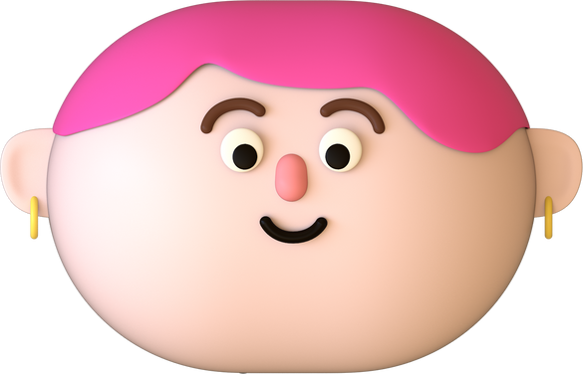
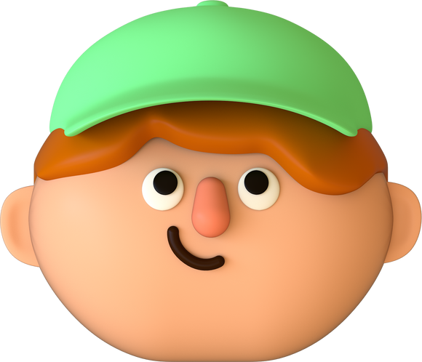


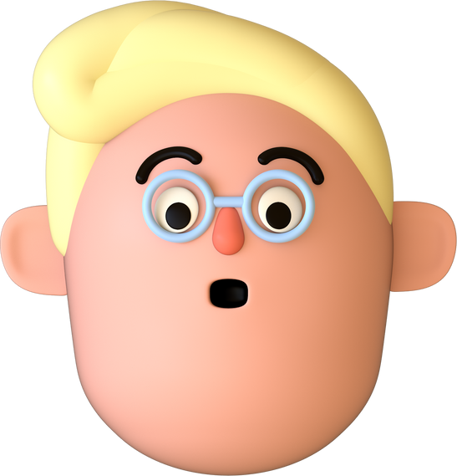
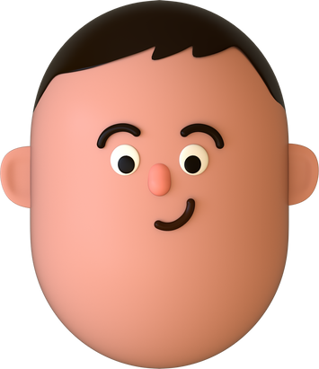
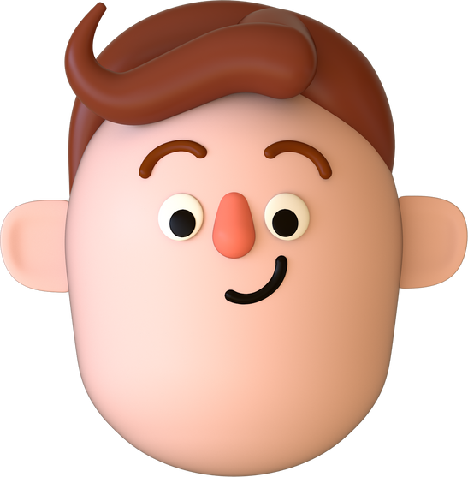
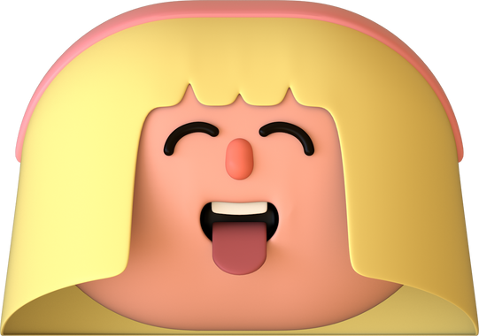
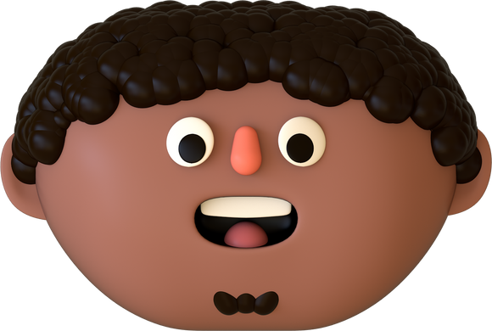
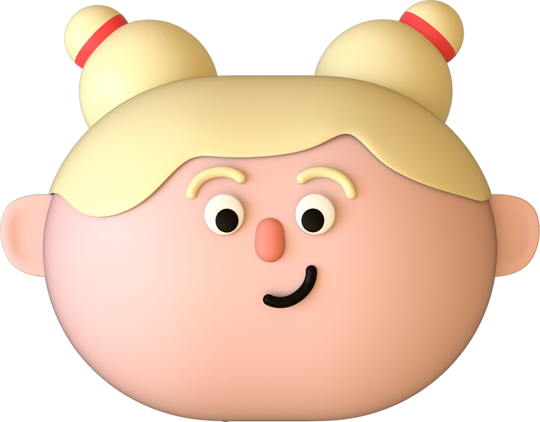
Thank You

