Slide 1
Phonetics and symbols
P-6-I
Unit-IV

Slide 2
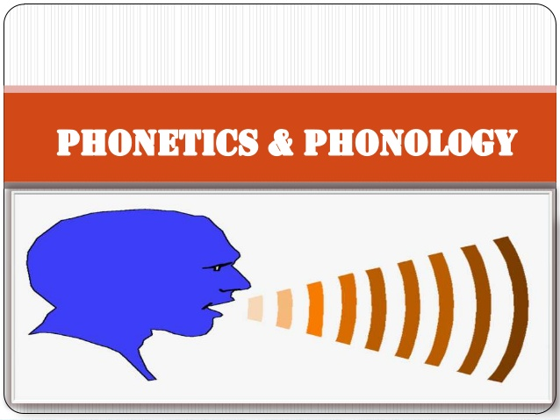

Slide 3
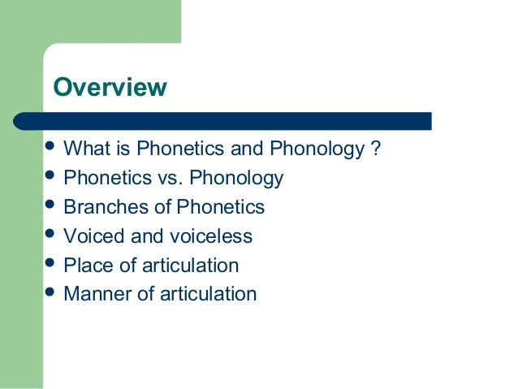

Slide 4
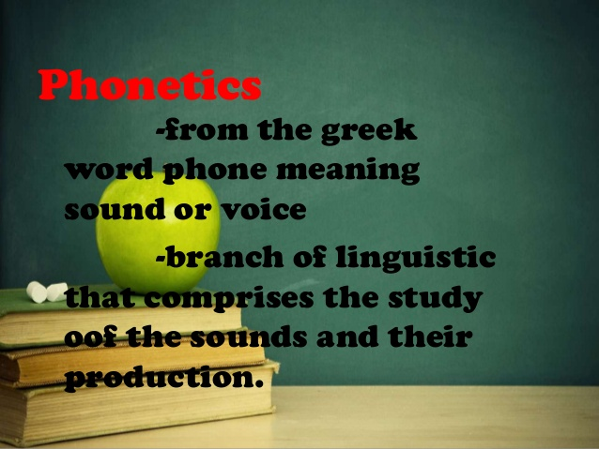

Slide 5
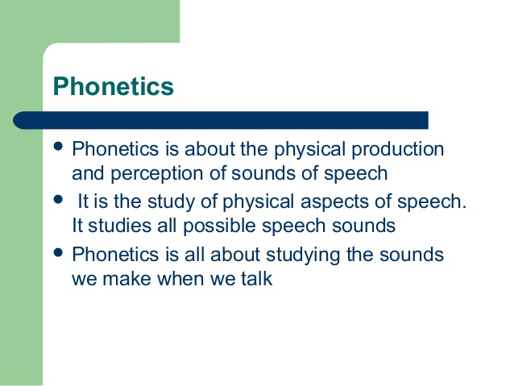

Slide 6
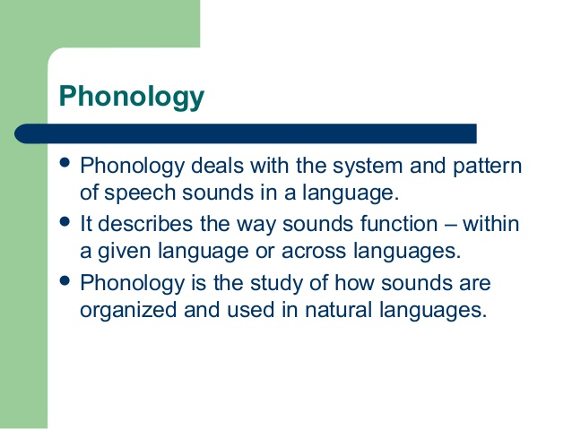

Slide 7
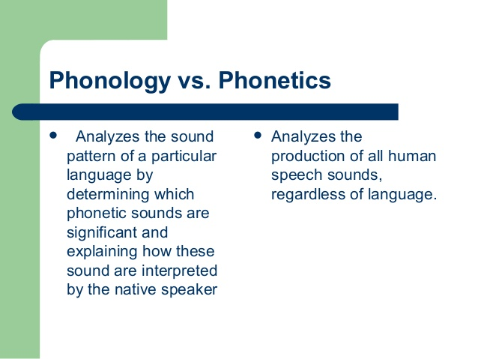

Slide 8
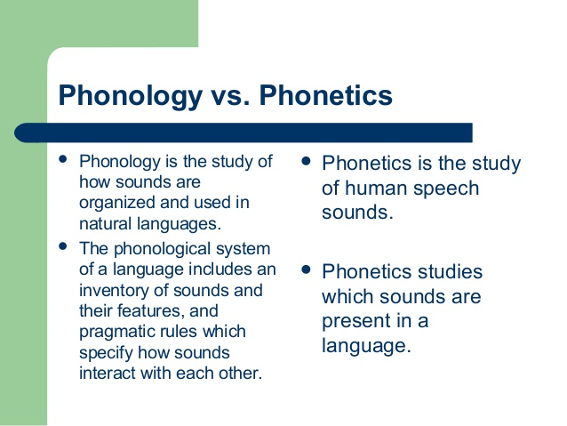

Slide 9
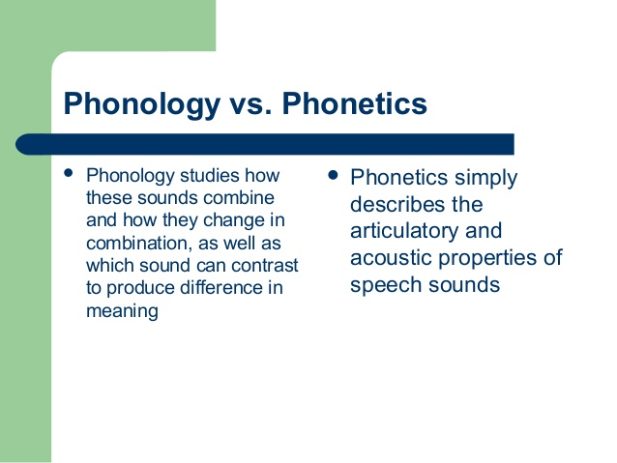

Slide 10
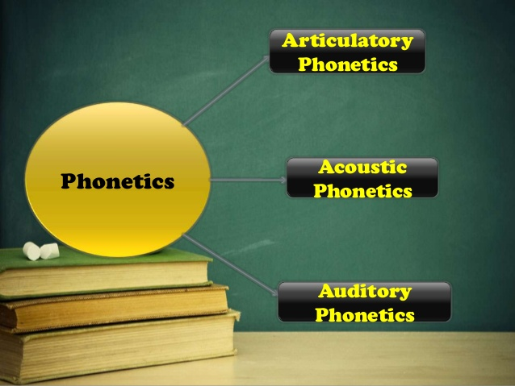

Slide 11
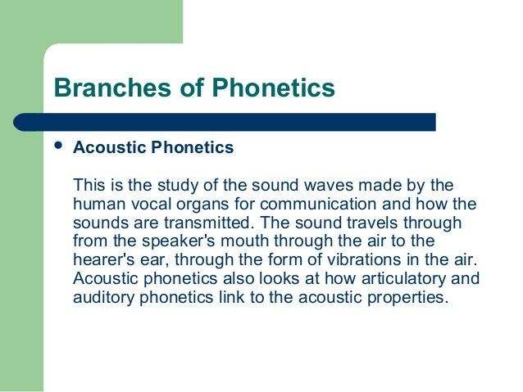

Slide 12
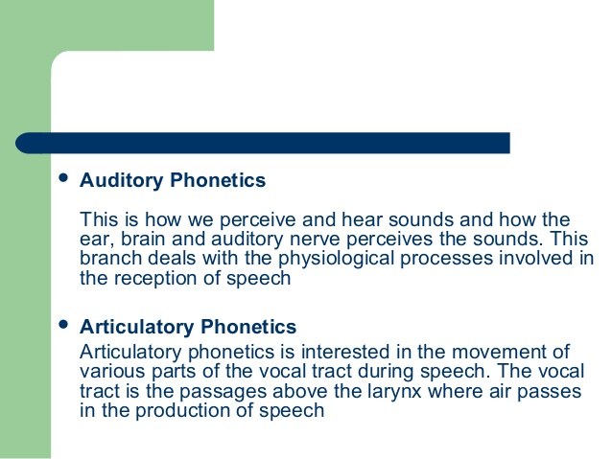

Slide 13
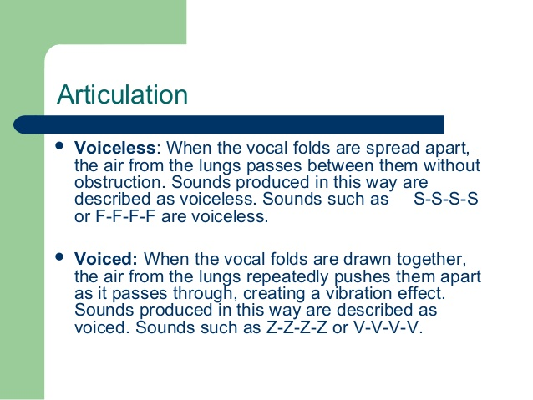

Slide 14


Slide 15
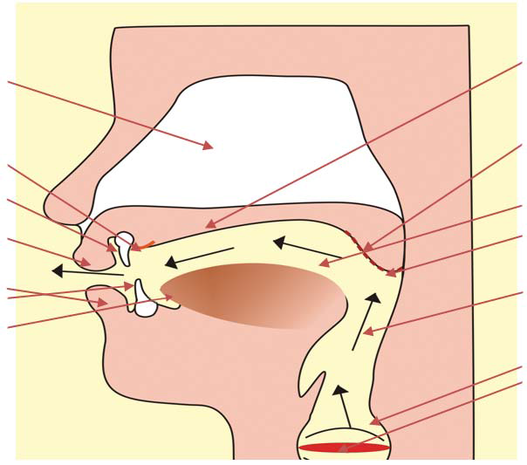

Slide 16
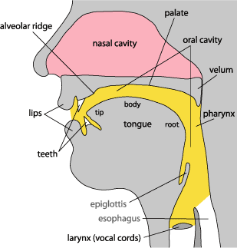

Slide 17
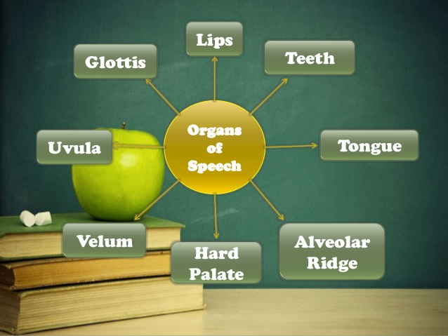

Slide 18
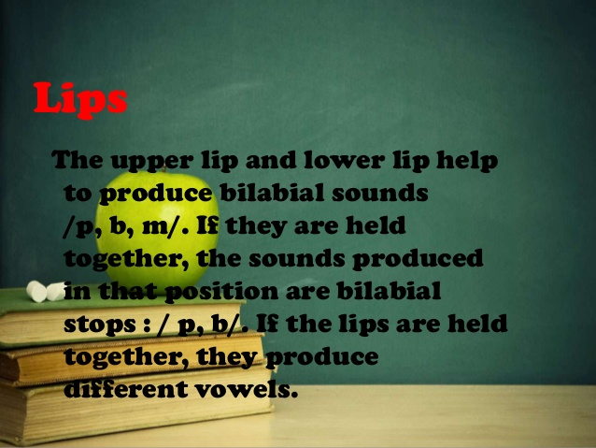

Slide 19
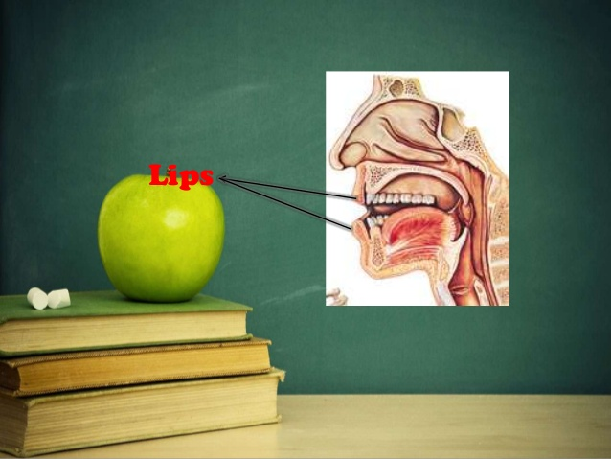

Slide 20
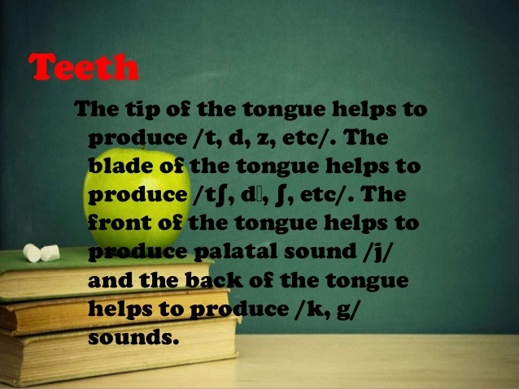

Slide 21
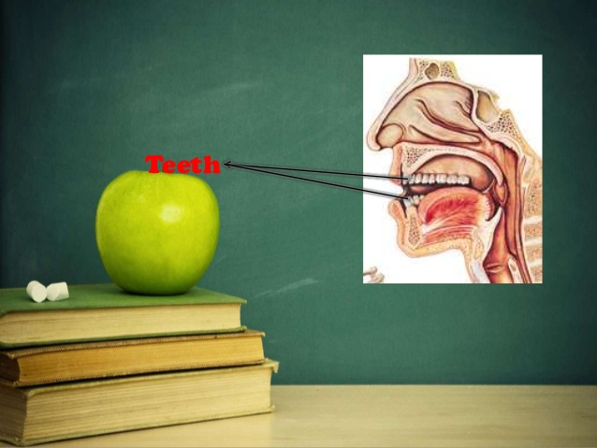

Slide 22


Slide 23
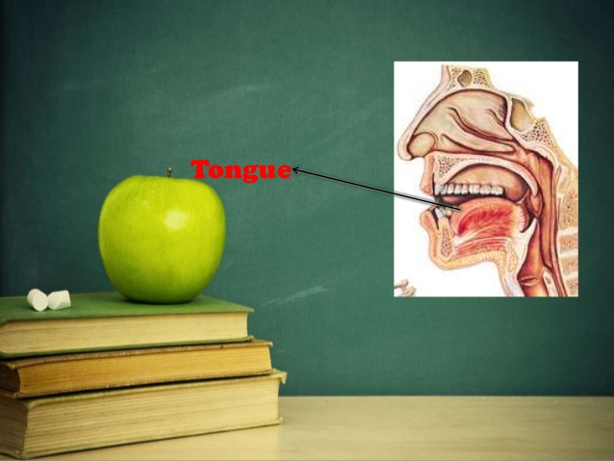

Slide 24


Slide 25
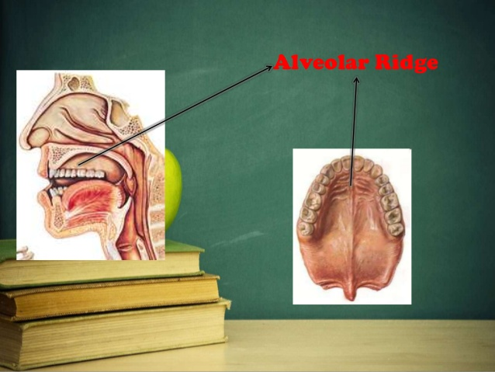

Slide 26


Slide 27


Slide 28
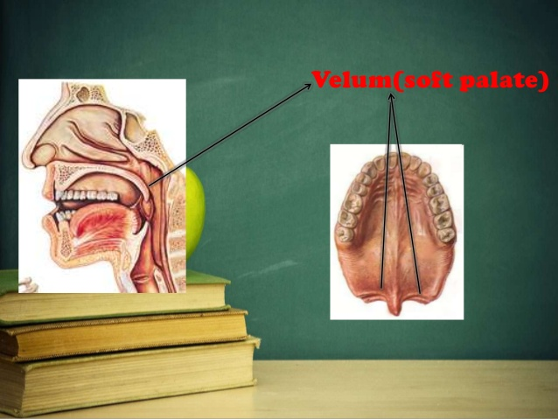

Slide 29


Slide 30


Slide 31
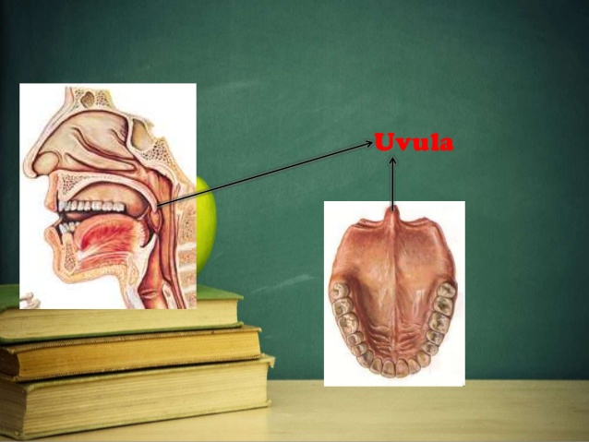

Slide 32
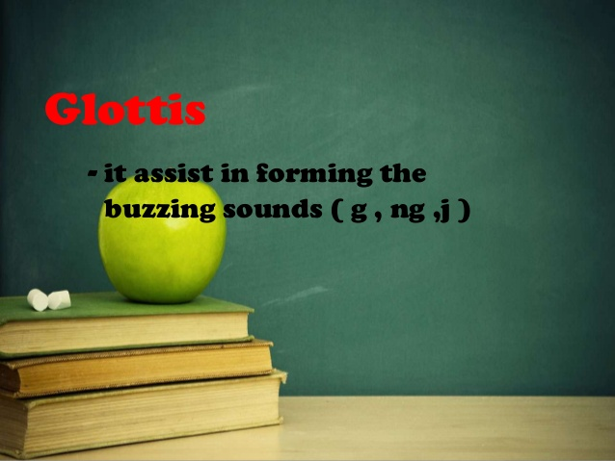

Slide 33


Slide 34
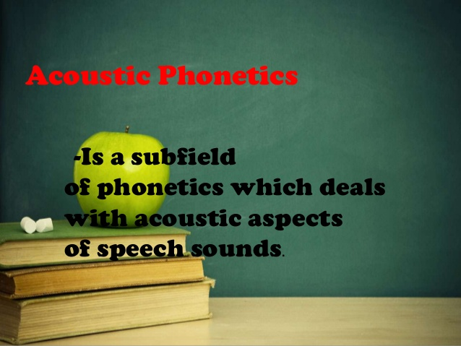

Slide 35
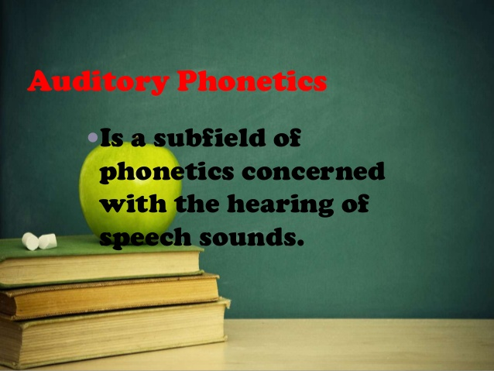

Slide 36
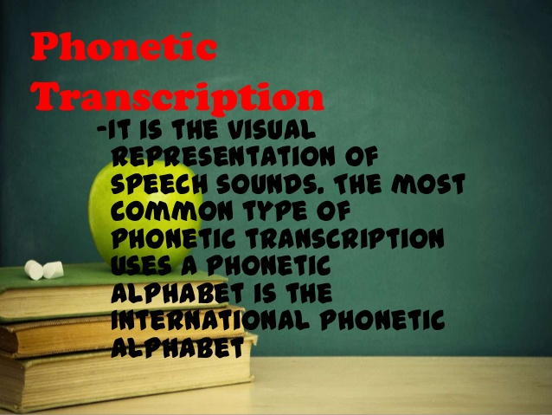

Slide 37
The Sounds of English
In the English alphabet there are 26 letters, but these letters produce 44 sounds. For this reason, one letter is used to produce more than one sound. In order to know the correct pronunciation certain symbols denoting these sounds have been devised and standardized. By learning these symbols you will be able to find the correct pronunciation of any word in a standard dictionary. These symbols will also help you to go through the book with guidance for correct pronunciation of words and conversations. These sounds are classified into two types:

Slide 38
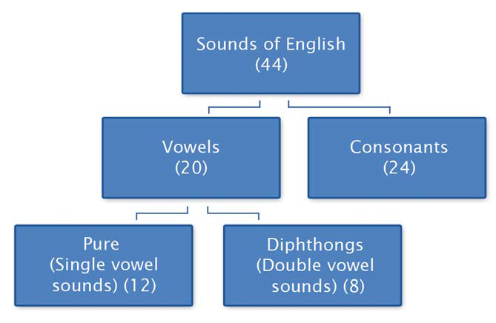

Slide 39
What is a vowel sound?
There are only 5 vowel letters in English (a,e,i,o,u), but the sounds indicated by these 5 letters are 20. A vowel sound is produced when the air comes out of the mouth freely without any blockage or closure in the mouth cavity by the tongue, teeth, lips, etc. The vowel sounds are of two types:

Slide 40
Single vowel sounds
When these sounds are produced, the tongue remains in the same position even when the sound is prolonged. They consist of one sound only and are called pure vowels as in ‘sit’, ‘pot’, ‘heat’, etc. (the underlined letters indicate the single vowel sounds)

Slide 41
Double vowel sounds
These vowel sounds are a combination of two single vowel sounds and in pronouncing them the tongue moves from one position to another. For instance, in the word ‘light’ the sound of ‘i’ is a combination of the vowel sounds /a:/ as in ‘art’ and /i/ as in ‘it’. The words ‘hair’, ‘toy’ and ‘poor’ also contain double vowel sounds.

Slide 42
You will find that sometimes two vowel letters may produce a single vowel sound as in ‘heat’, whereas, a single vowel letter may produce a double vowel sound as in ‘light’ explained above.

Slide 43
What is a consonant sound?
A consonant sound is one in which the air stream coming out of the lungs is modified in the mouth cavity by some blockage created by the tongue, lips, etc. When you say the sound of ‘p’ as in ‘pen’ a blockage is created in the outgoing breath by closing both the lips and thus, a consonant sound is produced.
The charts on the following pages illustrate all the vowel and consonant sounds of English.

Slide 44
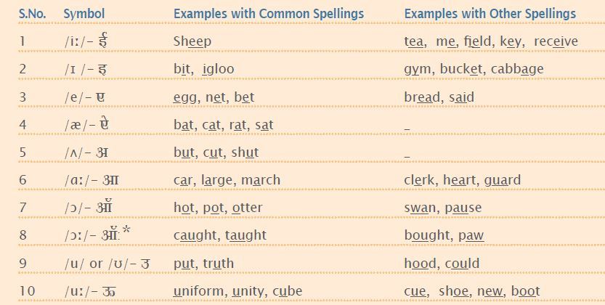
Vowel sounds in English

Slide 45
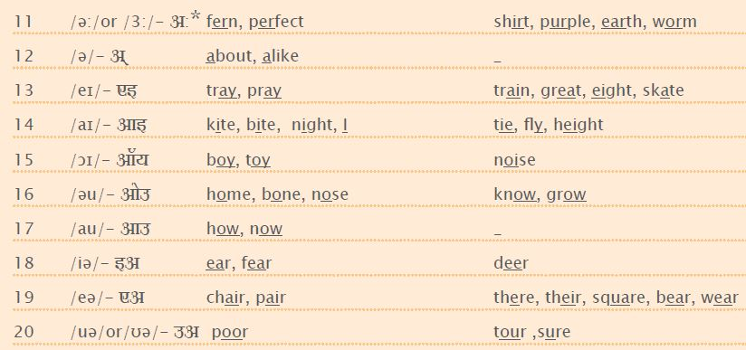

Slide 46

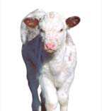
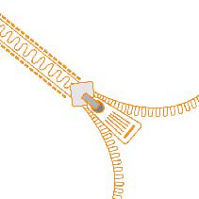
/i:/ Sheep, /i/ Zip, /e/ Ten

Slide 47
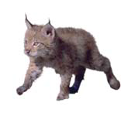


/æ/ Cat, /ʌ/ Sun, /a:/ Car

Slide 48



/ɔ/ Pot, /ɔ:/ Ball, /u/ Book

Slide 49



/u:/ Moon, /3:/ Bird, /ə/ Around

Slide 50



/eɪ/ Eight, /aɪ/ Kite, /ɔɪ/ Toy

Slide 51

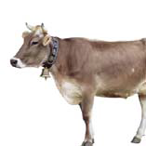

/əu/ Four, /au/ Cow, /ɪə/ Ear

Slide 52

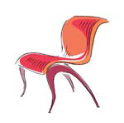
/eə/ Chair, /ʊə/ Tourist

Slide 53
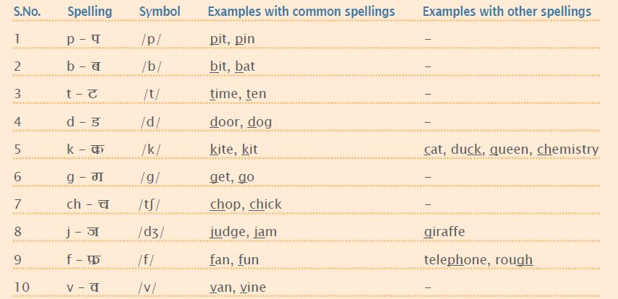
Consonant sounds

Slide 54
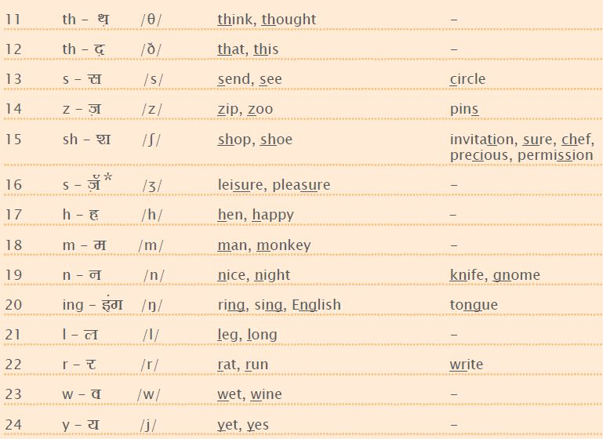

Slide 55



/p/ Pin, /b/ Ball, /t/ Ten

Slide 56
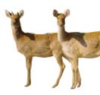


/d/ Deer, /k/ Kite, /g/ Girl

Slide 57



/dʒ/ Jug, /f/ Fan, /v/ Van

Slide 58



/θ/ Teeth, /ð/ This box, /s/ Sofa

Slide 59
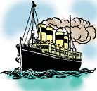

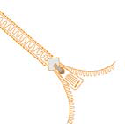
/z/ Zip, /ʃ/ Ship, /ʒ/ Treasure

Slide 60



/h/ Hat, /l/ Lamp, /r/ Rose

Slide 61



/m/ Monkey, /n/ Nine, /ŋ/ Ring

Slide 62


/w/ Wall, /j/ Yellow

