Slide 1
Importance of teaching grammar in language course(substitution)
Paper—6-i
Unit-III

Slide 2
simple substitution table. (the variables in this kind of table can be interchanged)
Compound substitution table. (the words or phrases can be used interchangeably)
Grammatical substitution table.( the pupils are taught how to replace one grammatical term for another so as to be grammatically correct.)

Slide 3
simple substitution table.
Kolkata | West Bengal
Patna | Bihar
Chennai | Tamil Nadu
Simla | Himachal Pradesh

Slide 4
Compound substitution table
Sumi |  | nice
Dona |  | bad
Tusi | Is a | beautiful | girl
Tina
Tenzin |  | claver

Slide 5
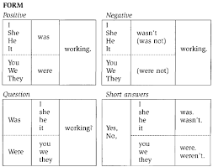
Grammatical substitution table

Slide 6
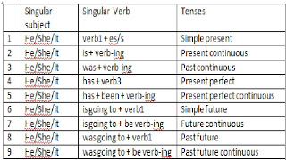

Slide 7
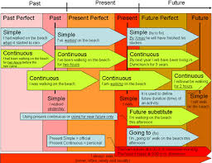

Slide 8
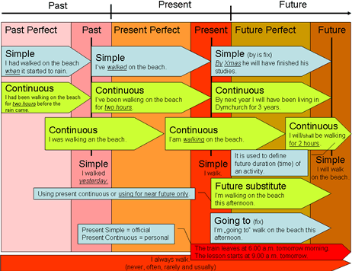

Slide 9
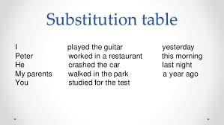

Slide 10
the procedure of substitution table can be summed up as followings---
the teacher repeats the model sentence twice or thrice in a natural way.
the student repeat it first individually and then collectively and continue till the satisfaction of the teacher.
The teacher should take initiative to correct the mistake in pronunciation, intonation, accent and articulation.
Then the teacher explains model sentence with the help of gestures, pictures objects, graphs etc. He should use mother tongue.

Slide 11
the pupils are asked that they can substitute words and phrases in the model sentence, ad they should be corrected in their selection in case they makes errors.
the meaning of the substitute words and phrases should be made clear with the help of teaching aids.
this process can be continued for substitution of the order words in the sentence.
the teacher help the students write the sentences in a table.

Slide 12
Thank you

