Slide 1
CCE in Language teaching
6-I
Unit-III

Slide 2
Concept of CCE
Continuous and Comprehensive Evaluation (CCE) refers to a system of school-based evaluation of students that covers all aspects of students' development. It is a developmental process of assessment which emphasizes on two fold objectives.

Slide 3
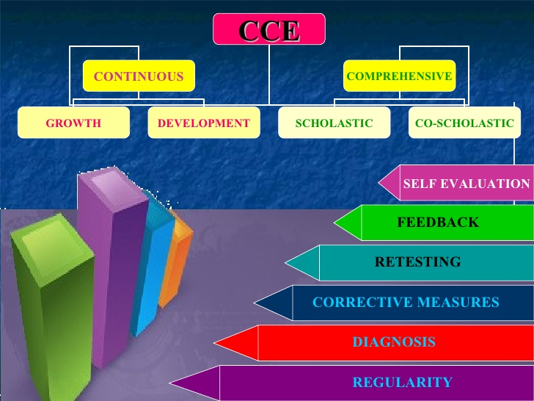

Slide 4
CCE in teaching English
Continuous and Comprehensive Evaluation, or CCE as it is popularly referred to, is posing some difficulty in as much as a uniform understanding and a comprehensive implementation method is concerned. No real fault of CCE that this perplexity exists. It is the varied interpretations of the concept of CCE and the way it is practiced that is causing some complexity for the teachers, students and their parents.

Slide 5
For the teachers of English languages, just as for teachers of other language, there is an added challenge as the CCE focuses not only on textual comprehension and overall understanding, but on verbal fluency, effective communication, lexical ability, pronunciation, effectual LSRW proficiency, creative expression and aesthetics. Much of all this is beyond the scope of conventional classroom teaching. Also considering the changing social and professional priorities a purely textual aptitude is never going to be enough to cope with the massive transition in each and every aspect of intellectual and productive human pursuits.

Slide 6
CCE is leading the conventional classroom to become a collaborative classroom wherein the environment and the ‘belief-change’ in student-teachers constitute a more important aim. It is aimed at making students participative and self reliant and at developing specific skills and abilities in the concerned subject/language, which, if utilized correctly, can become a boon for English teachers. (Infact this system would suit language teachers the most.)

Slide 7
For the teachers of English language in the CCE format of evaluation, teaching the text in the lecture mode only would give little hope of achieving collaborative classroom features. Therefore a large spectrum of options has to be practiced to meet the assessment indicators for fluency, articulation, diction, speech, elocution and expression. These are best developed and evaluated in a more activity driven teaching-learning mode. Hence this English Teachers Manual is perceived as a tool for solutions and as guide to develop suitable activities for skill development in English language.

Slide 8


Slide 9
OBJECTIVES
To assist the teachers in carrying out their task of English teaching with an in-depth Understanding;
To encourage employment of a variety of teaching aids and tools and techniques in English teaching;
To help teachers develop different activities of evaluating the students in English Language.
To understand the importance of checklist;
To understand how to prepare a checklist;

Slide 10
To help recognize specific abilities of children other than academics;
To develop an understand of CCE’s evaluating criteria;
To promote holistic education practices in English teaching;
To identify learner’s difficulties in English and provide remedial interventions by developing
interests, hobbies and passion for speaking English;
To help teachers devise different strategies to meet the emerging challenges of the new
CCE pattern introduced by CBSE.

Slide 11
Importance
It reduces the evils of external examinations.
It is for regular study habits.
It assesses pupils difficulties.
It involves the teacher in the programme of pupil-evaluation.
It supplements external examinations.

Slide 12
Merits
Validity
Reliability
Test easily
Motivating
Better teacher competence
Integration
diagnostic

