Slide 1
Bi-lingual method
Paper—6-i
Unit- III

Slide 2
Concept of bi-lingual method
The bilingual method is an approach to language education that involves teaching a second language alongside the student's native language. In this approach, both languages are used as a means of instruction, with the aim of helping students learn the second language more effectively.
The bilingual method can take many forms, depending on the goals and needs of the students. In some cases, the method involves teaching both languages simultaneously, with the teacher using one language for some parts of the lesson and the other language for other parts. In other cases, the method may involve teaching one language exclusively for a period of time before introducing the second language.

Slide 3
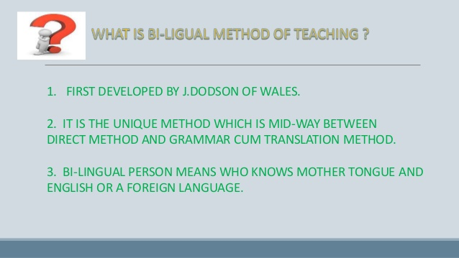

Slide 4
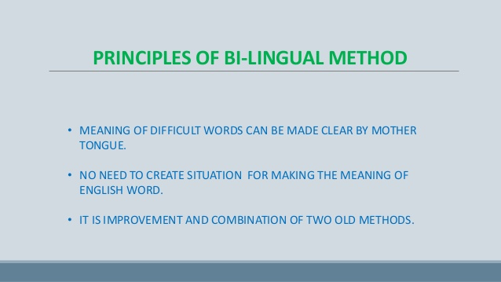

Slide 5
The understanding of words and sentences in foreign languages can be made easier by the use of mother tongue.
There is no need to create artificial situations for explaining the meaning of words and sentences of the target language.
Bilingual method is the combination of the Direct method and the Grammar translation method.

Slide 6
Structure
The architecture of the bilingual method is best understood as a traditional three-phase structure of presentation – practice – production. A lesson cycle starts out with the reproduction of a dialogue, moves on to the oral variation and recombination of the dialogue sentences, and ends up with an extended application stage reserved for message-oriented communication. The method is listed in Eppert’s Lexikon (1973: ) under the headword Konversation, where its eight teaching steps are described "The eight steps lead from imitation to free conversation," i.e. unlike the grammar-translation method, but like the direct method and the audio-lingual method it focuses on the development of oral skills.

Slide 7
Classroom research
Dodson’s experimental data – several modes of presenting dialogues were tested – have been confirmed by subsequent research, for example by a school-year long experiment of teaching French to Dutch learners (Meijer 1974), which compared the bilingual method with an audiovisual approach. A laboratory study with Japanese learners of English also confirmed Dodson’s results (Ishii et al. 1979). Similar results were reported by Sastri (1970) and Walatara (1973). Feasibility studies were undertaken by Kaczmarski (1979) in Poland, by Wolfgang Butzkamm (1980) for the teaching of English to German speakers in secondary schools, by Kasjan (1995) for the teaching of German to Japanese learners at university level, and by Moorfield (2008) for the teaching of the Maori language.

Slide 8
History
Although Dodson’s work inspired researchers from various countries, the bilingual method has been neglected by the mainstream, as evidenced in the absence of any mother tongue role in recognised overviews of L2 approaches and methods such as Richards & Rodgers (1987). However, Butzkamm & Caldwell (2009) have taken up Dodson’s seminal ideas and called for a paradigm shift in foreign language teaching. This call was repeated by Hall & Cook in their state-of-the-art article (2012: 299): "The way is open for a major paradigm shift in language teaching and learning.”

Slide 9
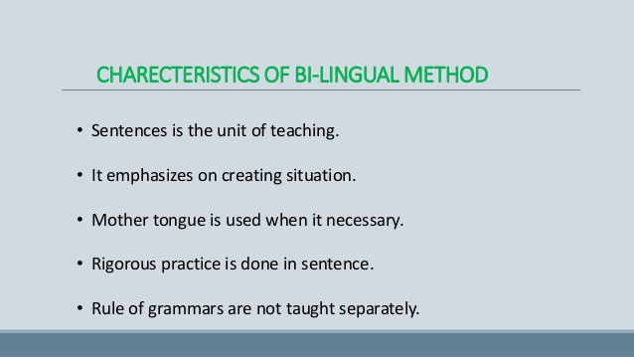

Slide 10
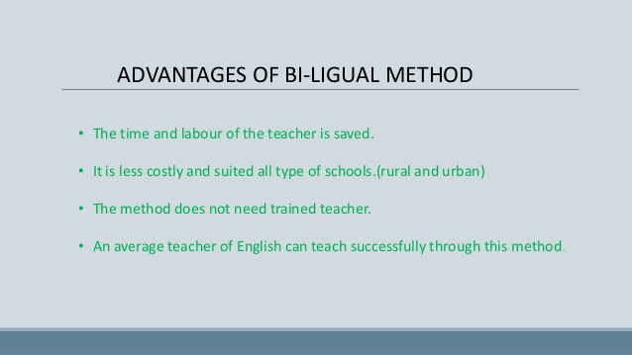

Slide 11
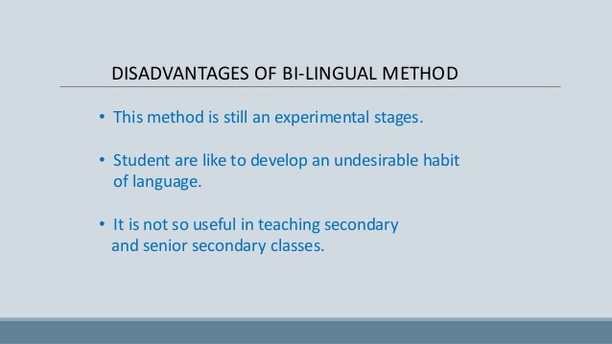

Slide 12


