Slide 1
Curriculum evaluation model
B.Ed. 2nd year
Paper-09
Unit-III

Slide 2
Curriculum Evaluation
Evaluation is a systematic process to determining the proficiency level of a system or a practice.
It serves to identify the strengths and weaknesses of a curriculum before implementing and its effectiveness after its implementation.
It refers to an ongoing process of collecting, analyzing, synthesizing and interpreting information to aid in understanding what students know and can do.

Slide 3
Approaches to curriculum evaluation
An approach expresses of viewpoints about the development and design of the curriculum, the role of the teacher, learner and curriculum especially in planning the curriculum, the goals and objectives of the Curriculum studies and the important issues that need to be examined.
It is not content-specific but it is a methodological process.

Slide 4
Approaches to curriculum evaluation Scientific and Humanistic approaches
Cronbach has identified two approaches for evaluation.→
Scientific Approach: In this approach, all efforts are focused on the learners. Student's achievements indifferent situations are compared by the way of test scores. Quantitative measures are adopted for data collection and statistical tools are employed for data analysis.
Humanistic Approach: This is the study of a program already in place, not the one imposed by the evaluator. It is qualitative and the techniques employed are observation, interviews, meeting discussion etc.

Slide 5
Intrinsic and pay off evaluation
Intrinsic evaluation of Curriculum implies that evaluators study the contents, it's sequence, organization, accuracy, learning experiences provided etc.
They believe that with accurate content and organization, students learning would be stimulated.
Most of the time evaluators tend to neglect the concept of intrinsic evaluation.
Pay off evaluation occurs when the effects of the delivered curriculum are examined and it's worth has been established.

Slide 6
Formative and summative evaluation
The formative evaluation aims to improve an existing program based on the feedback obtained from the evaluation.
The program developer must frequently provide with detailed and specific information to guide them in the developmental phase.
On this basis evaluators can revise the program while it is being developed before it can be implemented on a large scale.
Formative evaluation can occur at several stages during the curriculum development process at any stage the validity of the content can be checked that is whether students are achieving the stated goal if not then that content could be modified.
Summative assessment assesses the effect of a complete program. It is carried out at the end of an Educational program.
This type of Curriculum is based on the evidence about some effects of various components in the curriculum.

Slide 7
CIPP MODEL
CIPP model is for evaluation was given by Stufflebeam in1983 which includes four elements:
C- Context, I- Input, P- Process and P- Product. Context - What needs to be done? (Goals and objectives on the basis of which the outcomes are attained)
Input - How should it be done? It involves the resources, infrastructure, curriculum and content needed to implement the teaching learning mprocesses.
Process - Is it being done? ( It includes implementation of teaching learning processes and its formative evaluation.)
Product - Did the project succeed? (It includes evaluation of skills, values, attitudes and results to identify the outcomes and effectiveness of the educational program.)

Slide 8
Context Evaluation (What needs to be done?)
The objectives of context evaluation are to define, identify and address the needs of the target population.
The different types of methods for the evaluation of context include surveys, document reviews, data analysis and interviews.
1. Are the aims of the program suitable or not?
2. Do the objectives generate from aims?
3. Are the courses/subjects taught relevant to the aims?
4. Is the school fulfilling needs of the society?

Slide 9
Input evaluation
Input evaluation (How should it be done?)
The purpose of this type of evaluation is to provide information for determining the resources used to meet the goals of the program (Khawaja, 2001).
1. What are the different skills that Learners will gain?
2. Does practical and theory work compliment each other?
3. What type of resources should the program use for effective teaching learning process?
4. Are different labs well maintained?
5. Do the teachers have appropriate knowledge, skills and attitude for teaching?

Slide 10
Process evaluation
Process evaluation (Is it being done?)
Process evaluation focuses on the running of the program and teaching learning processes. Process deals with the following questions:
1. Is ICT been used in many school practices?
2. Are teachers and students of the school actively participating in different activities?
3. Is there effective two way communication between administration, teachers and other staff?
4. Which types of activities are conducted in the school?

Slide 11
Product evaluation
Product evaluation (Did the project succeed?)
Product evaluation includes the outcomes of the program.
1. What are the achievements of the students of the school in co-curricular and curricular activities?
2. What are the different summative and formative assessment strategies used by the school?
3. How will students practically implement what they have learned?
4. Is the school/program keeping a record of different activities of the students?
5. How could quality of teachers and school reputation be improved?

Slide 12
Tyler's objective Cantered model
Objectives
Selection of learning experiences
Organization of learning experiences
evaluation

Slide 13
This model was developed by Taylor in 1950. It lags steps for evaluation as it:
Begin with the behavioural objectives that have been previously determined. Those objectives should specify both the content of learning and the statement behaviour expected.
Identify the situation that will allow the students to express the behaviour embodied in the objective and that evoke or encourage this behaviour.
Select, modify or construct evaluation instruments and check the instruments for objectivity, reliability and validity use the instruments to obtain summarise the oppressed results.

Slide 14
Compare the results obtained from several instruments before and after given periods to estimate the amount of change taking place.
Analyse the reserves to determine the strengths and weaknesses of the curriculum and to identify possible explanations about the reason.
Use the results to make the necessary modifications in the curriculum.
He maintains that evaluation is a recurring process and that evaluation feedback should be used to reformulate redefine objectives.

Slide 15
Advantages of Tyler’s model
It is relatively easy to understand and apply.
It is rational and systematic.
It focuses attention on curriculum strengths and weaknesses rather than being concerned solely with the performance of the individual student.
It also emphasizes the importance of a continuous cycle of assessment analysis and improvement.

Slide 16
Disadvantages of Tyler’s model
It does not suggest how the object is themselves shall be evaluated.
It does not provide standards or suggests how standards should be developed.
It emphasizes on the prior statement of the objective may restrict creativity in curriculum development and its aims to place undue emphasis on the pre-assessment and prove assessment ignoring completely the need for formative assessment.

Slide 17
Kirkpatrick's model
Question related to training program
How effective it's been.
Are your people putting their learning into practice?
Whether training program is positively impacting their role and the wider organization?

Slide 18
Purpose of the model
Kirkpatrick's Four-Level Training Evaluation Model can help you to answer questions like these.
We can use it to objectively to analyze the impact of training, to work out how well your team members learned, and to improve their learning in the future.

Slide 19
Kirkpatrick's model
This was developed by Dr Donald Kirkpatrick in 1950.
Level 1: reaction evaluation measures how participants react to the training, whether they find it enjoyable or not.
level 2: learning evaluation, it analyses if trainees fully understand the training which is an increase in knowledge experience or skills etc.
Level 3: behaviour evaluation, it looks if the trainees are utilising what they have learnt.
Level 4: results revaluation, it determines if the materials had a positive effect on the business or organisation.

Slide 20
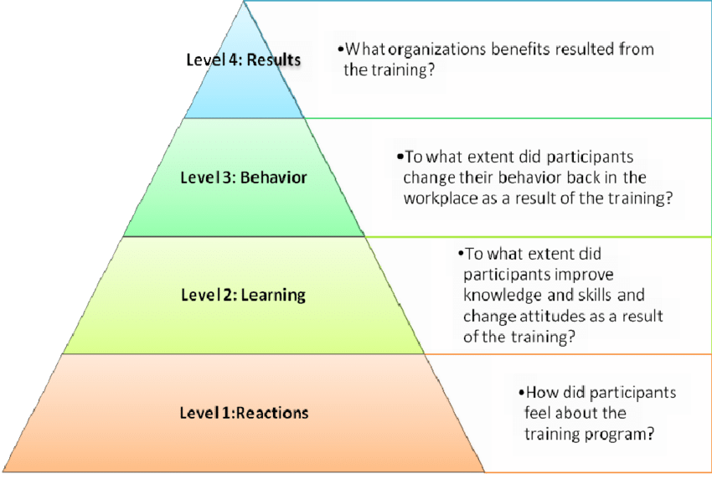

Slide 21
Levels | Reaction | Learning | Behaviour | Results
Example | Did the trainees feel that the training was worth their time? b) Did they think that it was successful? c) What were the biggest strengths of the training and the biggest weaknesses? d) Did they like the venue and presentation style? | It starts by identifying what one wants to evaluate like changes in knowledge, skills or attitudes. It can be done doing pre-test and post test. | a)Did the trainees put any of their learning to use? b) Are trainees able to teach their new knowledge, skills or attitudes to other people? c) Are trainees aware that they've changed their behavior | Increased employee retention. b) Increased production. c) Higher morale. d) Reduced waste. e) Increased sales. f) Higher quality ratings. h) Fewer staff complaints.

Slide 22
Advantages of this model
It is probably the best-known model for analysing and evaluating the results of training and educational programs. It takes into account any style of training both formal and informal to determine aptitude based on 4 level criteria.
It provides an opportunity to learn to demonstrate learning transfer.
It provides more objective feedback.
It is simple to understand.
It presents a useful taxonomic for considering the impact of training programs at different organisational levels.
The model provides a logical structure and process to measure learning.

Slide 23
Disadvantages.
It does not come under the wide range of individual organisational and training design.

Slide 24
Scriven's Goal free model

Slide 25
Curriculum
Pre-determine Goal
Select content
Material
Method
Outcome

Slide 26
Goal free evaluation
Here evaluator conduct the evaluation without particular knowledge of or reference to stated or predetermine goals and objective.

Slide 27
Evaluation
Observe and measure all actual outcomes, effects or impacts, intended and unintended all without being cued to the programmes instruction.

Slide 28
Evaluation process
Formative assessment
Summative assessment

Slide 29
Technique
Unstructured interview
Observation
Access to program/ project participation/ access to all data/ time.

Slide 30
Without referencing goal and objectives
Identify relevant effect
Determine the degree to which the effects are positive, negative or neutral
Uncovering side effect

Slide 31
Advantage
Avoiding true goals
Adapting environmental change

Slide 32
Scriven's Goal free model
Goal free evaluation model is methodologically neutral which means that it can be used or adapted for use with various other evaluation approaches models and methods as long as the other approaches do not mandate goal orientation.
In conducting a goal free evaluation, the evaluator functions as an unbiased observer who begins by generating a profile of needs for the group served by a given program.
Then by using methods that are primarily qualitative the evaluator assesses the actual effects of the program.

Slide 33
If a program has an effect that is responsive to one of the identified needs, then the program is perceived as useful.
This emphasizes on qualitative methods.
Disadvantages of this model are that it cannot provide sufficient information for the decision-maker. And some critics have faltered him for not providing more explicit directions for developing and implementing the model.

Slide 34
Advantages of this model are that it allows evaluators to be attentive to a wider range of programs outcome rather than just link for the program's results that are stuck to the programme aims or goals.
It can be used to supplement a goal-based evaluation.

Slide 36
Thank you

