Slide 1
Curriculum Administration paper-09 unit-III

Slide 2
Curriculum Administration
Curriculum administration is a complex process involving faculty and other subject’s experts. They help in ova-all planning and construction of curriculum.
The curriculum is based on the needs and interest of students concerned.
Thus it can be defined as an on going process of planning, organization, implementation and evaluation of curriculum by the faculty in all setting (Class room, Laboratory, Hospital and community), prescribed for a particular group of students for a specified time period.
The planning and developing the sound curriculum includes the participation of whole faculty in deciding on the objectives, selecting and organizing learning experiences that will contribute to the objectors and evaluating the effectiveness of the educational programme.
Having understood the meaning of curriculum and curriculum administration, let us now learn the importance of curriculum administration.

Slide 3
IMPORTANCE OF CURRICULUM ADMINISTRATION
provides learning experiences related to the theoretical, practical component in conformity with the laid down educational objectives of the programme so that teaching learning content is selected accordingly.
maintains the continuity and sequence of learning experiences.
provides supervised clinical nursing practices in accordance with the objectives.
co-relates theory with the practice.
provides opportunity to integrate theory with various learning experiences.
provides environment which is closely related to life situation, where the student will perform.
establishes a sound system of continuous evaluation.
examines how for the curriculum prescribed for a class is implemented.

Slide 4
FACTORS INFLUENCING CURRICULUM DEVELOPMENT
Factors relating to the learners: The needs, capacities health, family, vacation, religion and culture of the learner should be recognized and borne in mind when framing the curriculum so that it bring the desirable change in the learner.
Political. social, economic and religion factors influence the curriculum development. The research findings and advancement In medicine and technology also affect the curriculum.
The influence of modern methods of educational programme, and programmed
instruction on the curriculum affect the traditional curriculum content and teaching learning methods.
Available resources in terms of man, money and material also affect process of curriculum development.

Slide 5
STEPS IN CURRICULUM CONSTRUCTION

Slide 6
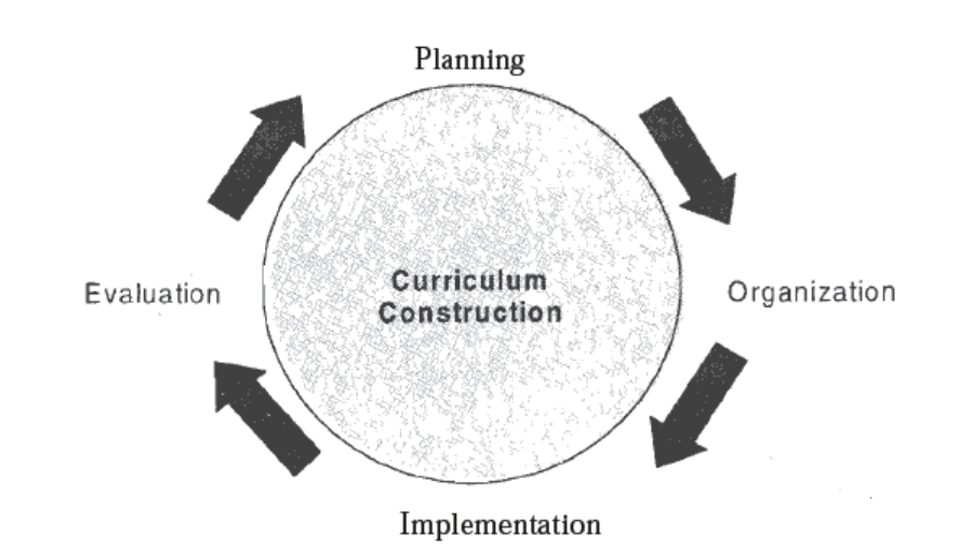

Slide 7
Planning of Curriculum
The curriculum planning is cooperative, continuous, Comprehensive and concrete, which includes the following:
Investigation
The formulation of the aims and objectives of the school.
Selecting learning experiences that will contribute to the objectives
Organizing the learning experiences to maximize cumulative effect, and
Evaluating the effectiveness of the educational programme in attaining its objectives through appraising the educational progress of the students.

Slide 8
Investigation
The curriculum committee investigates and analyses the existing situation to determine the need, resources and purpose of establishing the educational programme, its duration, design and staffing requirement based on the philosophy and objectives of the school.
The development of any curriculum is dependent on the availability of the resources, either actual or potential. Resources needed for curriculum developments include tangible and intangible.
The tangible resources include those things such as teachers, classrooms, libraries, materials….. community organization and others similar resources.
The intangible resources are within the teachers and students such as intelligence, leadership and motivation.

Slide 9
The Formulation of the Aims and Objectives of the School
The task of deciding the objectives is an important one, as these aims and purposes will guide the entire educational programme. In determine the aims and objectives, some of the factors should be considered.
The Statement of school philosophy.
The social and health need of society.
The need of the students and the expertise of the subjects.
The need of the community.
Availability of the resources and the changing nursing role in terms of the demands of’ profession.

Slide 10
The most important factor in the formulation of the aims and objectives is that they should be clearly stated and clearly understood and accepted by all the staff. The aims are the overall goals of the total school programme and may be formulated in a broad statement of one or two sentences.
They should reflect the philosophy of the educational programme.
What the students should be able to do at the end of a learning period that they could not do before hand.
Objectives must be learner centered.
Objectives should be clear and unambiguous stated in behavioral terms, understood and accepted by all staff.
The general level objectives should be, broad, and the specific objectives should be narrow, relevant and precise.
Objectives should be achievable. observable, logical and measurable.

Slide 11
Selection of Learning Experiences
To achieve the stated objections, learning experiences have to be selected. Leaning experiences are the mean of reaching aims and objectives of the educational programme. The learning experiences are planned and guided by faculty covering theory and practical and its content.
In selection of learning experiences following principles should be kept in mind:

Slide 12
The faculty should have systematic approach to the selection of learning experiences through which the students are provided with the opportunities to meet the objectives.
The learning experiences are planned in terms of objectives sought.
Select appropriate learning experiences for developing problem solving skills, attitude and interests. And give the student opportunity to explain, to interpret and to illustrate with related ideas.
Learning experiences should be varied and flexible.
Enough in keeping with the student's ability to under go the desired changes of behavior and is not beyond her particular stage of development.

Slide 13
A learning experience should involve student actively which results in a desirable change of behavior (Knowledge. skills and attitude) and should give students opportunity to practice the kind of behavior implied in the objectives.
Learning experiences are arranged for theoretical, practical and clinical component in such manner that it provides continuity, sequences and integration of learning.
Learning experiences are planned and evaluated cooperatively by the teacher and the students.
The selection of audiovisual material and teaching method should depend on the objectives stated.

Slide 14
Organization of Learning Experiences
After the learning experiences as also termed as subject matter, i.e., subject matter (learning experiences) have been selected carefully in relation to the desired objectives, they must be organized in the curriculum.

Slide 15
Grouping of Subject Matter Context
Placement of Learning Experience
Continuity
Sequence
Integration
Correlation Chart
Decision on the Weightage (Time Allotment)
The General Plan

Slide 16
Grouping of Subject Matter Context
The organization of subject matter (content) and the learning experiences should be in such a way so as to maximize the total effect of the various learning experiences into an effective, efficient and practical curriculum. The syllabus prescribed by the INC consisted of a list of subjects; the content (subject matter) in the curriculum can be organized as under:
Applied Basic Sciences
Physics and Chemistry,
Anatomy and physiology and
Microbiology.
Behavioural Sciences
Psychology and sociology

Slide 17
Placement of Learning Experience
When the broad plan for the organization of learning experiences has been decided upon, the next step 1s their placement in then total curriculum. They have to be distributed through out the course In such a manner that the criteria of continuity, sequence, integration and correlation of learning experiences are applied.

Slide 18
Continuity
The elements of the curriculum should be related to one another vertically and horizontally so that systematic body of ideas and activities will be expanded continuously into larger and more meaningful pattern. The vertical organization of learning experiences refers to the relationship existing between different levels of the same subject or skills. It is recurring emphasis in the learner's experiences upon particular elements. This relationship is known as continuity. Related to continuity but going beyond it is the relation ship known as sequence.

Slide 19
Sequence
Chronological order
Logical order and
Simple to complex

Slide 20
Integration
Requires the subjects and experiences which relate or contribute to the learning of one another should be so placed (horizontally) in the curriculum that it is possible for the students to put together all she learns into a unified, meaningful whole, The integration of learning experiences does not take place automatically; it must be planned, for example "food chemistry". "the function of the digestive system" "principle of nutrition" and "pharmacology related to digestive system" complement one another and should be taught at the same time and related in content.

Slide 21
Correlation Chart
The preparation of correlation chart gives a portrayal of the extent of correlation achieved in the total curriculum in relation to the different courses of study, various subjects and clinical experiences offered in the programme. The chart will depict what will be taught each week, month or of each year along with the information to the teachers as to what is being taught in other classes to enable them to adapt their teaching accordingly. Complete con-elation is not always possible. but if every effort is made to achieve it while planning the curriculum, the teaching staff’ will be in a position to know what the students have or have not been taught in other classes and can teach accordingly.

Slide 22
Decision on the Weightage (Time Allotment)
Decision on the weightage and time to be allotted for theory, practical experiences to be considered. allocation of instructional time.
Allocation of instructional time.
Allocation of time for supervised clinical and community experiences.
Allocation of time for self-activities and co-curricular activities.

Slide 23
The General Plan
Total duration of course
Total hours available
Core content
Course outline theoretical course of study
Guidelines for the practical
Master rotation plan
Instructional methods
Scheme of examination

Slide 24
Evaluation of the Curriculum
Evaluation is the fourth step in the development of the curriculum. The selection, organization and guidance of student's learning experiences should be submitted to continuous appraisal by the faculty.
The evaluation is the, process of finding out whether what was expected, desired or aimed at has been achieved. This is not only confined to the actual curriculum committee but extends to all the staff who, throughout the year, are evaluating the subject matter, activities and resources related to their specific subjects, 'so that when the committee does meet for this purpose they are in a position to make a positive and constructive contribution to the evaluation of the total curriculum.

Slide 25
The curriculum evaluation should measure the capabilities of the student’s during and upon completion of the programme and later as practitioners of nursing, to assess the effectiveness of the curriculum and to assess the teaching learning process.
There should be organized plan for student's evaluation, which is a systematic continuous process. The student's evaluation should be carried out to measure the progress of the students throughout the programme and on completion of the programme to determine the extent to which the stated educational objectives have been achieved.

Slide 26
There should be organized plan for student's evaluation, which is a systematic continuous process. The student's evaluation should be carried out to measure the progress of the students throughout the programme and on completion of the programme to determine the extent to which the stated educational objectives have been achieved.
Appropriate evaluative devices to be used to assess the particular aspects of behavior in relation to the specific content.
An evaluation instrument should measure the degree to which the student has achieved the objective.
An evaluation instrument should have objectivity, reliability and validity.
Evaluation of results is used as the basis for curriculum revision and improvement.

Slide 27
Thank you

