Slide 1
System approach to curriculum development paper-09 unit-III

Slide 2
System approach
The system approach involves continuous evaluation of learning outcomes and utilization of knowledge gained by analysis of results of evaluation to suitably modify the plan of approach to achieve the stated objectives.

Slide 3
A system is a collection of elements, interacting with each other to achieve a common goal.
It is a complex and systematic process.
Curriculum design considers various factors that influence curriculum.
Curriculum designing is based on three basic ideas which are theoretical, classical, and practical.
Curriculum design includes the purposeful, deliberate and systematic organization of curriculum.

Slide 4
It should facilitate and encourage all type of learning experiences essential for the achievement of the desired outcomes.
The main purpose of the process is to translate broad statements of content into specific plans and actions.

Slide 5
INPUT PROCESS OUTPUT

Slide 6
Curriculum development
Identify the needs of students which the curriculum intends to target. This thing can be done through data collection and understanding learners perception, strength, weakness etc.
Create a clear list of learning goals and outcomes.
Identify constraints: for example, if there isn't enough time to deliver all the instruction that it wants to, it will impact learning outcomes.
Identify instructional methods.
Establish evaluation methods for learners.

Slide 7
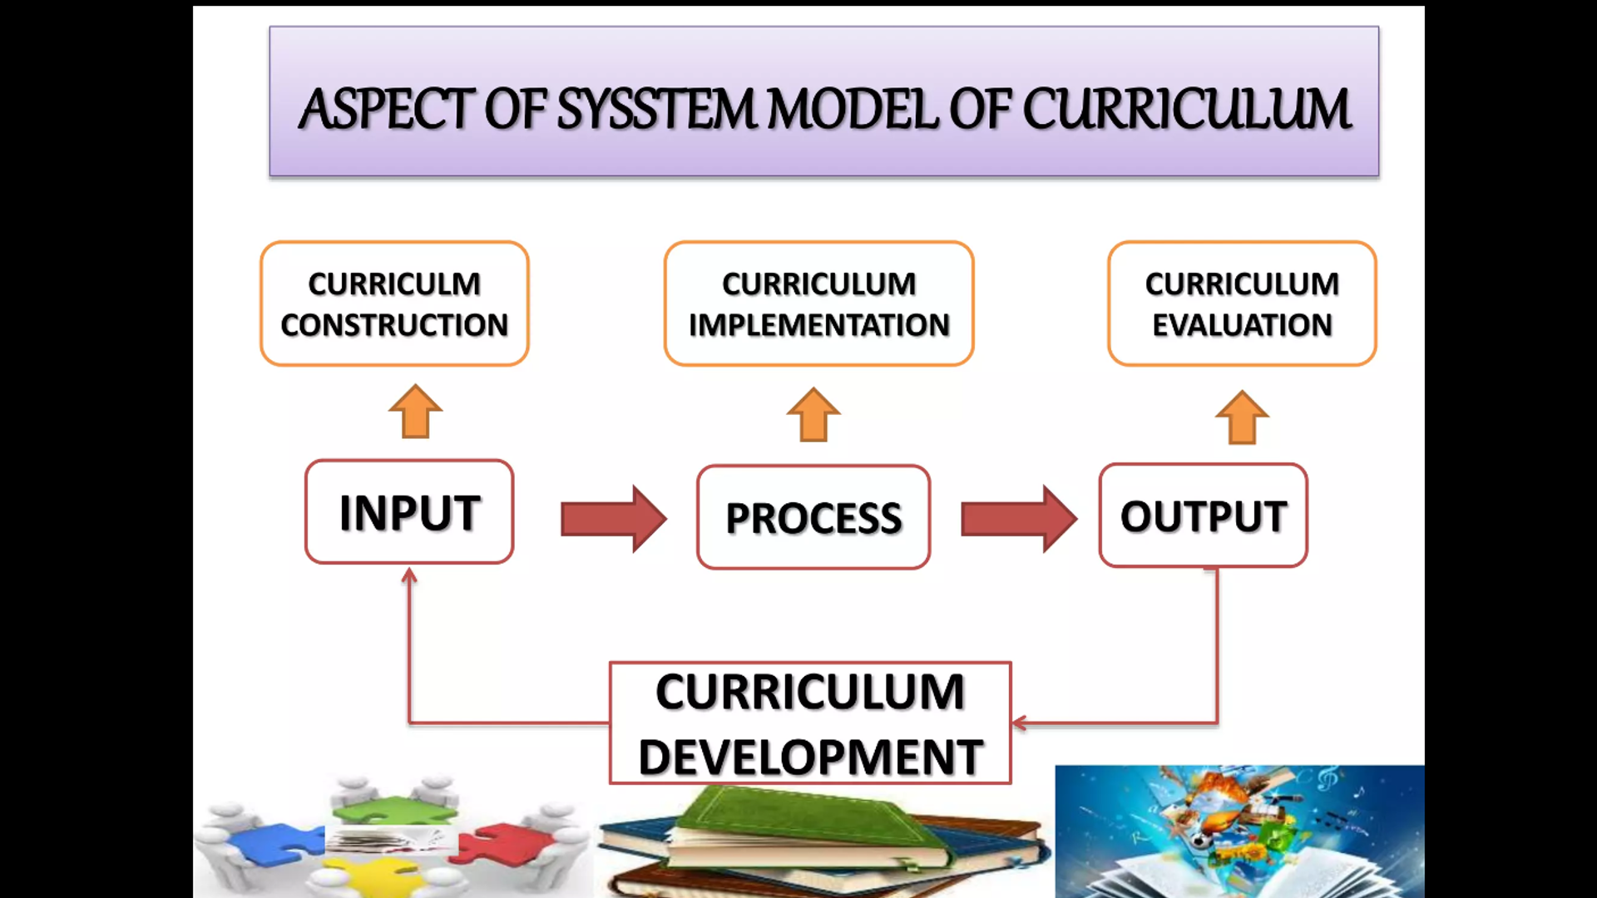

Slide 8
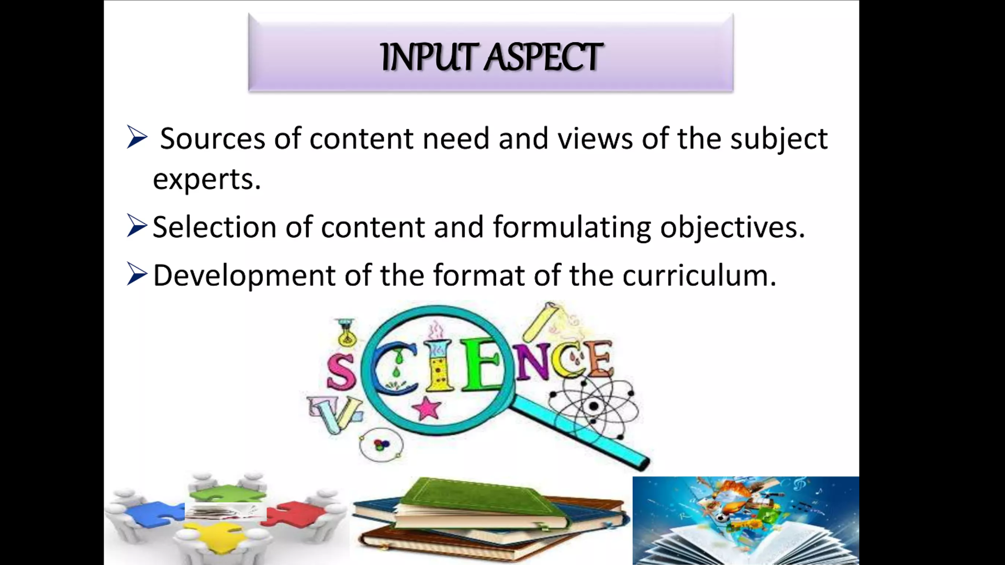

Slide 9
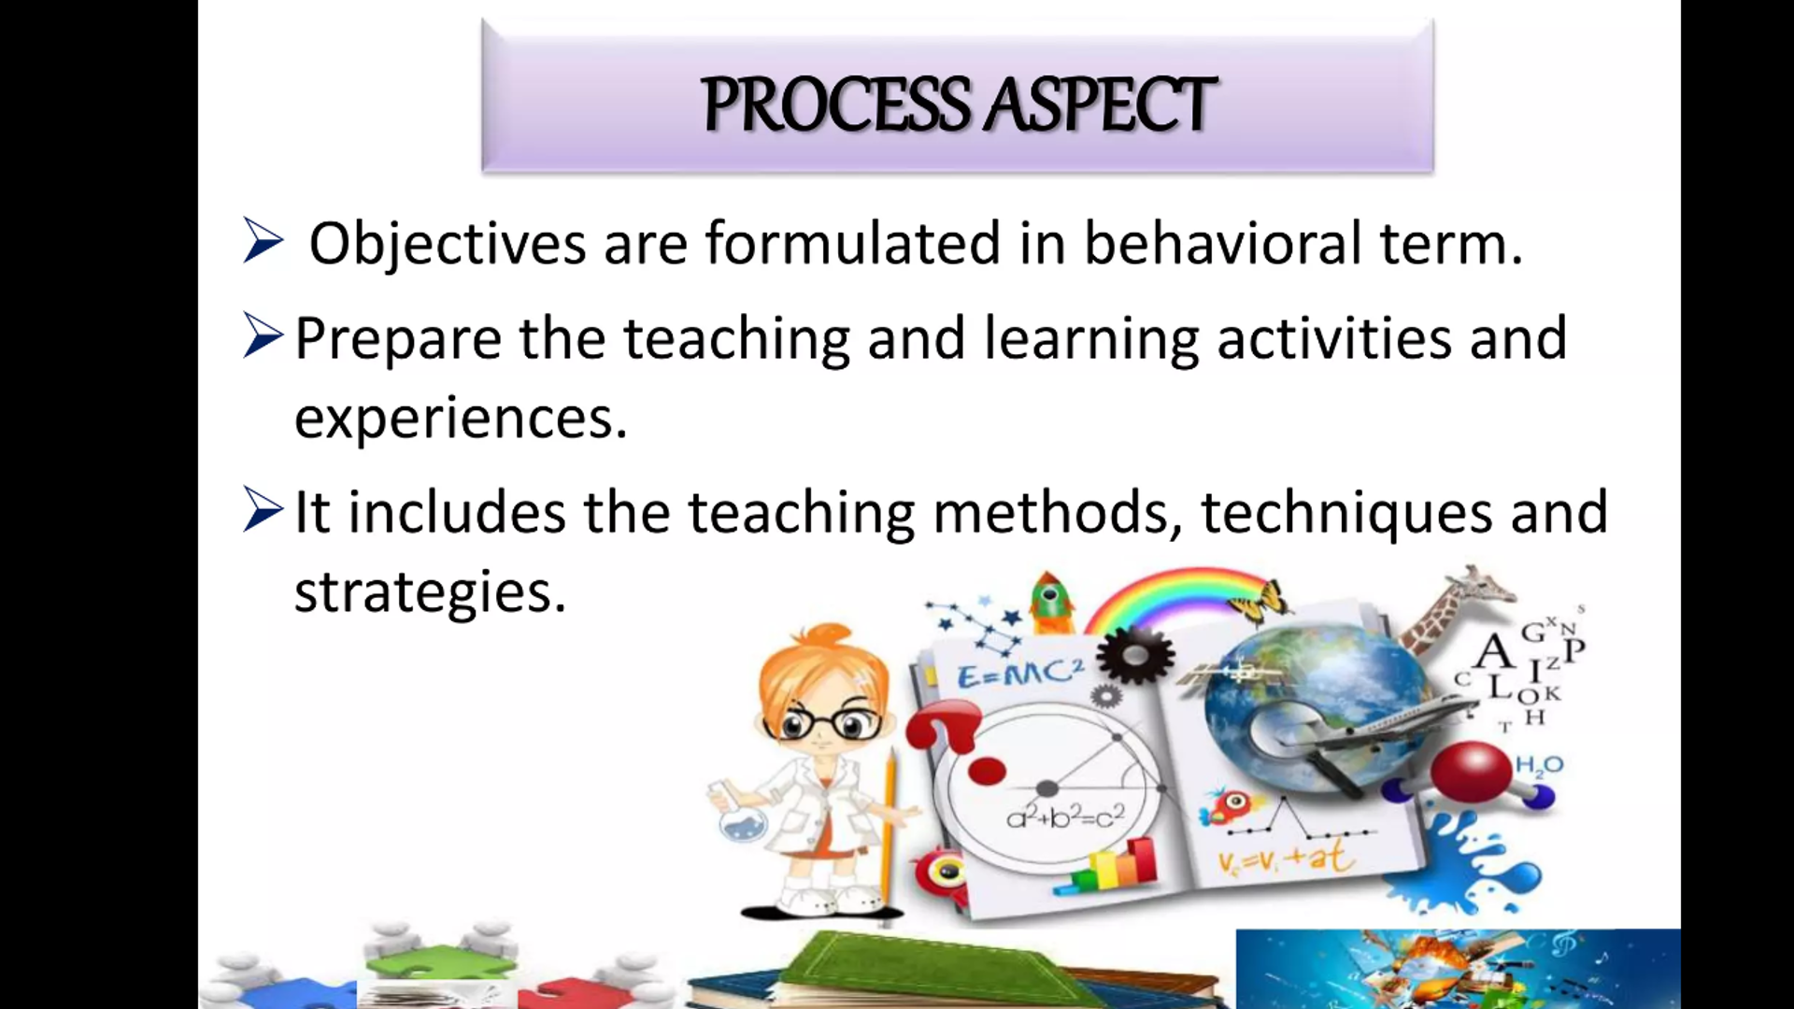

Slide 10
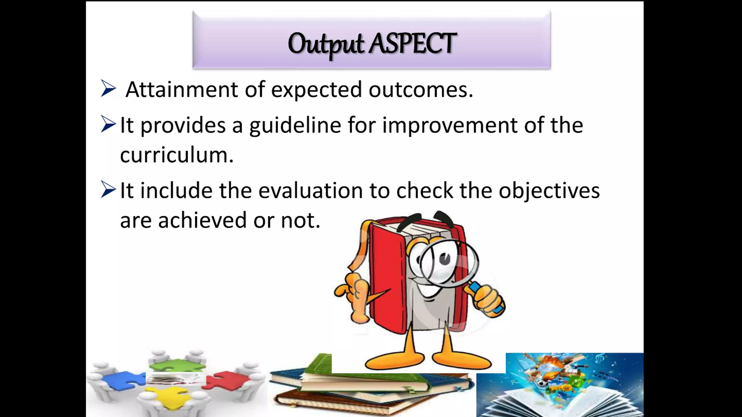

Slide 11
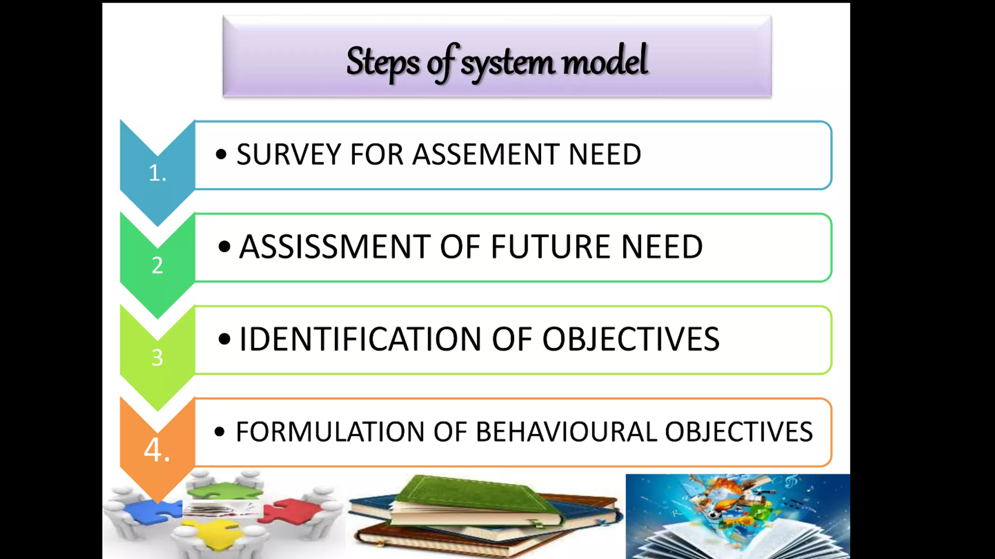

Slide 12
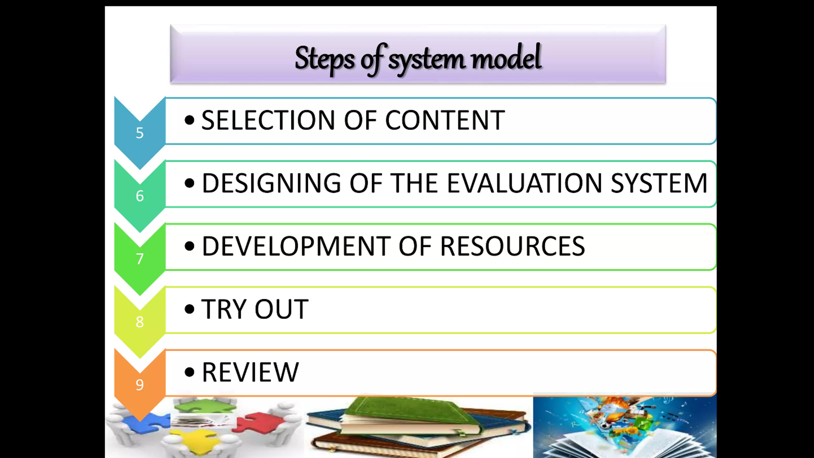

Slide 13
