Slide 1
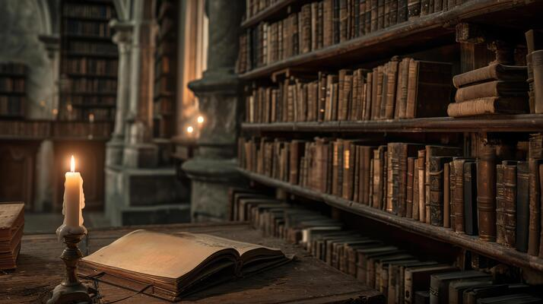
Importance of history room & HISTORY LIBRARY
Prepared by
ANURADHA ROY, ASSISTANT PROFESSOR (NAMCE)

Slide 2
HISTORY CLASSROOM
A history classroom is crucial for effective history teaching because it provides a dedicated space for students to actively engage with the past, critically analyze historical events, develop historical literacy skills, and foster a deeper understanding of the complex forces that shaped the world we live in today, allowing them to become informed citizens capable of making informed decisions about the future; essentially, it serves as a platform to learn from past experiences and apply that knowledge to the present.

Slide 3
But in modern times for the teaching of history a separate equipped classroom with home like atmosphere is now very essential. So C.P. Hill rightly said, ‘ History is a subject with its own techniques and it may fairly be claimed that it need its own room for their effective use. Many of essential aids cannot easily be carried about the school; the history pupil requires atlases and reference books at hand,…. Moreover, an atmosphere favorable to the study of history should be created and this can be far more readily achieved if history rooms are set up where work done and in progress visible.’

Slide 4
Key reasons why a history classroom is important:
1. Interactive learning environment:
A classroom allows for discussions, debates, group projects, and presentations, which are essential for students to explore different perspectives, challenge assumptions, and build critical thinking skills when analyzing historical events.
2. Access to primary sources:
Teachers can utilize primary sources like documents, artifacts, and visual materials within the classroom to provide students with direct access to historical evidence, allowing them to interpret the past firsthand.

Slide 5
3. Visual aids and technology:
Maps, timelines, and digital tools can be used effectively in a classroom setting to help students visualize historical contexts, understand chronological order, and connect different events.
4. Collaborative learning:
The classroom environment encourages collaboration among students, allowing them to learn from each other's perspectives and interpretations of historical events.
5. Inquiry-based learning:
A dedicated history classroom facilitates a structured approach to inquiry, where students can ask questions, research topics, and develop their own understanding of historical narratives.

Slide 6
6. Cultural awareness:
By studying diverse historical perspectives and experiences, students can gain a broader understanding of different cultures and societies, promoting empathy and tolerance.
7. Civic engagement:
A good history classroom cultivates active citizenship by encouraging students to analyze contemporary issues through the lens of history, fostering a sense of responsibility for their communities.

Slide 7
A history classroom should have contain the following equipment :
Albums 10. Art Gallery
Maps 11. Audio Aids
Charts 12. Visual Aids
Wall sheets 13. Textbooks
Flags 14. Reference books
Time lines 15. Bulletin Board
Time graphs
Models
Museaum

Slide 8
1. Albums: Pictures relating to different topics in history
2. Maps: Historical, Economical, Geographical , Political and Social maps of all the countries.
3. Charts: Printed charts and pictures should be kept in the history room. Moreover, charts prepared by both the students and teachers should be kept.
4. Wall sheets: The wall sheets like charts, diagrams and posters on which selected information about the teaching of history is presented
5. Flags: Flags of different nations of the world should be kept in the classroom.
6. Time lines: The history classroom should provide a time lines. Important dates and persons should be marked appropriately all along the time while teaching.

Slide 9
7. Time graphs: There are show the gradual and incidental rise and fall of the dynasties.
8. Models: Models are just like the real things. The pupils should also be encouraged to prepare models connected with the different topics under the guidance of the teacher.
9. Museum: The museum contains coins, tools, dress, statues, pottery, weapons, ancient paintings etc. These are exhibited in the history classroom.
10. Art Gallery: Beautiful and important paintings of Ancient, Medieval and Modern history arranged in class-wise and in chronological order in the history classroom.

Slide 10
11. Audio Aids: Radio, Tape-recorder, Gramophone are to provided in the classroom.
12. Visual Aids: The history classroom contain film-projector, filmstrip projects.
13. Textbooks: Collection of books as planned to teach a particular course in history must be available in the history classroom
14. Reference Books: Good historical dramas, novels, pictorial books, books and culture of the civilization of the world, history of different countries and their people, history on sociology, geography, auto biography etc. are kept in the classroom
15. Bulletin Board: Some important cuttings and pictures, collected by pupils from magazines, newspapers should be deployed on the bulletin board.

Slide 11
conclusion
History requires a specific equipped classroom. Generally history as a subject was taught in a general classroom . No separate classroom was provided for the teaching of this subject. The teacher only followed the textbook method. Students read the textbook in the class and the teacher explained the difficult word and phrases.
Teaching of history needs students activity and students participation . This can be possible when the students of history provided with a separate classroom with a pleasant atmosphere.

Slide 12
History library
A history library is an individual part for effective teaching history. It skillful guided, a proper foundation of student’s reading habits can be laid. History library may contribute in making history a living and vital discipline. Libraries are important for teaching history because they contain primary and secondary sources that help historians research and learn about the past. History library gives suitable opportunities to the pupils to use facts in a creative and productive way to arrive at a conclusions and enable them to grow knowledge, abilities, skills and interests. So history library is hub of history teaching.

Slide 13
Essential Equipment For The Library
Shelves
2. Tables and Chairs
3. Filling Cabinets for Catalogue Cards
4. Racks for Newspapers and Magazines
5. Bulletin Boards
6. Storage Room and Work Room

Slide 14
Important Library Resources for History
a. Book resources
I. Text-books II. Unit Booklets III. Reference materials IV. Library materials V. Source books
b. Non-book resources
i. Periodicals ii. Pamphets iii. News papers iv. Special documents and publications v. AV Materials

Slide 15
Key reasons of Why history library is important?
Primary and secondary sources: Libraries have collections of letters, documents, and other materials that are used as sources for historical research.
Ancient and medieval manuscripts: Some libraries have manuscripts that are important to scholars.
Historic buildings: Some libraries are historic buildings themselves.
Research skills: Students can learn how to use the library to conduct research.
Academic resources: Libraries have books, journals, multimedia materials, and other academic publications that students can use for research.
Study areas: Libraries have study areas and computer workstations that students can use.

Slide 16
Important library resources
The book resources can be categorized as under---
Textbook: A number of good textbooks in history, geography, civics, economics and social science are available in the library. New and revised editions of standard text books must be kept in the library for upto date knowledge.
Unit books: A number of unit booklets on a variety of topics should also be available in the library.
Reference materials: The library should be well-equipped books reference materials- standard or conventional reference books and non- conventional reference books
The library should be contain books of fairy tales, discovery and exploration, heroism, mythology, patriotic stories, scientists, science, and various kinds of encyclopedias.

Slide 17
Function of History Library:
1.Providing materials of instruction and reading: The school library renders valuable service to both the teacher and the pupil by providing a wide variety of text and reference books, related to various school subjects. It provides a lot of reading material to the pupil for answering questions, doing assignments and solving problems.
2. Stimulating reading for enjoyment and recreation: The school library contains number of books of general interest, both for the pupils and the teachers. Interesting story-books, biographies, books on travels, adventures, inventions and discoveries etc. motivate pupils and stimulate reading for the sake of recreation and enjoyment.
3. Teaching the techniques of searching references: School library teaches the techniques of searching reference by a proper use of variety of material , contained there in. A definite procedure in followed in purchasing, organizing, storing, issuing and receiving books, periodicals and other materials in the library room.
4. Providing opportunities to pupils to assume responsibilities: The pupils are taught to keep books with care , to serve on library communities , to act as library service. They learn to work in co-operation with others, to help other pupils in the selection of books and to assist them in the solution of some of their problems.

Slide 18
Suggestions for motivating pupils to utilize library
Interactive displays: Use eye-catching displays, book trailers, and themed corners to highlight new releases, popular genres, or specific topics.
Curate a diverse collection: Ensure the library has books across various genres, reading levels, and interests to cater to diverse student needs.
Reading challenges and incentives: Organize reading challenges with rewards for reaching milestones, like book-themed prizes or special privileges.
Author visits and book talks: Invite authors to visit the library for presentations, Q&A sessions, and book signings.
Collaborative learning activities: Encourage group projects where students research and present information from library resources.
Digital literacy workshops: Teach students how to effectively navigate online databases, e-books, and digital research tools.
Personalized recommendations: Train library staff to provide tailored book suggestions based on student interests.
Book clubs and discussion groups: Foster a community around reading by creating book clubs with facilitated discussions.
Creative spaces: Design designated areas for reading, group work, or quiet study with comfortable seating and aesthetics.

Slide 19
CONCLUSION
We must have to ensure the library is accessible to all students with diverse learning needs and create a welcoming and supportive environment with friendly staff. Regularly evaluate the library's offerings and adapt to student needs and interests.

