Slide 1
listening
Paper-4
Unit-ii

Slide 2
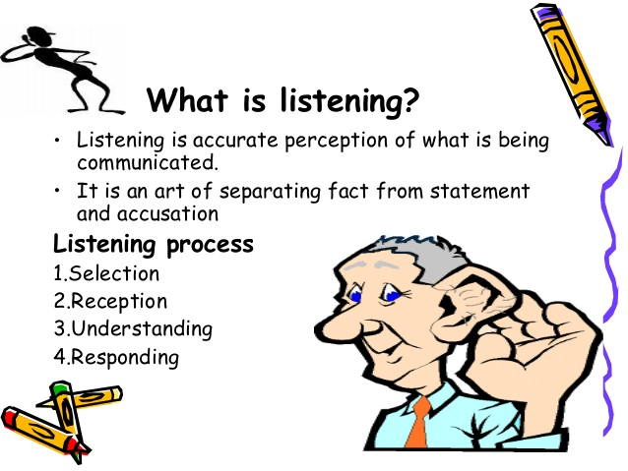

Slide 3
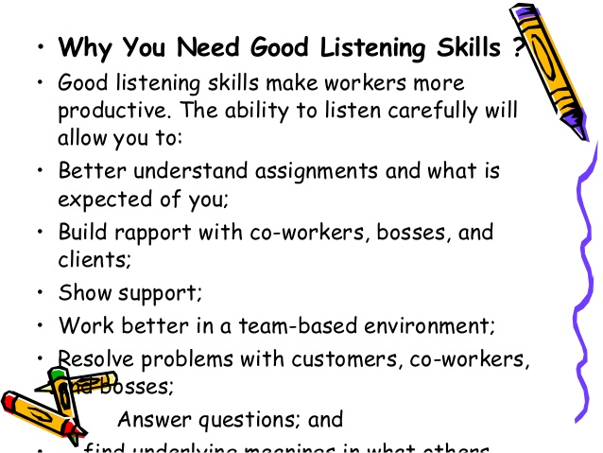

Slide 4
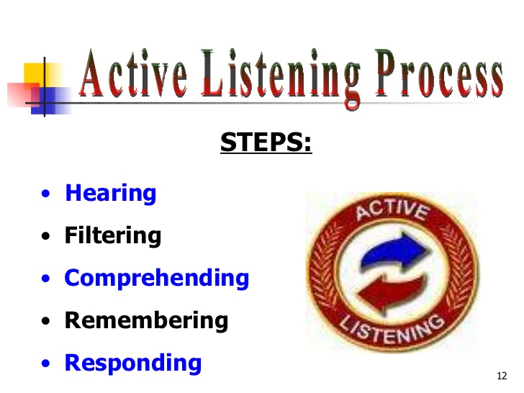

Slide 5
Types of listening
Casual listening: often we listen to someone or something without any particular purpose. At such times, we do not listen to them with much concentration, unless we hear something which interests us. This type of listening is often found in social contexts when we interact with others.
Focussed listening: it is the ‘intensive listening’ for information or transacting business. The listener in attentive and concentrates on what the speaker is saying.

Slide 6
Purpose of listening
Listening to talk or lecture.
Participating in a meeting, seminar, debate or discussion.
Participation in conversation.
Listening to announcement at school and at public places outside school.
Talking part in a school.
Participating in a telephone/mobile conversation.
Listening to record/broadcast music, news, sports commentataries, weather broadcast, etc.
Watching a film, play or TV programme.
Being interviewed.
Being tested orally in a subject of study.

Slide 7
Different kinds of listening materials
Authentic listening materials.(exam hall, sports commentary, radio recording, announcement made at railway station, bus stop and at the airports)
Recorded listening materials.
Live listening materials.

Slide 8
The listening task/activities
Extensive listening (for interest/entertainment).
Intensive listening ( listening very carefully).
Listening for perception (practice languages at the primary/middle school).

Slide 9
Method generally followed in classroom
Story based method.
Task-based teaching.

Slide 10
Barriers to listening
The listener may not have listened to something properly.
He may have listened to it properly but may not have comprehend the message because of difficult words or the sentence patterns used.
He may have heard the speaker but may not have listened to him because of pre-occupation of his mind with something else.
He may have listened to and understand the speaker but may not have succeeded in interpreting the massage because of lack of previous knowledge.

Slide 11
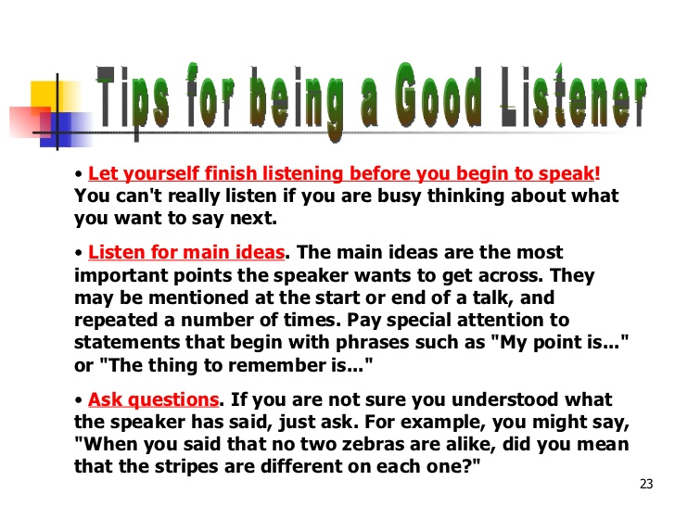

Slide 12
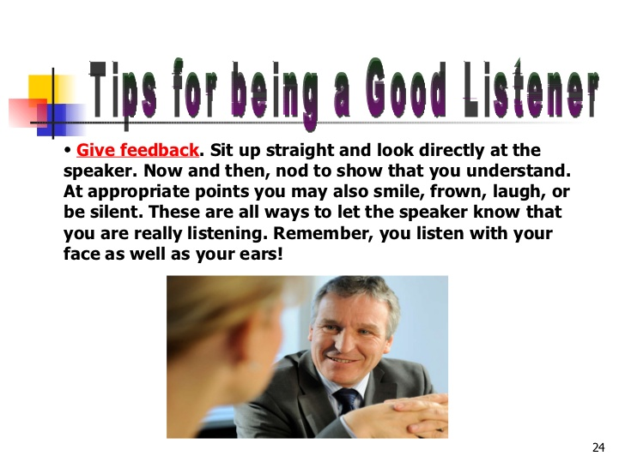

Slide 13
Thank you

