Slide 1
Dimension of competence
Paper-4
Unit-II

Slide 2
competence
the ability to do something successfully or efficiently

Slide 3
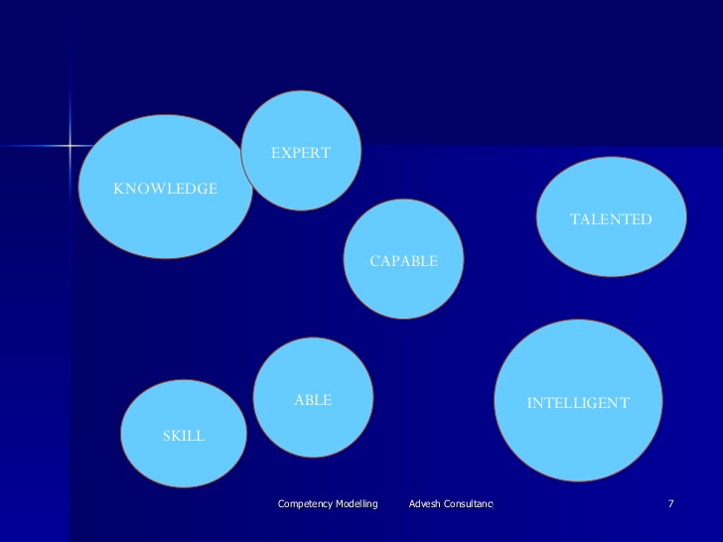

Slide 4
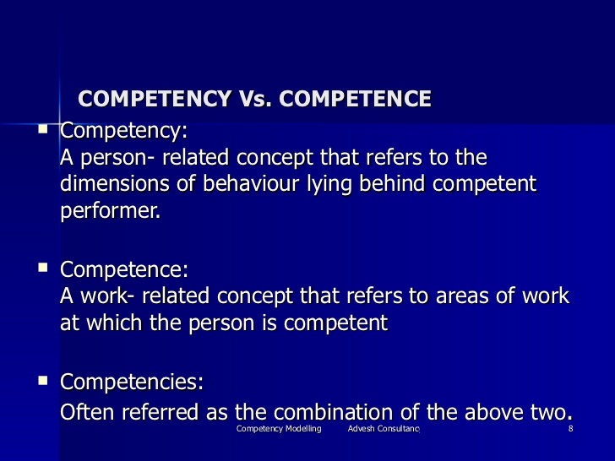

Slide 5
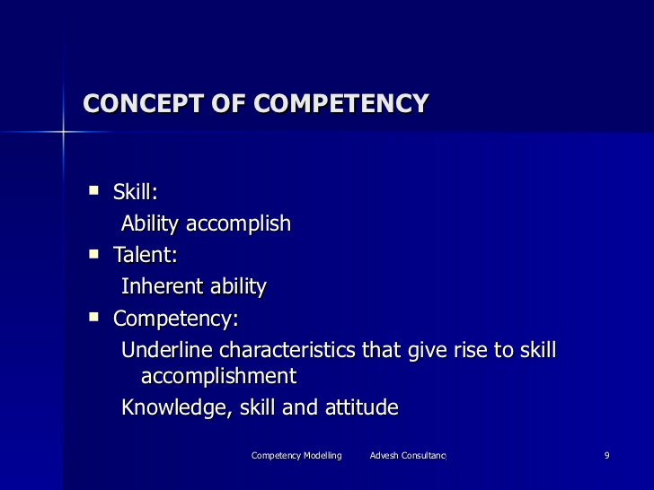

Slide 6
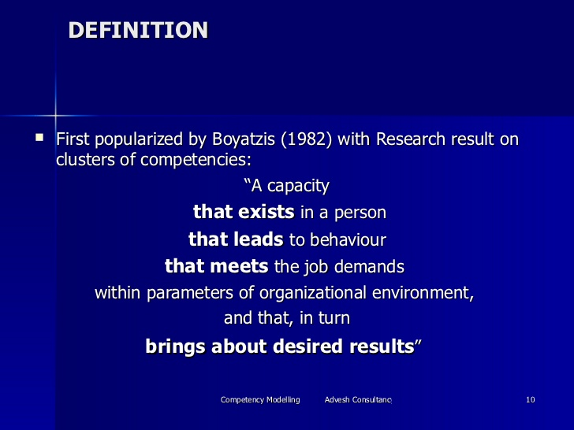

Slide 7
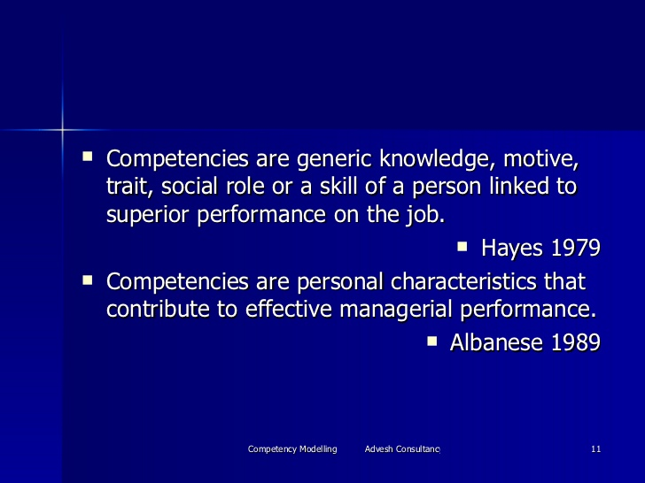

Slide 8
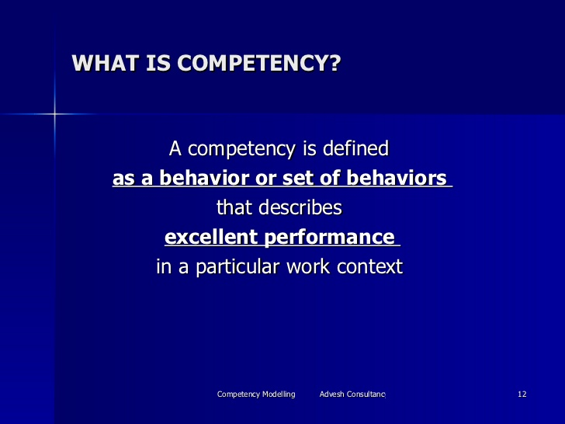

Slide 9
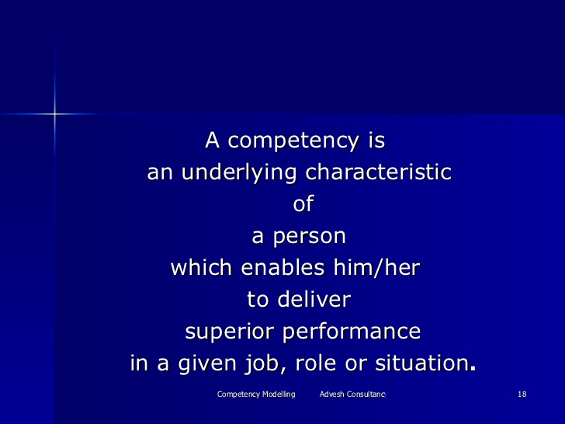

Slide 10
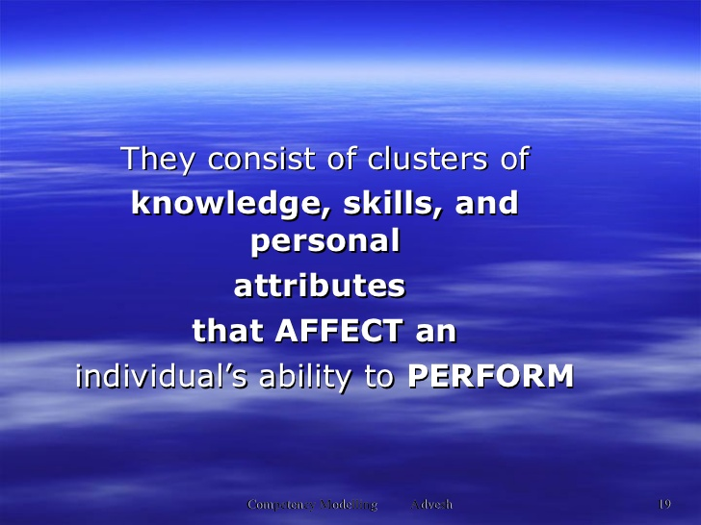

Slide 11
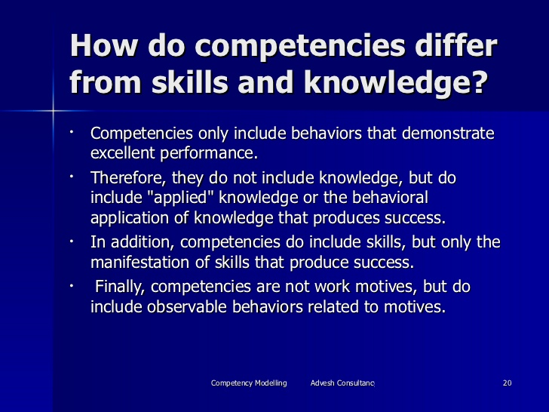

Slide 12
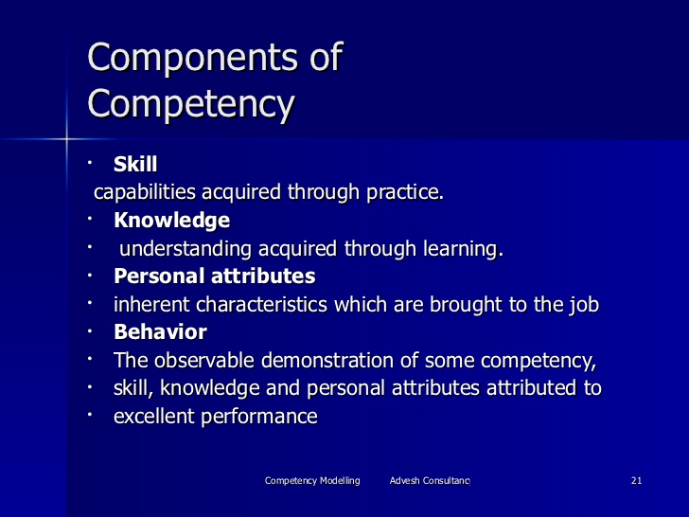

Slide 13
How do you know that students have learned a languahe?
We can assess students using formative and summative assessments.
But how do we know that students will actually be able to use their language in real life, authentic situations?
In short, how do we know that our students are competent in the target language?
One way to judge this competency is through students performance.
However, how do we evaluate whether this performance is an accurate measure of what students actually know?

Slide 14
Competence for learning
Learning style.
Reasoning
Creativiaty
Positive motivation.
Key skills.
ICT skills

Slide 15
Thank you

