Slide 1
Skinner’s Operant Conditioning Theory

Slide 2
Definition of Operant Conditioning
Operant conditioning refers to a kind of learning process whereby a response is made more probable on more frequent by reinforcement. It helps in the learning of operant behaviour, the behaviour that is not necessarily associated with a known stimuli.

Slide 3
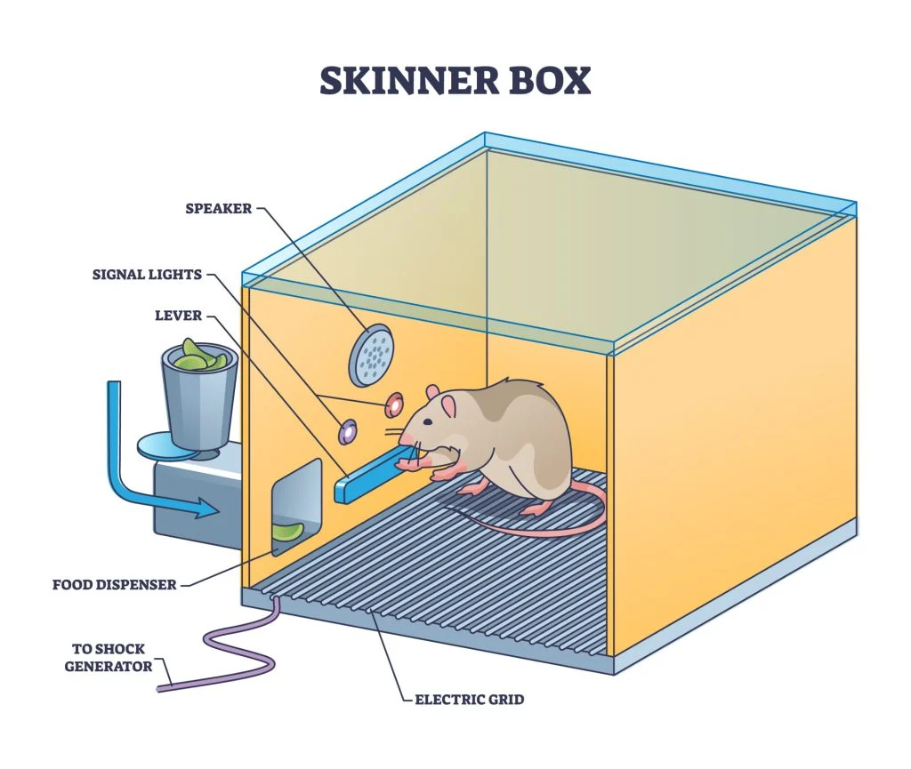
B. F. Skinner Experiment
Skinner box or Operant chamber :
A simple box with device at one end that can be worked by animal in the box.
Rats, cats, monkeys (lever)
Pegion (key for pecking)

Slide 4
Operant Conditioning
Reinforcement
Punishment
Positive Reinforcement
(Adding Good)
Negative Reinforcement
( Removing Bad)
Strengthening of Behaviour
Presentation Punishment
(Adding Bad)
Removal Punishment
(Removing Good)
Decreasing or Suppressing of Behaviour.

Slide 5
Schedules of Reinforcement
Continuous Reinforcement
Partial Reinforcement
Reinforcement after every response
Interval
a) Fixed
b) Variable
2. Ratio
Fixed
Variable

Slide 6
Reward
Reinforcement
Reward is a subjective interpretation of behaviour associated with pleasure events.
Reinforcement is simply defined as an effect that increase the probability of a response.

Slide 7
Educational Implication
The principle of operant conditioning may be successfully applied in behaviour modification.
Operant conditioning emphasizes the importance of schedules in the process of reinforcement of behaviour. In trying to impart or teach a particular behaviour therefore great care should be taken for the proper planning of schedules of reinforcement.

Slide 8
In its most effective application, the theory of operant conditioning has contributed a lot to the development of teaching, machines and programmed learning. The theory of operant conditioning has shown that learning proceeds most effectively if
The learning material is so designed it produces fewer chances for failure and more opportunities for success.
The learner is given rapid feedback concerning the accuracy of his learning.

Slide 9
Thank You .

