Slide 1
Role of Mass-Media
By Anuradha Roy
Assistant Professor, NAMCE(B.Ed)

Slide 2



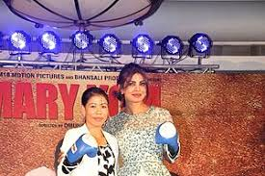

Slide 3



Slide 4
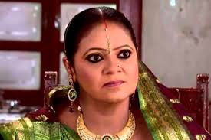
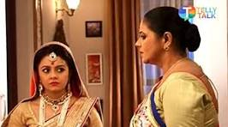


Slide 5
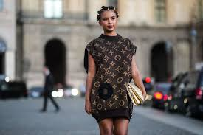
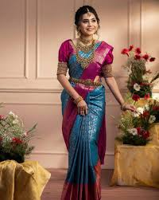
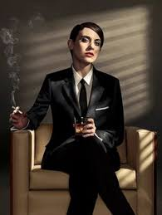

Slide 6
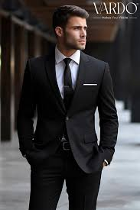
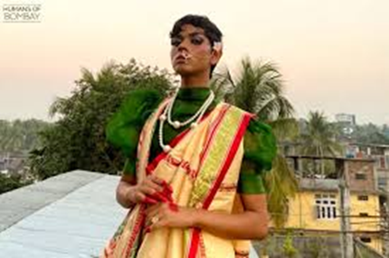

Slide 7




Slide 8

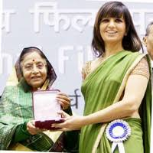
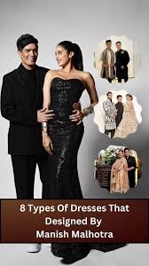
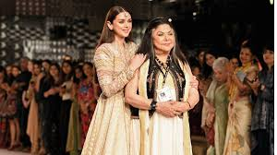

Slide 9
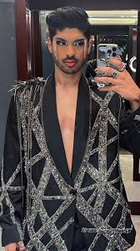
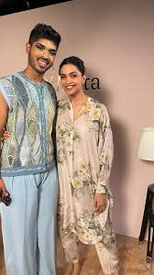

Slide 10
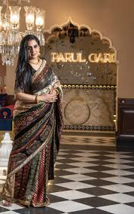


Slide 11



Slide 12
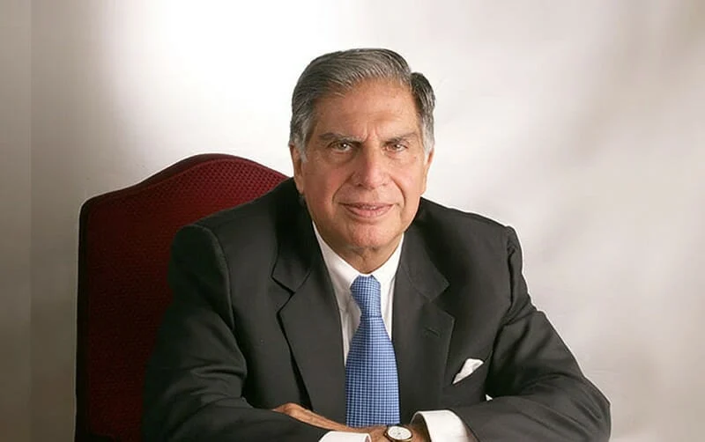


Slide 13
Media should not always represent women in all the advertisement or serials through the television as in traditional role of as wife or as mother.
Avoid Stereotypical role in mass media.

Slide 14
Promotion of mixed school or co-education .
Equal participation in school\college programme both male and female should be shown.

Slide 15
The media can be an important factor in the promotion of gender equality both within the working environment and in the representation of women and men.

Slide 16
Media should represent the relationship between women and men in a gender sensitive way.

Slide 17
Media can promote a balanced gender representation in and through the news (Print as well as electronic).
Media should not always represent women all the advertisement or serials trough the television as in traditional role of as wife or as mother.

Slide 18
Media should give high priority to the subject of portraying women as equal as men in society , which can act as the tool in removing gender disparity.
Media should portray the women as independent character, as modern, liberated women rather than a consumer.

Slide 19
To challenge gender sterotyping , media should put emphasis on economic, social, educational participation and contribution made by women-rather than representing them as inferior , unimportant.
Media can reinforce female self-consciousness through its varied programme.
Interviews of women should not be limited to certain accepted profession such as educations or doctors, they should be shown in wide spectrum of profession.

Slide 20
Media can help in generating the interest of women in acquiring knowledge sport, national and international politics and engaging them towards more effective participation of national affairs.

Slide 21
Media can organize public awareness campaign via-Television, radio, different social media platform etc. for altering attitudes towards traditional gender norms

Slide 22
The media coverage of women should be increased so that women get more opportunities to present their opinion.
Media should represent the relationship between women and men in a gender sensitive way.

Slide 23
Both men and women should be potrayed in stereotypical images that emphasis passive, submissive, qualities and encourage them to play a subordinate secondary role in the family and society.
The children must not be potrayed in deregatory stereotyped ways in the advertisements.

Slide 24
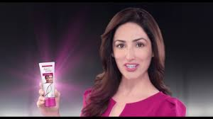
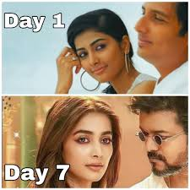


Slide 25


