Slide 1
Type of Hero
  1.Dhiroddhatha
  2.Dhira Lalitha
  3.Dhirodatta
  4.Dhira Prasantha

Slide 2
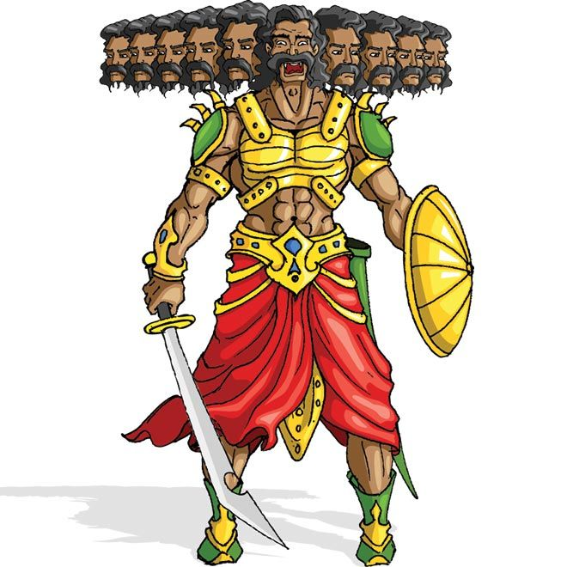
Dhiroddhatha

Slide 3
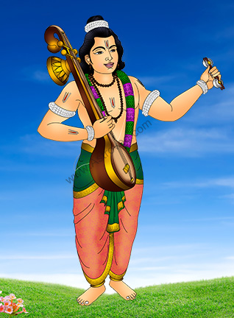
Dhira Lalitha

Slide 4
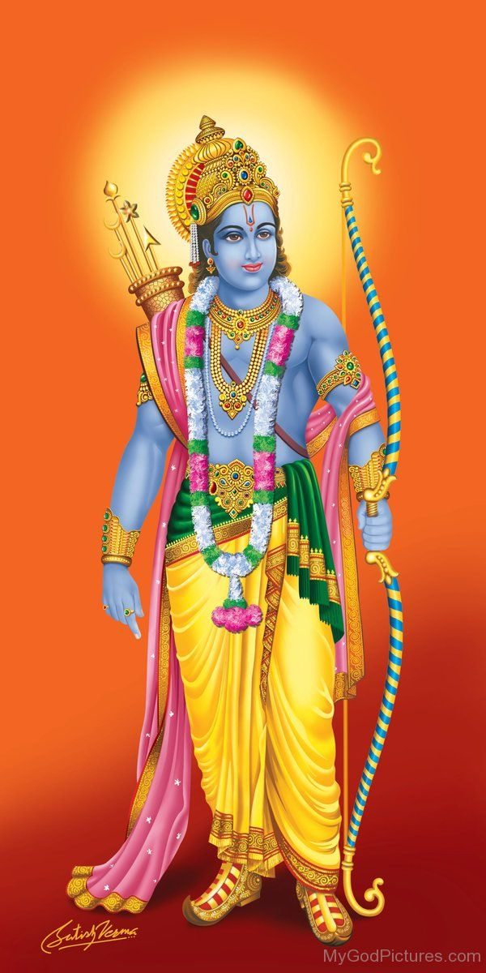
Dhirodatta

Slide 5
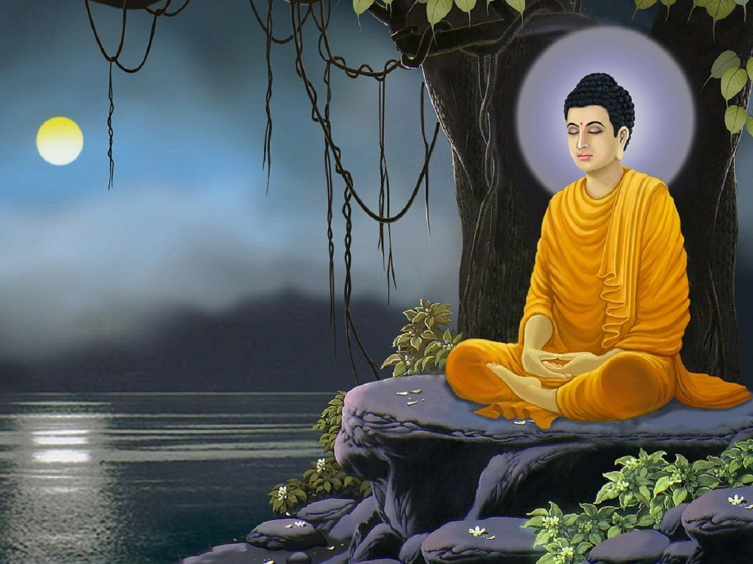
Dhira Prasantha

Slide 6
Types of heroes according to the nature of Love
Sattur
Uttama
Madhyam
Adhama
Hongaprabiddha

Slide 7
types of nayika
1.Vasakasajja
2.Virahotkanthita
3.Svadhinabhartruka
4.Kalahantarita
5.Khandita
6.Vipralabdha
7.Proshitabhartruka
8.Abhisarika

Slide 8
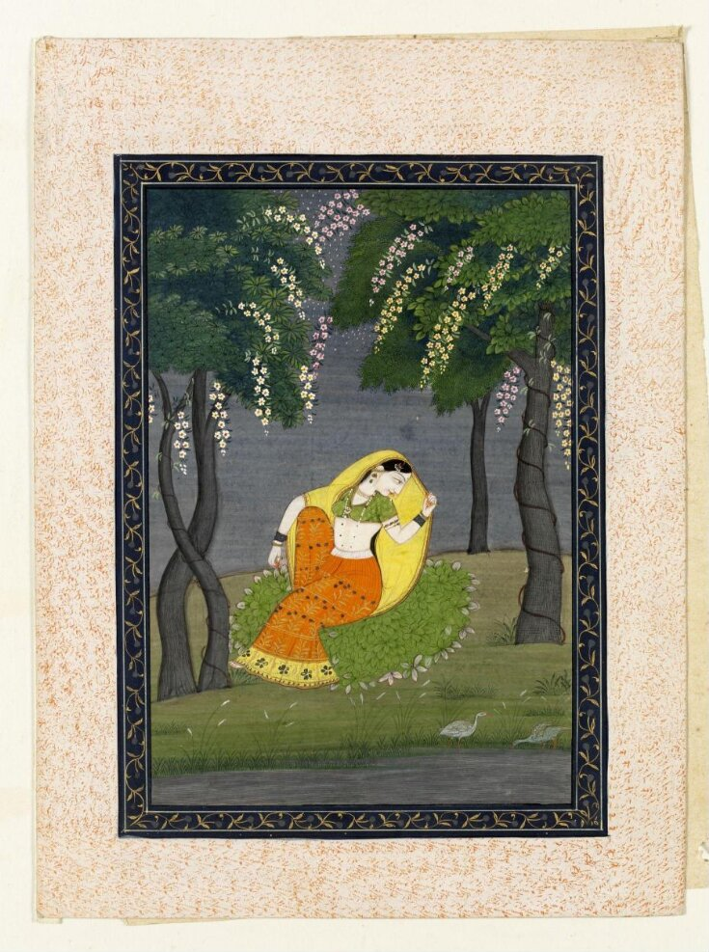
Vasakasajja

Slide 9
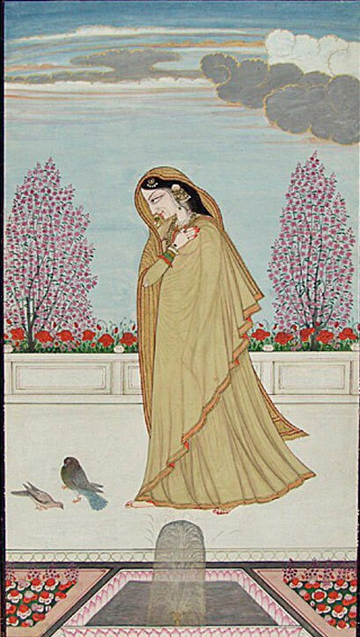
Virahotkanthita

Slide 10
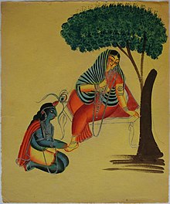
Svadhinabhartruka

Slide 11
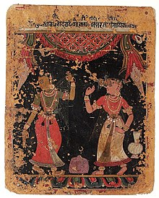
Kalahantarita

Slide 12
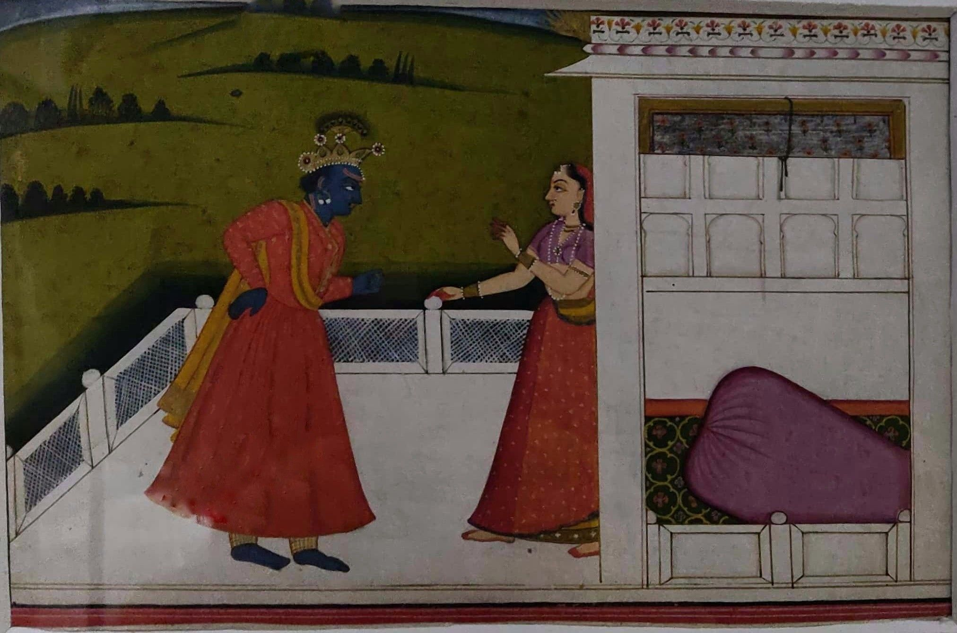
Khandita

Slide 13
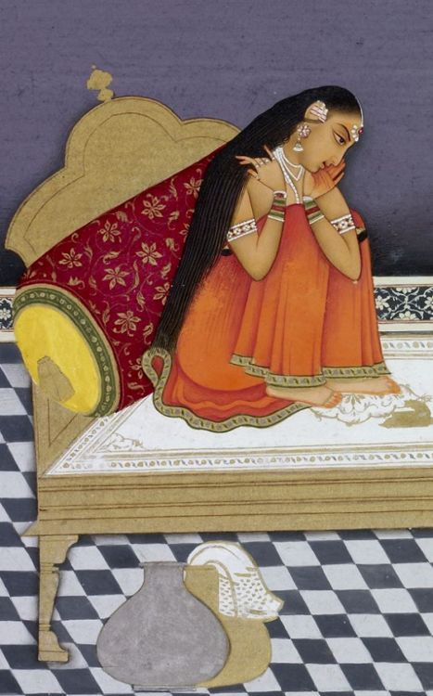
Vipralabdha

Slide 14
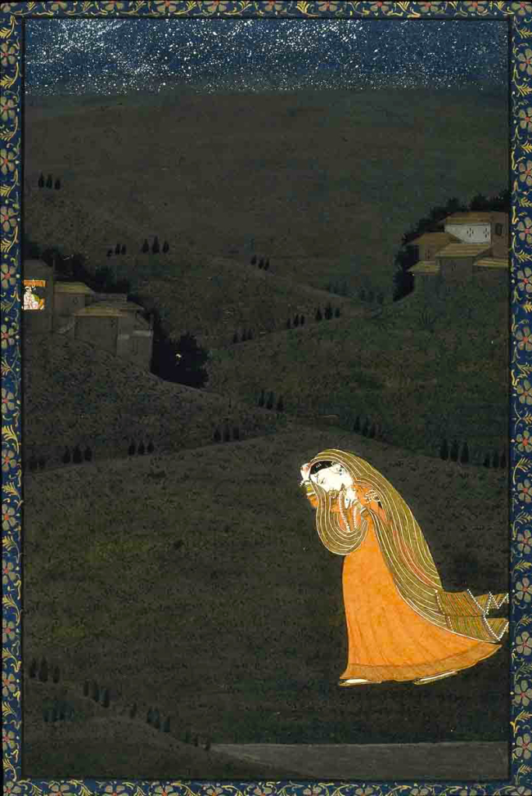
Proshitabhartruka

Slide 15
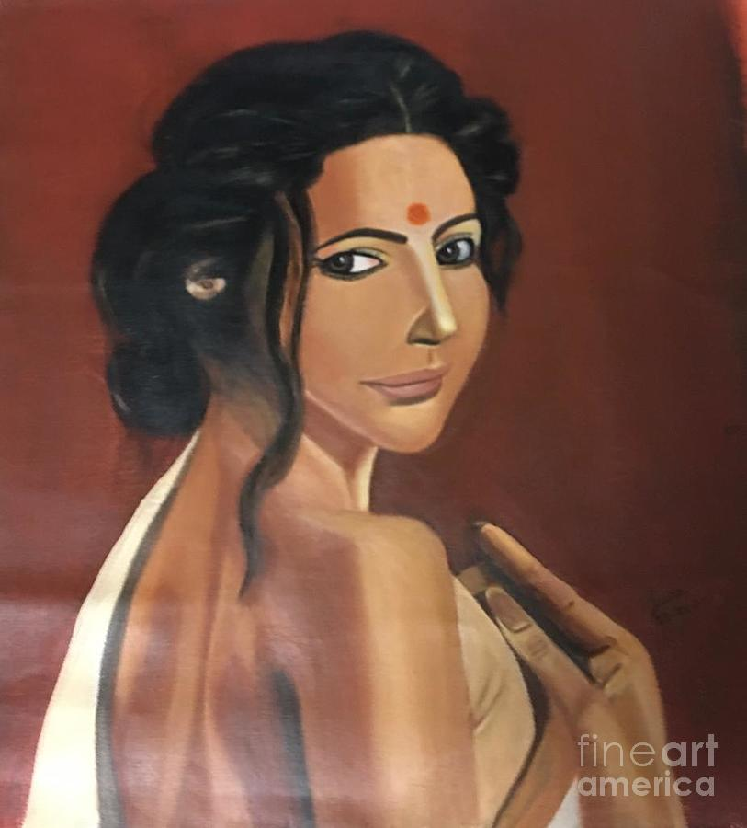
Abhisarika

Slide 16
mugdha nayika
Praudha nayika
Dheera nayika

