Slide 1


PAPER :-08
GENDER ISSUES AND
CONCERNS
TOPIC:- Define the term sex and gender.
Difference between sex and gender
Assistant Professor of Nazir Ajmal Memorial college of Educatio.
Mrs Sangita Sutradhar

Slide 2
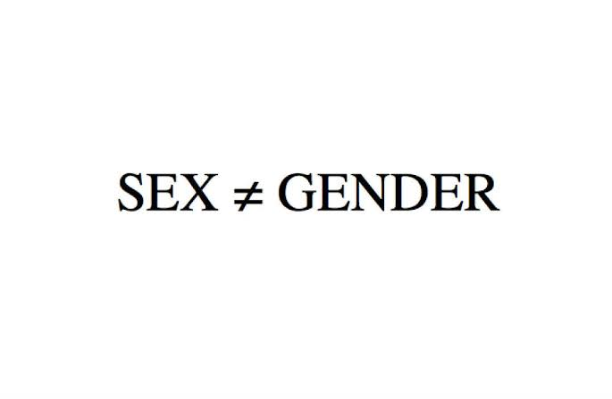
INTRODUCTION
Throughout the history,most people ordinarily seem to think that sex and gender are coextensive.People often use the term “SEX” and “GENDER” interchangeable.But now a days,the concept regarding these two terms has developed.

Slide 3
SEX
SEX describes the biological differences between men and women which are universal and determined at birth.
“SEX” refers to the biological features such as:
Chromosomes
Organs
Hormones
Other physical features
Generally male or female.

Slide 4
GENDER
Gender is perceived as socially constructed.
These are socially constructed roles, behaviors, and attributes that a society considers appropriate for men and women.
It refers to the roles and responsibilities of men and women; created in different cultures.
It is the social elaboration of biological sex.
Roles and expectations are learned.
Changes with time.

Slide 5
Gender is that force which contribute to the patterning of social life.
It explains difference between men and women.
Gender is something we do and perform.

Slide 6
Difference between SEX and GENDER
SEX | GENDER
Refers to the biological characteristics that define men and women. | Refers to the socially constructed roles, behaviour that are appropriate for men and women.
Male and Female are sex categories | Masculine and feminine are gender categories
Determined by organs by birth | Determined by social roles based on gender
Denotes physical differences between male and female | Denotes behavioural and cultural practice.

Slide 7
SEX | GENDER
Sex refers to the biological and physiological difference between men and women | Gender refers to the socio and cultural difference between men and women
Sex has two main categories: male and female. | Gender has two main categories: Masculine and Feminine
Concept of sex is same all over the world | Varies between and within the societies.
Can’t be changed by time | Changes over time

Slide 8

CONCLUSION
Thus Sex is usually categorized as female or male but there is variation in the biological attributes that comprise sex and how those attributes are expressed.
Gender refers to the socially constructed roles, behavior's, expressions and identities of girls, women, boys, men, and gender diverse people

Slide 9
Thus,it becomes important to learn the difference between the sex and gender of a person.
• In order to get proper knowledge,children should be taught from a young age about the concept of sex and gender.

Slide 10
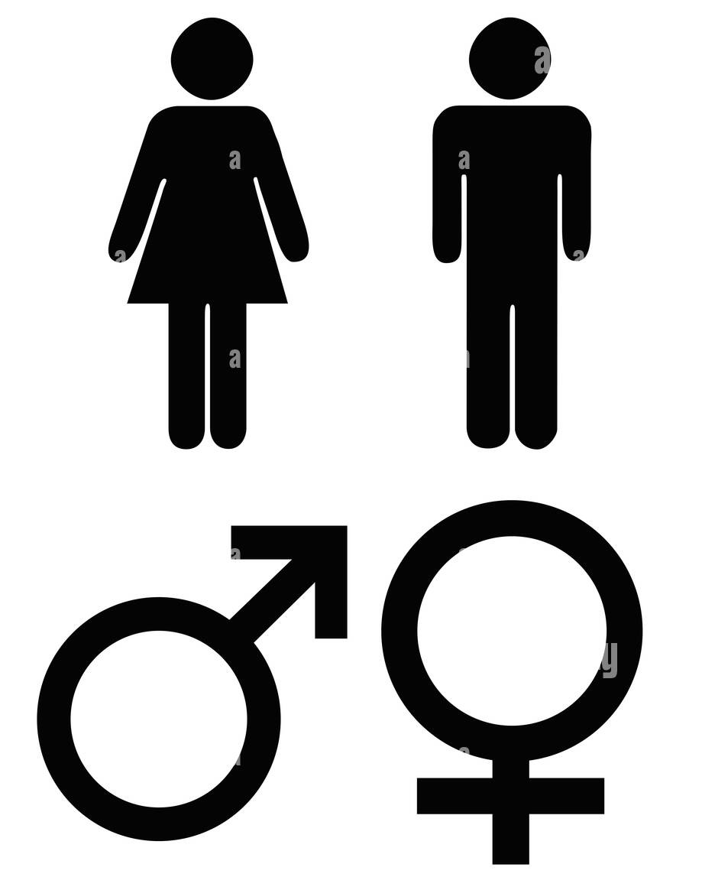
THANK YOU

