Slide 1
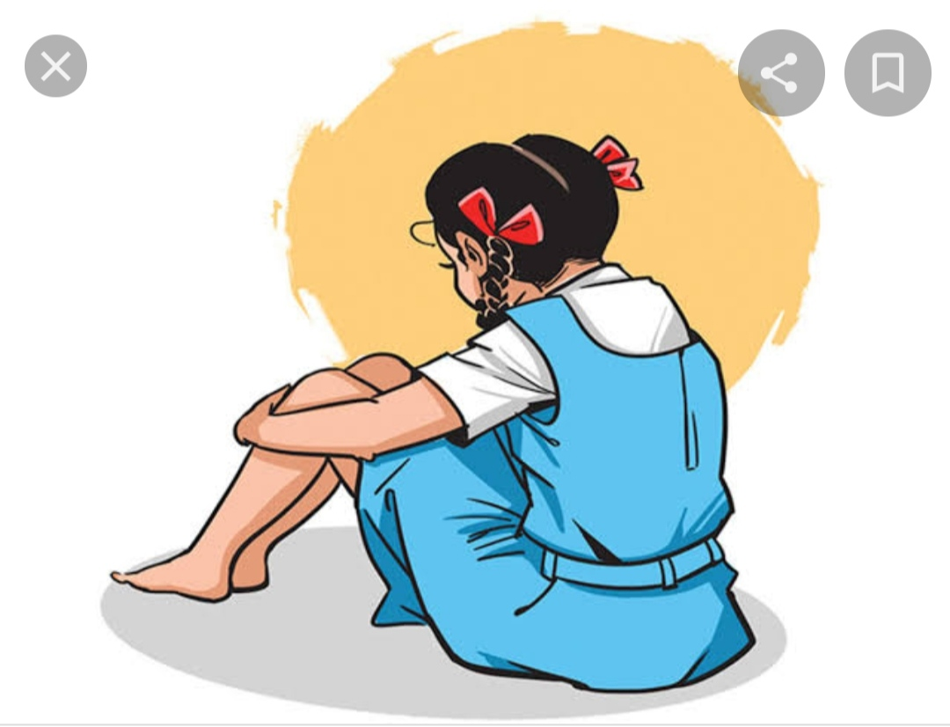
Inclusion of Girl Children in Education- Concept
Inclusion of girls in education implies making efforts to enable the girls to keep pace with boys and to review education in the perspective of equality as spelt out by various policies. It focuses on addressing exclusion of girls from the school.

Slide 2

Inclusion of Girl Children in Education- Concept
Late Pt. Jawaharlal Nehru rightly stressed on the education of women by saying " Education of boy is the education of one person but education of girl is the education of the entire family. "

Slide 3

Inclusion of Girl Children in Education-Concept
The University Education Commission 1948-49 remarked in view of the importance of education of women-"There can't be an educated people without education of women. If general education had to be limited to men or to women, then opportunity should be given to women, for by them it would more surely be passed to the next generation. "

Slide 4
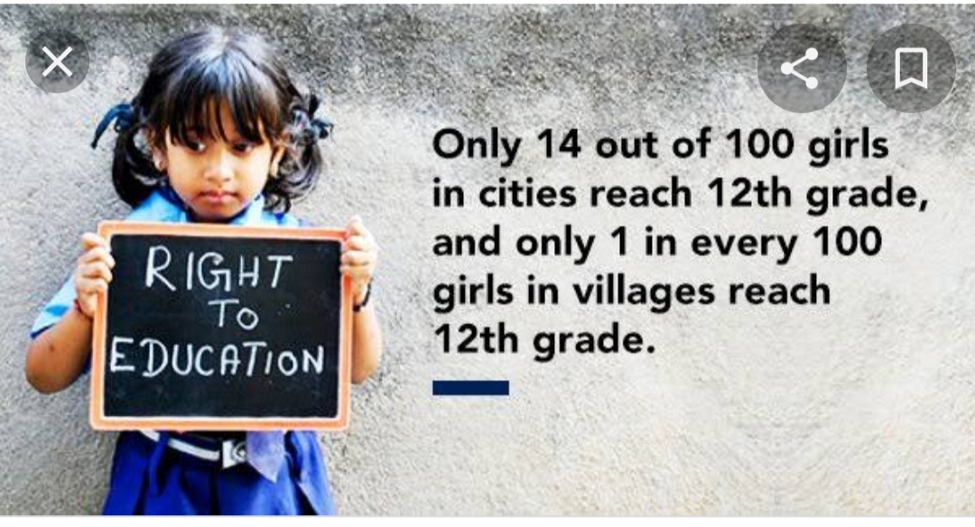
Inclusion of Girl Children in Education-Concept.
The Article 15(1) provides that the state shall not discriminate any citizen on ground only of sex.

Slide 5
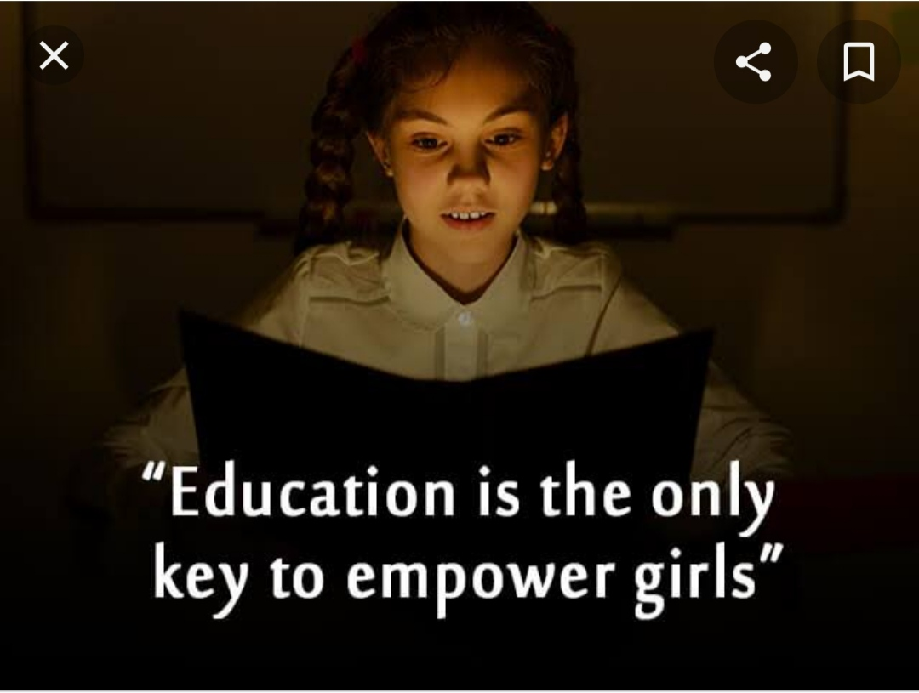
Inclusion of Girl Children in Education
Under Article 15(3) the state can make special provision for education of women and children.

Slide 6

Inclusion of Girl Children in Education-Concept
It is only through the education of women, that we can expect better atmosphere at homes, better hygiene conditions, greater production, greater reduction in fertility rate and happier family life.

Slide 7
Inclusion of girl children means-
Minimising the sex Stero-typing in education.
A challenge to address gender discrimination in education.
Providing measures to address economic, academic, social dimensions that lead to exclusion.
Accessing educational opportunity equally.
Meeting the goals of constitutional objectives framed for education of girls.

Slide 8

Inclusion of girls in education is possible by following measures-
Provisions of transport.
Special escorts for girl children.
Counselling programme that negotiate domestic work burdens of the girls.
Gender training programmes for the teachers for making classroom practices more gender sensitive.

Slide 9
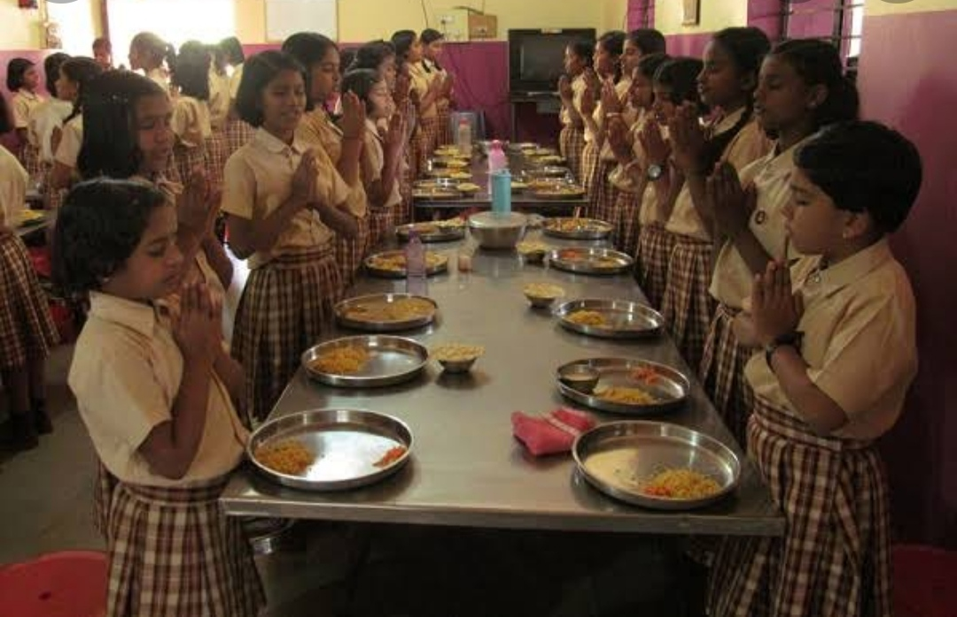
Inclusion of girls in education is possible by following measures-
Provision of gender sensitive curriculum, classroom pedagogy and life skills in the educational programmes..
Setting up of residential schools for girls with all types of facilities.

Slide 10

Inclusion of girls in education is possible by following measures-
Recruitment of more number of women teachers in the schools.
Provision of security to deal with the forms of gender bias in the schools.

Slide 11

Inclusion of girls in education is possible by following measures-
Encouragement of the participation of the parents specially the mother.
Forming of forums of female teachers.
Provision of management system which report on practices of gender based discrimination.

Slide 12
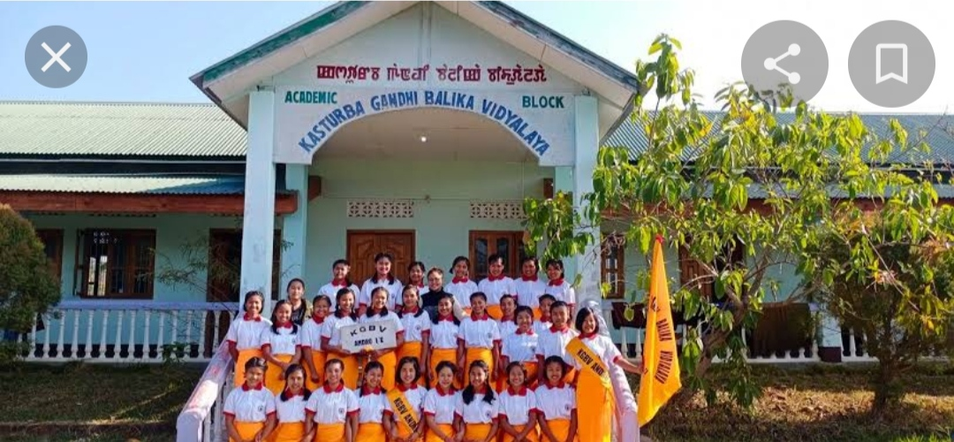
Inclusion of girls in education is possible by following measures-
Appointment of women in school monitoring committees.
Setting up of Kasturba Gandhi Balika Vidhyalaya where female literacy is below national average.

Slide 13
Thank you🌹

