Slide 1
Educationally Backward

Slide 2
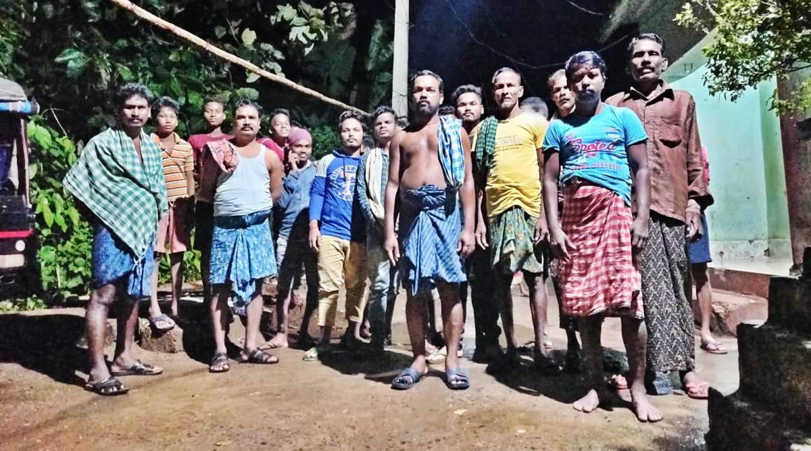
EDUCATIONALLY BACKWARD

Slide 3
EDUCATIONALLY BACKWARD - Meaning
Another group or section who are considered as culturally or educationally backward is the OBC – OTHER BACKWARD CLASSES.
In the Indian Constitution OBC are described as “socially and educationally backward classes.”
Under Article 340 of the Constitution of India, it is obligatory for the govt. to promote the welfare of the OBC.
The role of SSA is very important in the education of OBC.
The RTE 2009 Act also places compulsion on the state to ensure no discrimination to the child of weaker section from completing elementary education.

Slide 4
INCLUSION IN EDUCATION WILL HELP THE OBC IN THE FOLLOWING-
To prevent from being subjected to unfair treatment.
To address their deficiencies in education with the will power, strong determination.
To have well equipped school.
To meet the educational needs irrespective of their low socio-educational status.
To access the educational programmes without restrictions.
To ensure quality education.
To access the resources and opportunities of the educational institution.

Slide 5
INCLUSION IN EDUCATION WILL HELP THE OBC IN THE FOLLOWING-
To address their cultural and educational deprivation.
To get proper safeguard against educational disadvantages.
To get due recognition rather than struggling for the same.
To remove handicapness and frustration in terms of achievement in education.
To feel more secured and honoured with the non-disadvantaged.
To ensure full participation in education.

Slide 6
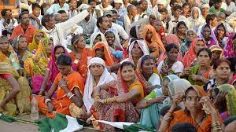

Slide 7
THANK YOU

