Slide 1
INCLUSION IN EDUCATION
PREPARED BY HALIMA ABDUL MATIN

Slide 2

MEANING OF INCLUSION
Inclusion means – to take in.
It is the opposite of exclusion, discrimination.
Inclusion is about membership and belongingness.
Inclusion is an all embracing societal ideology.

Slide 3

MEANING OF INCLUSION IN EDUCATION
It is providing quality education .
It refers to the placement and education of children with diverse needs in regular classroom.

Slide 4
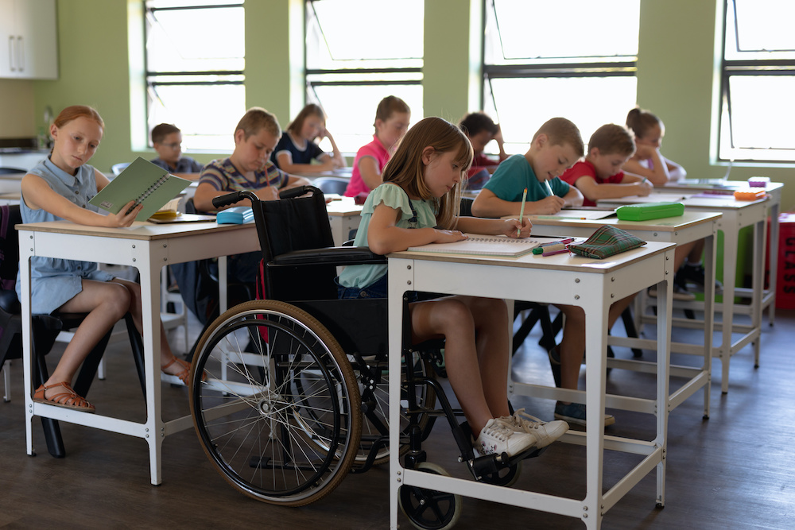
MEANING OF INCLUSION IN EDUCATION
Inclusion in education rejects the use of special schools or classroom.
It is restructuring schools as the common place where they can learn without any discrimination.
The ultimate goal for inclusion in education is to create a unified school system that serves all the students together.

Slide 5

NATURE/FEATURES/CHARACTERISTICS
A common educational community.
Access to knowledge.
A sense of belongingness.
Increasing participation.
Goal of equality.
Addressing differences
Revolutionary contrast to exclusion.
Emphasises on the existing variations.
Approach to remove barriers.
It is social reform.

Slide 6

NATURE/FEATURES/CHARACTERISTICS
Holistic approach.
Philosophy of collective membership.

Slide 7

For whom/To whom?
No development is complete without inclusion.
For development of education, for realizing its goal inclusion is needed.
Inclusion is only possible if education is given without discrimination.
Now the question is who are discriminated people?

Slide 8
Socially Disadvantaged Section
The term disadvantaged is a generic term for individuals who face special physical or mental disability, who lack financial or economic support, who are politically deemed to be without sufficient power.
Socially disadvantaged children are seen in interior tribal and rural areas of country where educational facilities have not reached yet.

Slide 9
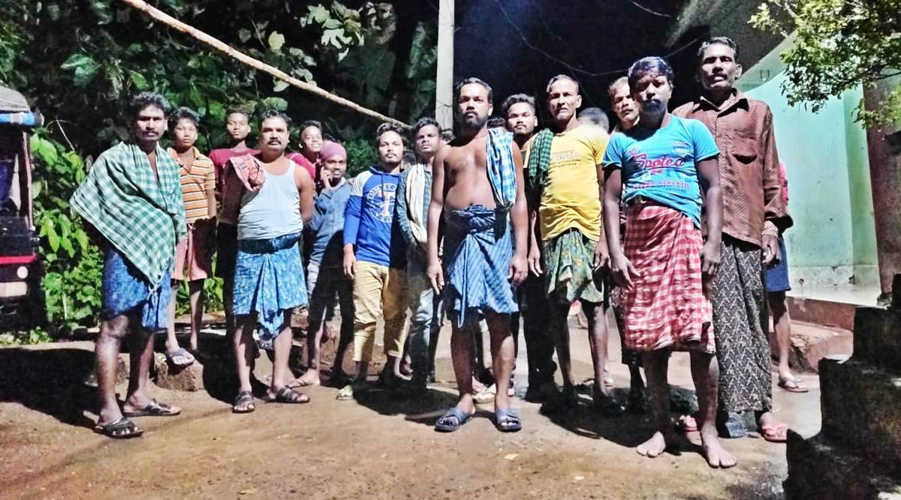
SOCIALLY DISADVANTAGED SECTION
SCHEDULE CASTE- The schedule caste were called by various names like ‘chandals’.
Majority of SC have been regarded as ‘untouchables’.
Under the government of India Act 1935 the untouchables are designated as Schedule Caste.

Slide 10
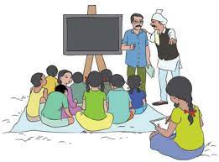
SCHEDULE CASTE
The personalities like Gandhiji, Dr. Ambedkar’s effort towards removal of untouchability was significant.
As a result Article 17 of the constitution of India abolished untouchability.
Mahatma Gandhi defined SC as Harijans- the people of God

Slide 11
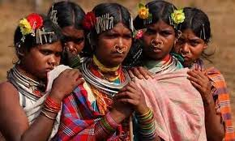
Schedule Tribe
The term ‘tribe’ means ‘simple folk’ living in hills and forests.
Gandhiji called them Girijans.
Gillin and Gillin defines- a tribe is a group of local communities which lives in a common area, speaks a common dialect and follows a common culture.

Slide 12
EXCLUSION OF CHILDREN OF SC/ST IN EDUCATION
The children belonging to these group show poor academic performance of high drop out rates.
They also have adjustment problems.
They have deficiencies in the two most important skills reading and language.
This is the factor of high drop outs.
Cultural or social deprivation creates a complex set of condition which again give rise to intellectual deficiency in the children.

Slide 13
INCLUSION OF CHILDREN OF SC/ST IN EDUCATION
Constitution of India guarantees special educational and other measures for these group.
Article 46- THE STATE SHALL PROMOTE, WITH SPECIAL CARE, THE EDUCATION AND ECONOMICI INTEREST OF THE WEAKER SECTION OF THE PEOPLE, IN PARTICULAR OF THE SC AND ST AND SHALL PROTECT THEM FROM SOCIAL INJUSTICE AND ALL FORMS OF SOCIAL EXPLOITATION.

Slide 14
It is important that Article 330, 332, 335, 338 to 342 and the entire Fifth and Sixth schedules of the constitution deal with special provisions for implementation of the objectives set in Article 46.
Article 15(4) provides special provision for the advancement of any socially and educationally backward class.

Slide 15
SPECIAL PROVISIONS FOR THE SC/ST
A relaxed norms for opening of primary/middle schools.
Abolition of tuition fees.
Providing incentives- free text book....
Free and compulsory elementary education.
SSA- Useful quality education to all children in the 6-14 age group by 2010
DPEP is a scheme, the thrust of which is on disadvantaged group.

Slide 16
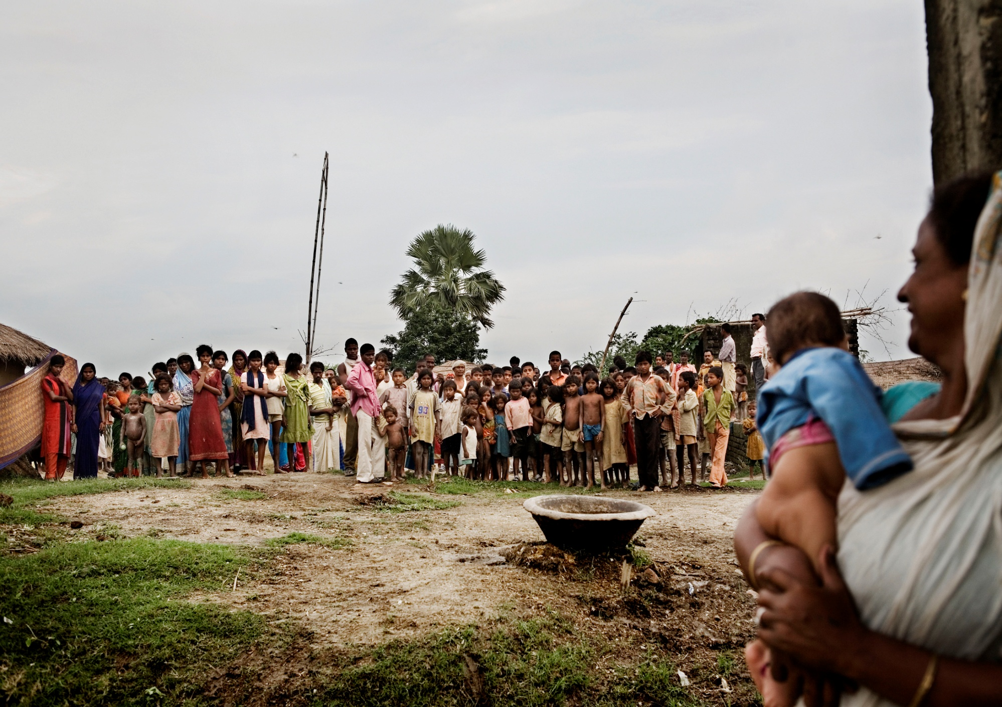

Slide 17
POSSIBLE BY-
Establishment of schools with minimum norms of infrastructure.
Establishment of norms of behaviour.
provision of escort.
Encouragement of co-curricular activities.
Increasing and encouraging the interaction and participation.
Avoiding segregation in the classroom.
Opening school or centre of education in the SC concentrated neighbourhood.

Slide 18
POSSIBLE BY-
Provision of monitoring the attendance and retention – SC/ST.
Provision of scholarship.
Provision of special facility – residential schools or transport.
Sensitisation of teachers to SC/ST culture.
Provision of free text book.
Encouragement of involvement of community members in the school activities to reduce social distance.

Slide 19
INCLUSION IN EDUCATION WILL HELP -
To address disadvantages and diversity.
To cater the needs of every child.
To sensitise the teacher to the issues of social disadvantages.
To remove the stigma of disadvantages.
To remove the sense of inferiority.
To show low social and psychological strain.
To remove high sense of avoidance for failure.
To reduce drop-out rates.
To remove the social barriers to meaningful participation in schools.

Slide 20
THANK YOU

