Slide 1

Creative Drama & Its Educational Implication
Presented by :
Jugal Chutia
Assistant Professor
Nazir Ajmal Memorial College of Education, Hojai
M.A in Performing Arts/Dance/Drama/Theatre
M.A in Assamese, BPA, NEEDS, NTA UGC NET

Slide 2
Western Drama
Greek Theatre : 6th century BCE
Important Dramatist :
1. Aeschylus
2. Sophocles
3. Euripides

Slide 3
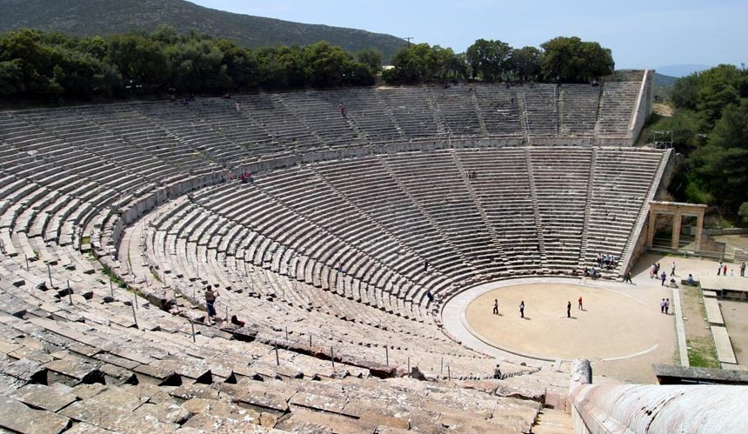
Greek Stage

Slide 4
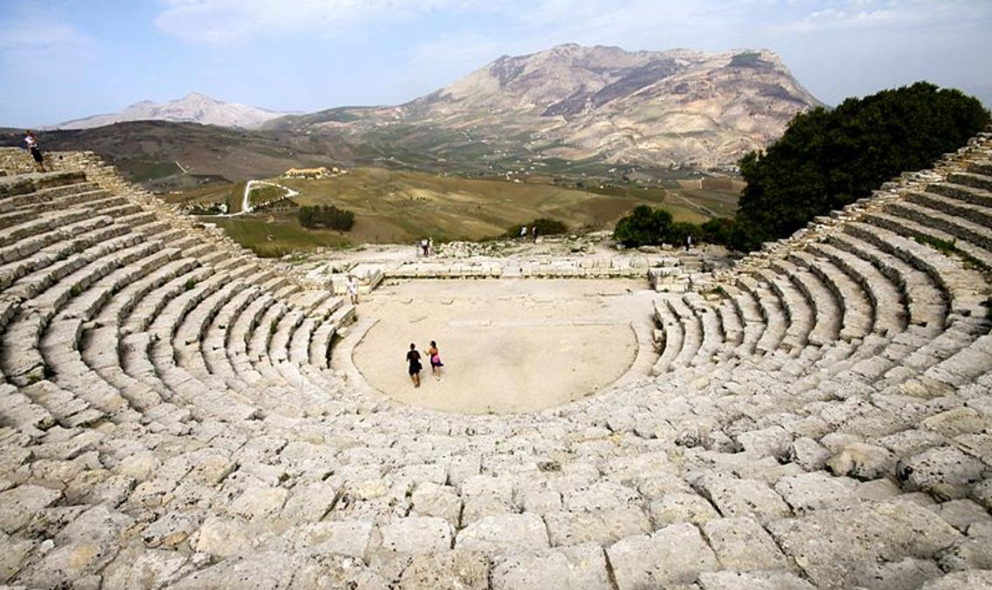
Greek Stage

Slide 5
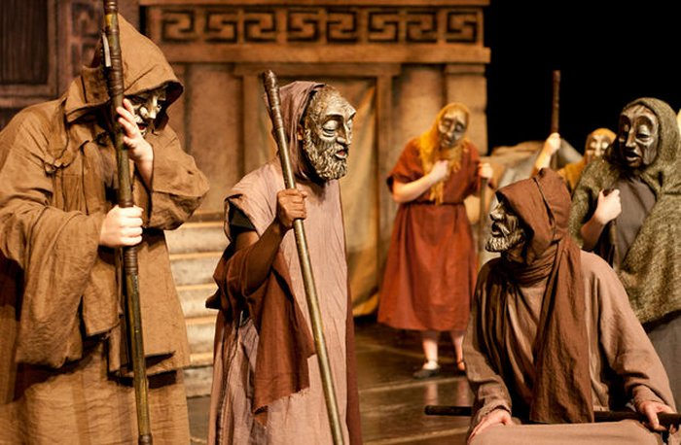

Slide 6
Roman Theatre = 240 BCE
Mystery Plays
Morality plays
Miracle Plays

Slide 7
Elizabethan / Shakespeare Period 1562 - 1642
Shakespeare
Christopher Marlowe
Ben Jonson

Slide 8
Modern Western Drama
1.Henrik Ibsen
2.Bertolt Brecht’s
3.Konstantin Stanislavski
4.Michael Chekhov
5.Jerzy Grotowski

Slide 9
Indian Theatre
Sanskrit Drama = 1st Century CE
Dramatist:Bharat Muni.
Sudraka.
Bhasa
Bhavabhuti
Kalidasa
Medieval Indian Drama
British Period
Modern Indian Drama

Slide 10
Bharata Muni is regarded as the founder of the Indian drama
Sanskrit dramas were mostly performed on stage in
Tamil Nadu.
Kerala.
Karnataka.
Andhra Pradesh.
Uttar Pradesh and Gujarat.

Slide 11
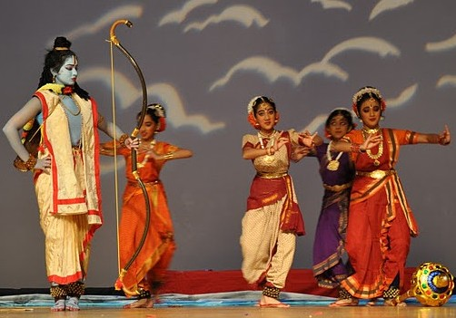

Slide 12
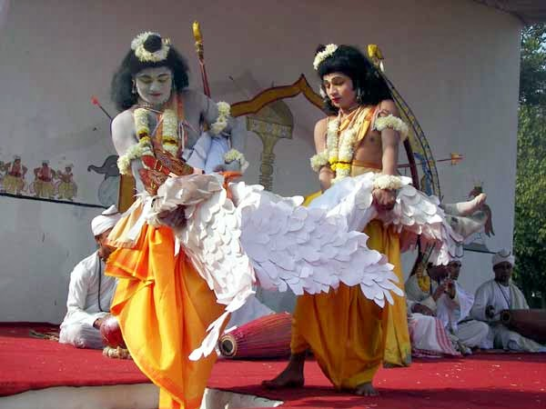

Slide 13
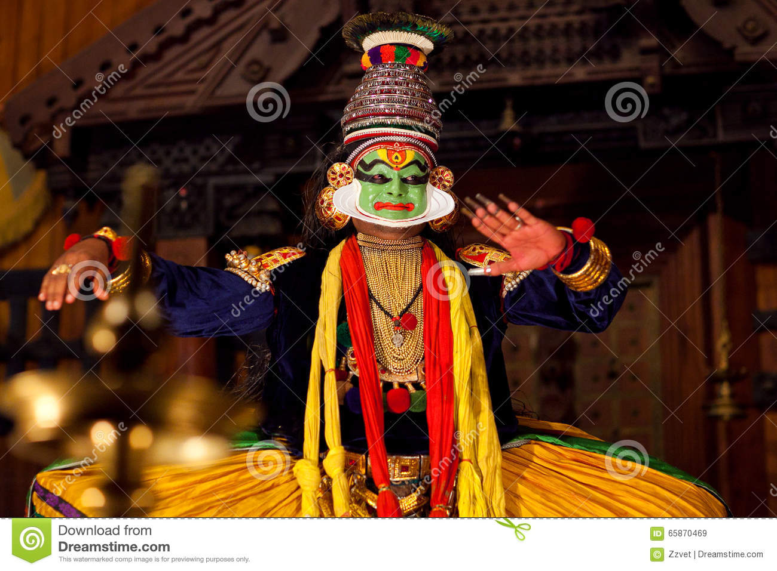

Slide 14
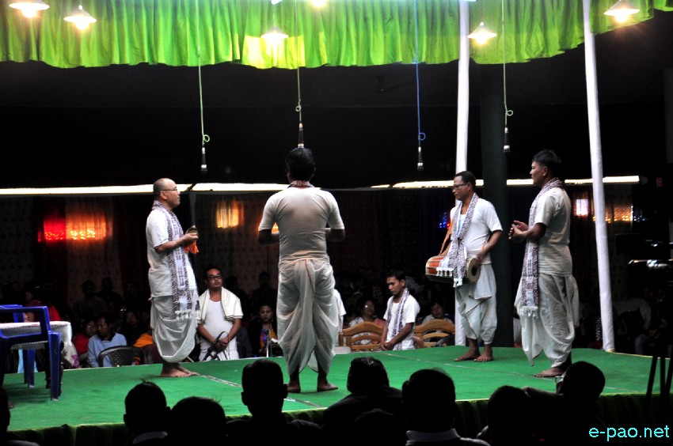

Slide 15
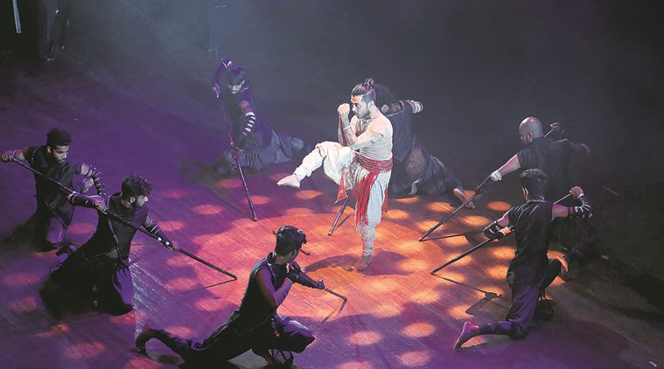

Slide 16


Slide 17


Slide 18
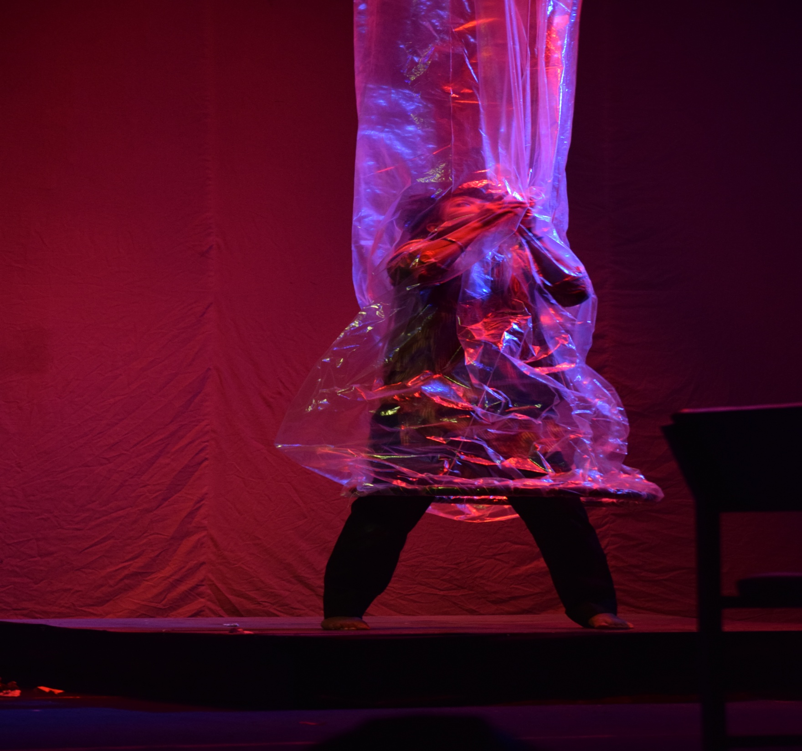

Slide 19


Slide 20


Slide 21


