Slide 1
Definitions of curriculum
P-09
Unit-I

Slide 2
B. Othanel Smith (1957): A sequence of potential experiences is set up in the school for the purpose of disciplining children and youth in group ways of thinking and acting. This set of experiences is referred to as the curriculum.

Slide 3
Bobbit (1918): Curriculum is that series of things which children and youth must do and experience by way of developing abilities to do the things well that make up the affairs of adult life; and to be in all respects what adults should be.

Slide 4
Caswell and Campbell (1935): curriculum is composed of all of the experiences children have under the guidance of the teacher.“
Daniel Tanner and Laurel N. Tanner (1988): "that reconstruction of knowledge and experience systematically developed under the auspices of the school (or university), to enable the learner to increase his or her control of knowledge and experience."

Slide 5
David G. Armstrong (1989): "is a master plan for selecting content and organizing learning experiences for the purpose of changing and developing learners' behaviours and insights.“
Duncan and Frymier (1967): a set of events, either proposed, occurring, or having occurred, which has the potential for reconstructing human experience.

Slide 6
Harnack (1968): The curriculum embodies all the teaching-learning experiences guided and directed by the school.

Slide 7
Ralph Tyler (1957): The curriculum is all of the learning of students which is planned by and directed by the school to attain its educational goals.
Ronald Doll (1970): The curriculum is now generally considered to be all of the experiences that learners have under the auspices of the school.

Slide 8
Curriculum Aims & Objectives
p-09
Unit-I

Slide 9
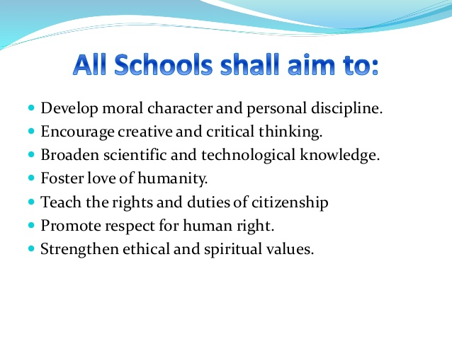

Slide 10
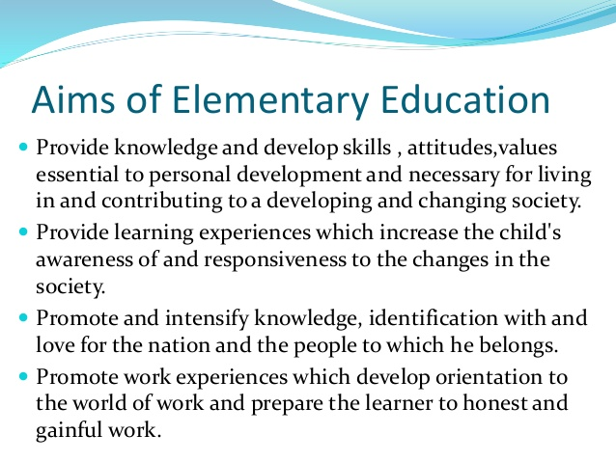

Slide 11
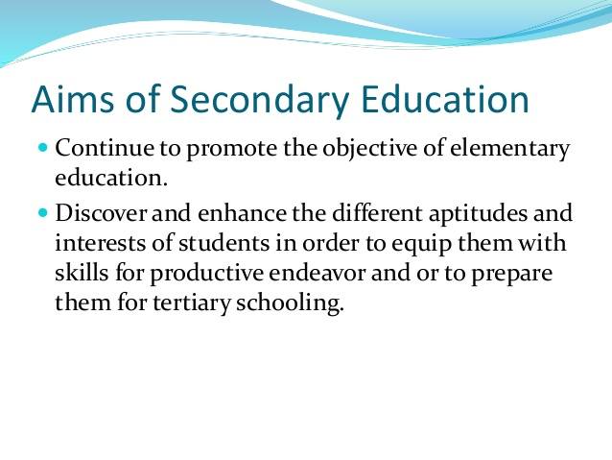

Slide 12
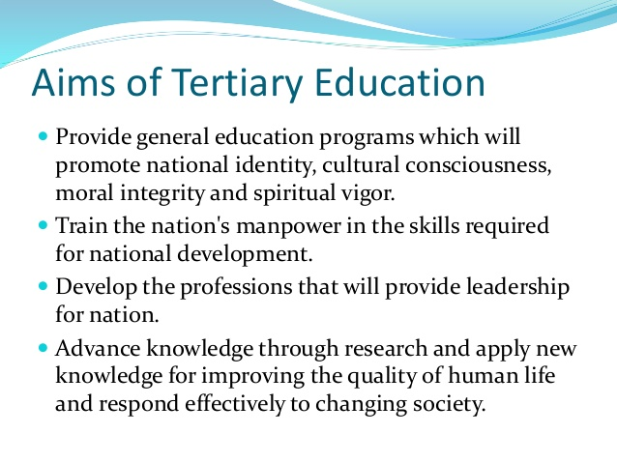

Slide 13
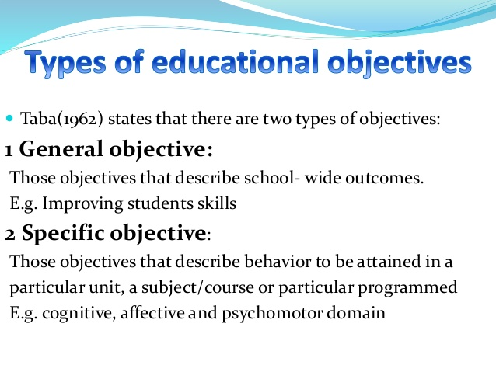

Slide 14
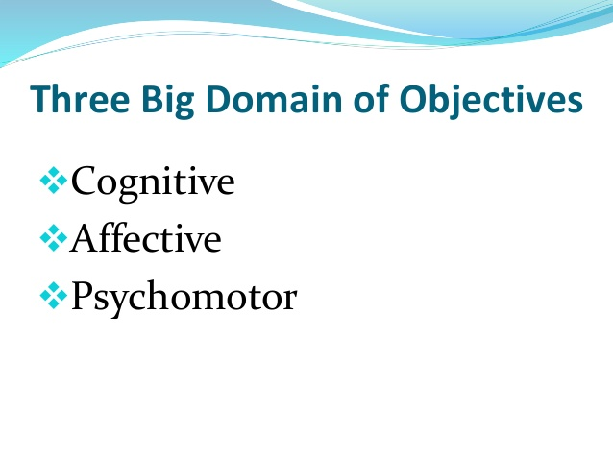

Slide 15
Curriculum Aims:
All students know what they need to achieve to succeed in life
Staff and students have high expectations and strive for excellence
Learning and teaching takes place in a safe and purposeful environment
Students are encouraged to have enquiring minds and seek opportunities to become global citizens
Staff challenge and support students’ paths to success

Slide 16
Curriculum Objectives:
Creative and flexible approaches to learning and teaching
Offering an innovative curriculum developed with the aspirations and interests of the student at the centre
Making effective use of ICT and new technologies to motivate and inspire students
Nurturing close partnerships with local and international organisations, giving students a wide range of opportunities to experience the world of work
Providing opportunities for students to extend their learning outside of the formal curriculum, including an entitlement to four hours per week of enrichment activities from Year 7

Slide 17
Thank you

