Slide 1
The role of English in the present national context and its place in the secondary school curriculum
Paper -6-i
Unit - i

Slide 2
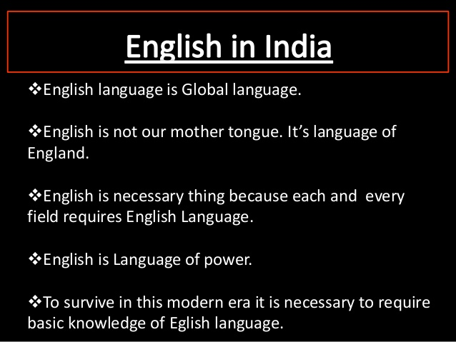

Slide 3


Slide 4


Slide 5
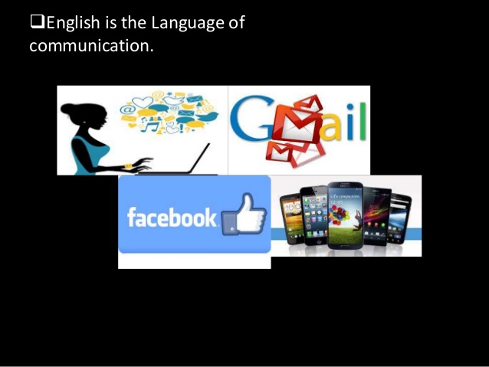

Slide 6
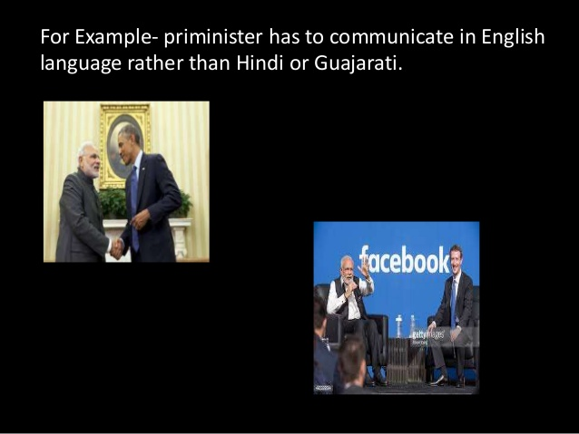

Slide 7


Slide 8


Slide 9


Slide 10


Slide 11
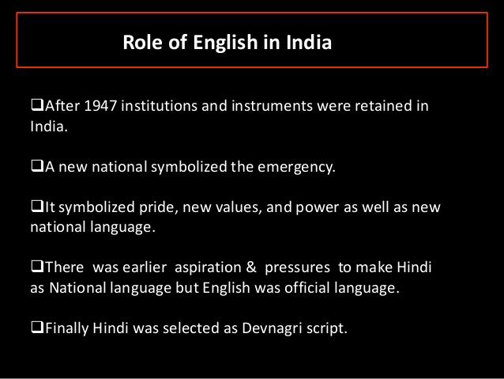

Slide 12
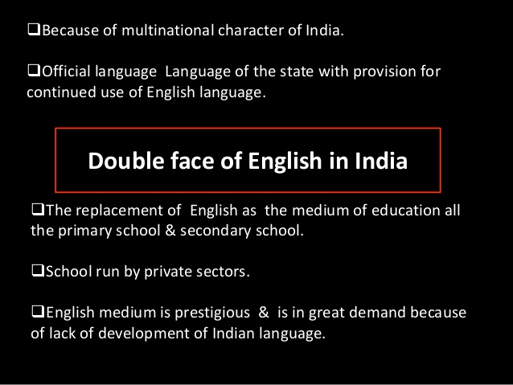

Slide 13
The role of English in the present national context
Language is intimately tied to man’s feeling and activity. It is bound up with nationality, religion and feelings of self. It is used for work, worship and play by everyone, he be beggar or banker, savage or civilised.
Languages are important in the life of any nation. The members of a social group need language to communicate with each other and for all social purposes, for public administration, for commerce and industry, for education and so on.
Ours is a country with Multilingual, Multicultural, pluralistic milieu. An individual can function best through the language which he acquires natively, i.e., the mother tongue. The social aspirations can best be fulfilled when they are allowed to function through the mother tongue. Therefore it is natural to think of mother tongue for the purpose of education. But the necessity to have a common language for interaction has lead to the learning of English.

Slide 14
STATUS OF ENGLISH IN THE pre-INDEPENDENCE ERA
STATUS OF ENGLISH IN POST INDEPENDENCE ERA
STUDIES ON ENGLISH LANGUAGE SITUATION AND STATUS.
English as a link language .
English as an International link language.
English as the window of the world.
English as a library language.

Slide 15
The role and importance of English in India can be summed up as under.
English plays vital role in national and contribute to the Indian philosophy of world fraternity.
We can communicate with the people of other countries and exchange our thoughts, ideas, feelings, points of view etc. Through English.
English language enrich our knowledge in various fields.
The study of English language felicitates the relationship between different nations of the worlds and develops international understanding among the people and help in establishment of world peace.
Knowledge of English is a passport for employment in foreign countries.
English language helps the development of a balanced personality. All the great personalities of the world belonging to various field----- leaders, scientists, philosophers, authors etc. Are the product of English language.
Without English we cannot expect development in any field of our life as it is the most developed language of the world.
English language helps us promote cultural values.

Slide 16
Its place in the secondary school curriculum
After independence the position of English underwent a great change. But it is a matter of deep regret that English cannot occupy the same place in the school curriculum as it did in the past. In the present school curriculum, English is learnt and taught only from the practical point of view and it is not used as a medium of instruction. English is taught as a language of comprehension rather than a literary language.

Slide 17
Thank you

