Slide 1
Language and Learning
Paper – 4
Unit - i

Slide 2
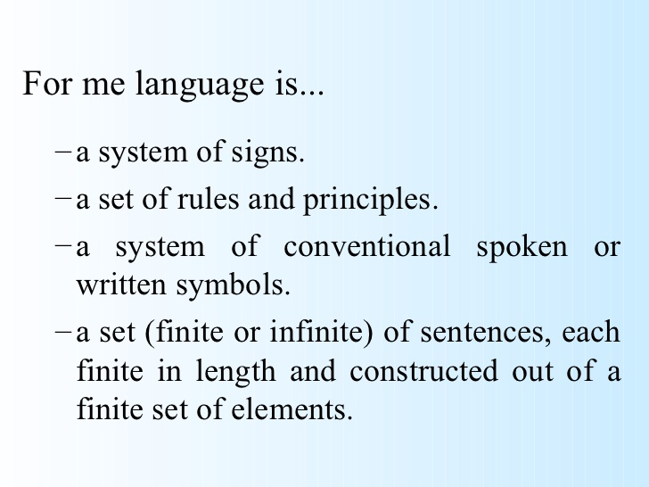
What is language?

Slide 3
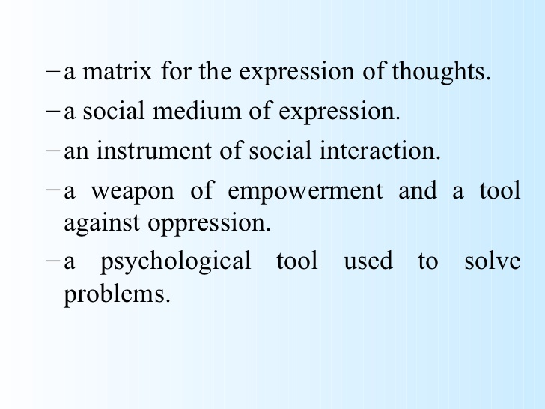

Slide 4
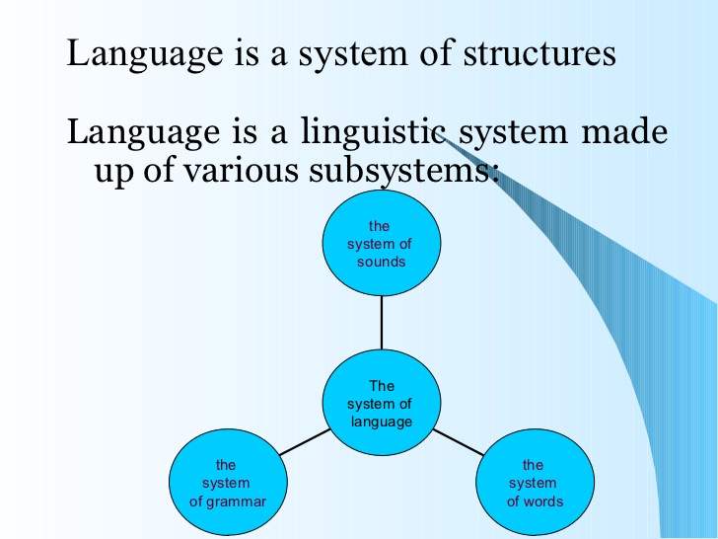

Slide 5
Language is human system of communication that use arbitrary signals, such as voice sound, gesture or written symbols. It is the human ability to acquire and use complex sentences of communication and language is any specific, example of such a system. It enables human to express their feeling, thoughts and ideas through verbal and non-verbal sounds, symbols and gestures.

Slide 6
What is learning?
learning is the acquisition of habits, knowledge and attitudes. It involves new ways of doing things, and it operates in an individual’s attempts to overcome obstacles or to adjust to new situations. It presents progressive changes in behaviour..... . It enables him to satisfy interest to attain goals.
knowledge acquired through study, experience, or being taught.

Slide 7
Language acquisition
Language acquisitions is the process by which human acquire the capacity to perceive and comprehend language, sentences to communicate.

Slide 8
First language acquisition
Language acquisition usually refers to first language acquisition which studies infant’s acquisition of their native language or mother tongue. It studied how children starts understanding and speaking their first language.
It is distinguished from 2nd language learning which deals with the learning additional languages both in children and adults.

Slide 9
Biological clock of 1st language acquisition
Language utterance | age
crying | Birth
cooing | 6 weeks
bobbing | 6 months
Intonation pattern | 8 months
1 word utterance | I year
2 words utterance | 18 months
Word inflection | 2 years
Question, negatives | 2.5 years
Complex structure | 5 years
Matures speech | 10 years

Slide 10
Stages of 1st language acquisition
pre-taking stage (0-6months)
Bobbling stage ( 6-8 months)
Holophrastic stage (9-18months)---kaka, baba, mama, dada like that.
two words (18-24months)--- 50 words
Telegraphic stage (24-30months)-----produce multiple words/sentences like that
multiword stage (30+ months)---13,000-28300 words

Slide 11
Theories of 1st language acquisition
In the boarder sense many theories and approach have been emerged over the years to study and analysis the process of language acquisitions. Three basis main theories are:
Imitation or behaviourism theory
Innateness or mentalist theory
Interaction or developmental perspective theory

Slide 12
Imitation or behaviourism theory
B.F skinner put forwarded behaviourist theory as ‘the operant process.’ this theory states that language acquisition is a process of imitation, re-in-force-ment. it argues that children learn to speak by imitating the utterances heard around them and strengthen their responses by repetition, correction and other reaction that adults provide. Thus language is practice based. According to this theory children start out as clean slates and language learning is process of getting linguistic habits printed on these slates. So language acquisition is a process of experience and children acquire their 1st language step by step. Which are given below:

Slide 13
Imitation
Repetition
Memorization
Controlled drilling
Reinforcement (positive negative)

Slide 14
Second language learning
2nd language: a language to her than mother tongue that a person of community uses. It is usually learn to public communication, trade purpose, higher education and administration.
2nd language learning: it is the process by which people learn a 2nd language. Deferent techniques can be used for L2 learning, such as class room lecture, graphic organization, map, charts or directly observing and interacting with native speakers

Slide 15
Benefits
It increase the brain health
It can provide batter job opportunities
It provides cognitive ability of a person
One can experience new culture
It increases attention abilities
It effects one’s way of seeing the world

Slide 16
Factor affecting L2 learning
Internal factors: age, personality, motivation, experiences, cognition, native language etc.
External factors: curriculum, instructions, culture and status, motivation access to native speakers

Slide 17
Comparison between L1 and L2
feature | L1 acquisition | L2(foreign language) learning
1. Overall success | Children normally achieve perfect L1 mastery | Adult L2 learners are unlikely to achieve perfect L2 mastery
2. General failure | Success grantee | Complete success rare
3. variation | Little variation in degree of success or route | L2 every in overall success and route
4. goals | Target language competence | L2 learner may be content with less than target language competence or more concerned with fluency than accuracy
5. institutions | Children develop clear institutions about correctness | L2 learner are often unable to form grammatically judgements
6. instruction | Not needed | Helpful or necessary
7. Negative evidence | Correction not found and not necessary | Correction generally helpful or necessary
8. Affective factors | Not involved | Play a major role determining prificiency

Slide 18
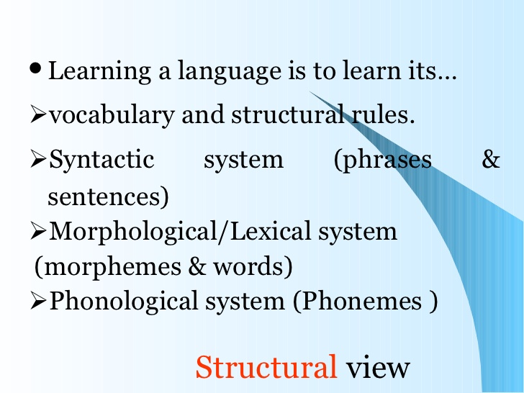

Slide 19
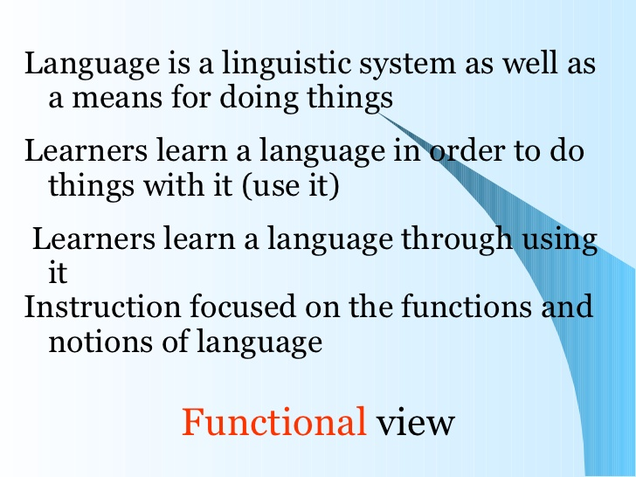

Slide 20
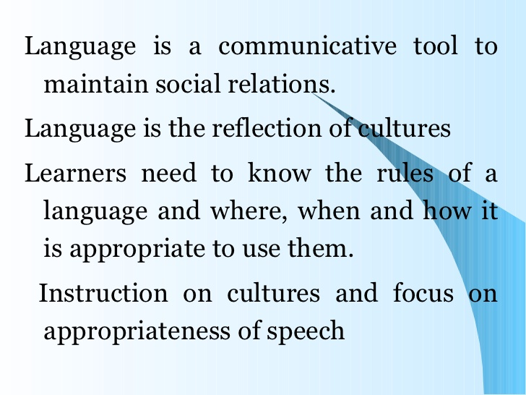

Slide 21
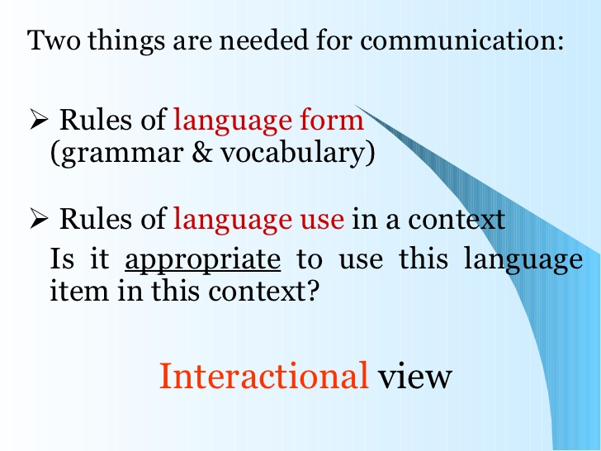

Slide 22
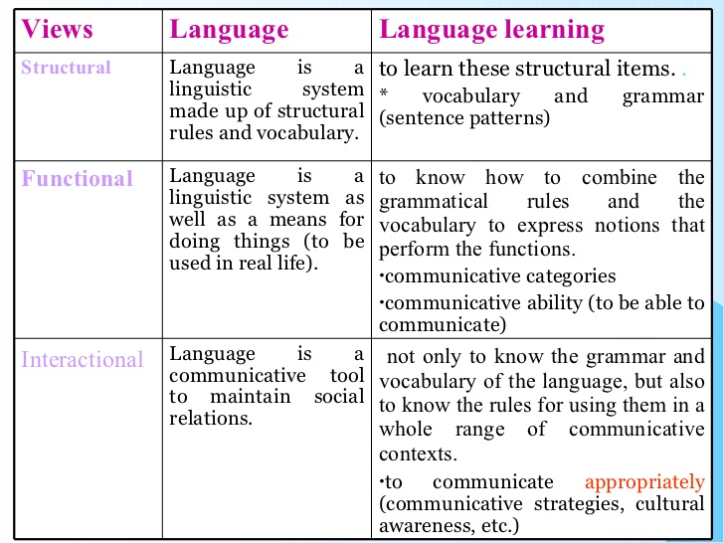

Slide 23
Tips For Learning A Foreign Language
Conversation, Conversation, Conversation.
Start with the 100 most common words.
Carry a pocket dictionary.
Keep practicing in your head.
Figure out pronunciation patterns.
You’re going to say a lot of stupid things. Accept it.
Use audio and online courses for the first 100 words and basic grammar.
After the first 100 words, focus on becoming conversational.
Date someone who speaks the target language and not your native language.

Slide 24
Facebook chat + Google Translate = Winning.
When you learn a new word, try to use it a few times right away.
TV shows, movies, newspapers and magazines are a good supplementation.
Most people are helpful, let them help.
These are the phases you go through.
Finally, find a way to make it fun
Use flashcards.
Buy bilingual books.
Watch a TV show in another language or a movie with subtitles
Try informal learning sessions.
Sign them up for an online class.

Slide 25
Thank you

